Slide 1

Healthcare Transportation Project
Vancouver, WA

Slide 2
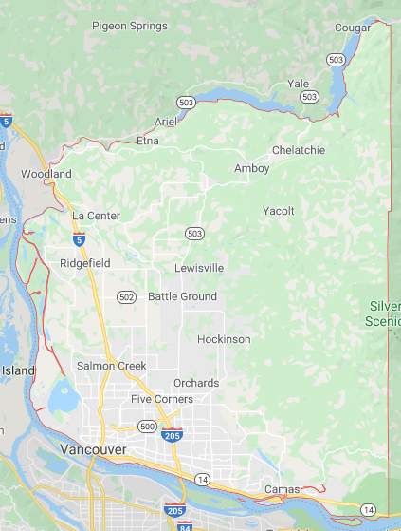
Focus Question
How might we ensure older adults, people with disabilities, and those who lack transportation resources, living in rural North Clark County find transportation to access healthcare and social determinants of health destinations?

Slide 3
Insights Leading to Developed Concepts
When people lose their ability to provide transportation for themselves, they become reliant on:
  friends/family;
  social services (including volunteer driver programs);
  paid transportation services.
Loneliness leads to poorer health outcomes. ¹
Lack of access to medical facilities and social determinant of health locations leads to poor health outcomes.
Medical trips are usually the priority for most local transportation programs, yet transportation to social activities is also very important for those experiencing social isolation.
¹https://www.ncbi.nlm.nih.gov/pmc/articles/PMC4386514

Slide 4
What we Learned During Assumption testing
Most North County residents we spoke to would take advantage of a shuttle service now or when they lose their ability to provide their own transportation.
Battle Ground, WA is the correct destination for most North County residents and acts as a HUB location.
All payment options (free, $2 or under, donations) are good choices.
An Activity Coordinator is not needed.

Slide 5
What we Learned During Assumption testing
A shuttle service would need to pick-up a rider at their house. A centralized meeting point doesn’t work for most potential riders.
The best method for riders to travel within Battle Ground would be to have the shuttle on call; walking distances are too far.
Some folks are interested in learning how to using Travel Trainers to learn how to ride local transit service: C-TRAN.

Slide 6
North County shuttle service
North County Shuttle Service
A shuttle service operating in rural North Clark County serving seniors, people with disabilities, and those lacking the ability to provide transportation for themselves.
The shuttle would operate five days a week and provide riders the ability to access destinations within Battle Ground for four hours before returning home.
Service is meant to increase access social determinants of health locations, including, but not limited to medical appointments, grocery stores/food banks, and socialization activities.

Slide 7
Discovery needed during limited launch Phase
Trip Length
Social Space
Populations served
Scheduling Method
Service Areas
Vehicles
Pandemic Transportation – How to do it safety?

Slide 8
Benefits of Solution
Residents who are homebound will have a transportation option that will allow them to socialize with friends, neighbors, and peers, while travelling to healthy destinations.
Increased access to healthcare and social determinant of health locations.
Decrease in social isolation and loneliness in North County.
Increased positive health outcomes.
Increased community participation.

Slide 9
Market Size and Opportunity
Rural North Clark County
Seniors, People with Disabilities, and those who lack transportation
About 16,000 persons over the age of 50 living in North Clark County²
About 43,000 persons living with a disability living in North Clark County ²
²U.S. Census Bureau (2018). American Community Survey 5-year estimates.

Slide 10
Market Size and Opportunity
250 days of operation per year (M-F minus ten federal holidays)
One 5 passenger seat mini-van (possibly two vehicles if demand warrants)
Operating at 80% capacity equals 1,000 round trips per year (2,000 trips with second vehicle)
Operating at 100% capacity equals 1,250 round trips per year (2,500 trips with second vehicle)

Slide 11
Business Model
Grants
  Local healthcare foundations
  Community organizations
  WSDOT / FTA
Partnerships
  Local businesses
  Transit
  Community Organizations
Service charge for riders
  $2 or under, donations, or free

Slide 12
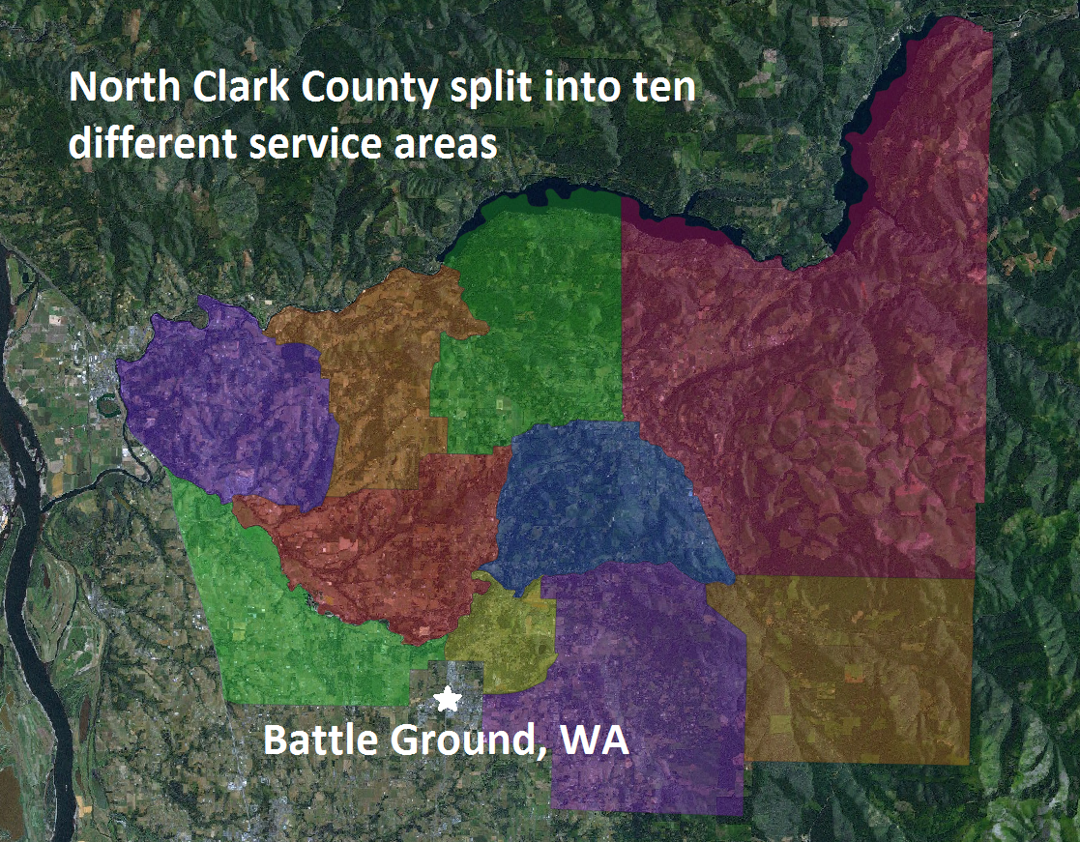
Thank You!

Slide 13
Team members and project partners
Anna Riedel
Kaiser Permanente
Jason Scott
Kaiser Permanente
Althea Ender
Kaiser Permanente
Sue Neal
Battle Ground Healthcare
Alexandra Holbrook
PeaceHealth
Mikayla Springob/Nina Davenport
Area Agency on Aging/Disabilities of SW WA
Aideet Pineda
Molina Healthcare
Yasmina Aknin
Clark County Public Health
Anna Willis
Washington State DSHS
Carolyn Noack
Free Clinic of SW WA
Daniel Smith
Community Health Plan of Washington
Bill Baumann
Human Services Council
Jeananne Edwards
Human Services Council
Michael Kelly
Human Services Council
Darin McClure
Meals on Wheels
Amy Elkinton
Citizen Representative
Harry Kiick
Citizen Representative

