Slide 1
Community Mobility
Design Challenge 2019
Team Project Pitches
Thursday, April 30, 2020

Slide 2
What have our teams been up to?

Slide 3
Our 2019 Design Challenge Teams
Clark County, Washington
Ozaukee and Washington Counties, Wisconsin
Allen County, Kansas
Mercer County, New Jersey
Lee and Ogle Counties, Illinois

Slide 4
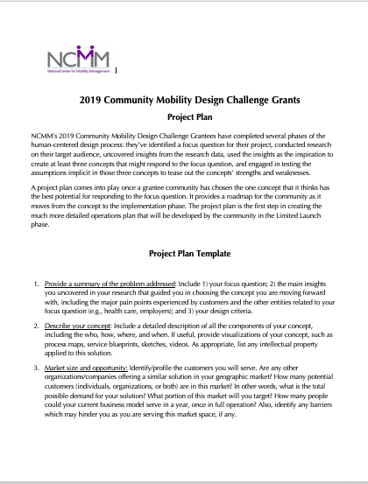
Wrapping Up
Final Monthly Reports and Invoices Due on May 15th
Project Plan Outline is Due on May 15th
Limited Launch information is coming soon

