Slide 1
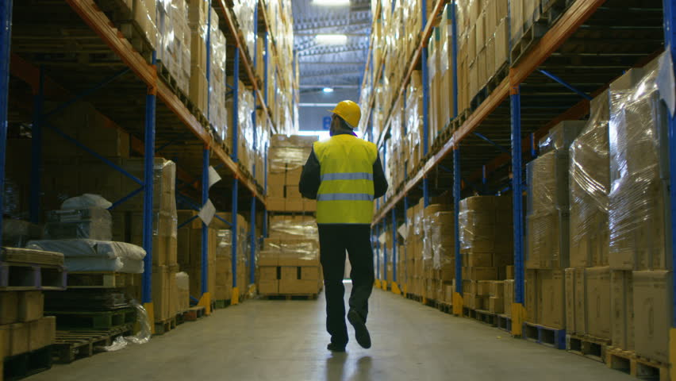
Mercer County
New jersey
Greater Mercer TMA
Mercer County Planning
Mercer County TRADE
NJ Transit
Delaware Valley Regional Planning Commission (DVRPC)
RISE, A community partnership
Trenton Area Soup Kitchen (TASK)
East Trenton Collaborative
Get Me to Work on Time!

Slide 2
Project Area Map
17 Miles

Slide 3




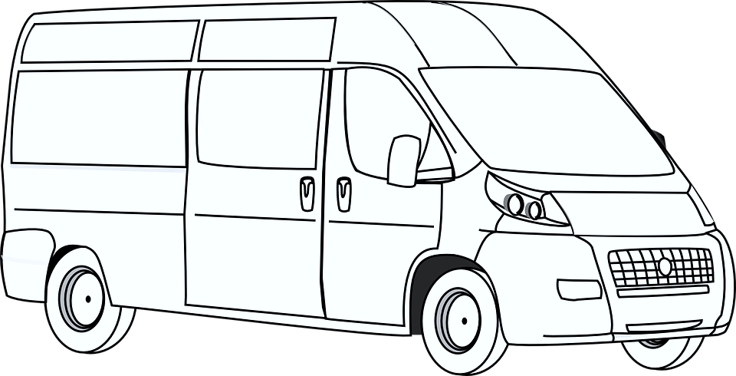
The Focus Question
How do we get underserved workers in Trenton and Hightstown to warehouse jobs in
East Windsor and Cranbury?
Lack of Public Transportation
Limited
Income
Jobs are located miles away
Employers Need Workers, Workers Need Jobs
Current Private Options Unreliable, Expensive

Slide 4
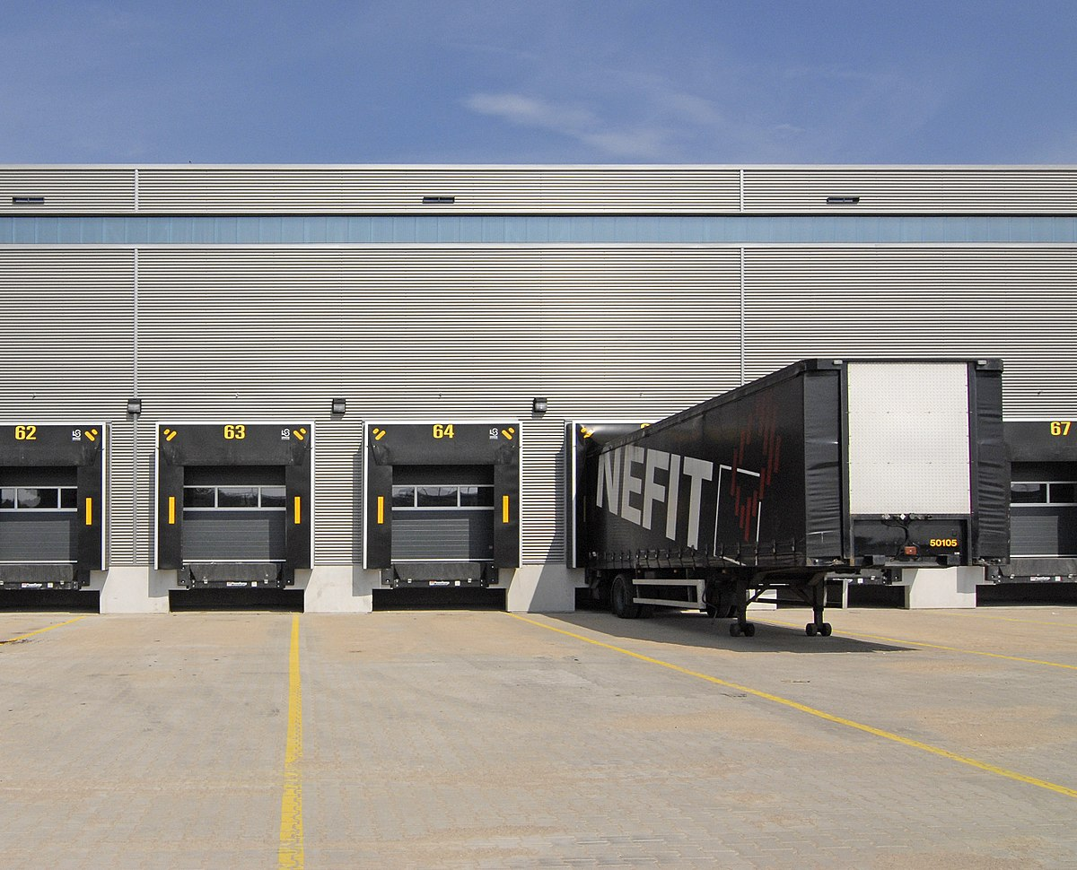
Insights
Insights
  Mismatch between labor market origins, public transit and job destinations
  Fixed route service doesn’t fit well with warehouse development patterns and schedules
  Warehousing is growing in region
  Employers are actively seeking employees
  Carpooling is an acceptable option
  Temp Agency transportation has shortcomings
  Customers need a backup transportation plan
  Customer “ask” is modest
Design Criteria
  Needs to be affordable
  Needs to be convenient
  Needs to be flexible
  Needs to be reliable
  Appropriate for leveraging various funding sources (public, private, corporate)
Servicing sprawling warehouse districts requires innovative solutions

Slide 5
customer interview ,
Trenton Area soup kitchen
“She shared stories of terrible bus conditions from temp agency buses, with overcrowding and people sitting on each other and folded chairs in the aisle. And was terribly frustrated by the high cost for the temp agency bus service, which is $5.00 each way.”

Slide 6






Concept: Waze Carpool App
ADAPTED TO ADDRESS CUSTOMER NEEDS
=
Waze App
Subsidies
Incentives
Geofence
Job Access
Existing app
$.58/mile rate
Payments fully facilitated by app
Can filter by workplace, groups of people you know
Reduced ride cost
Set maximum fare
Credits for riders
$ for drivers
Guaranteed Ride Home
Set up ride subsidy for trips with an origin or destination in targeted areas
It’s a Win!

Slide 7




Project’s Value
Job Access
Savings
Creates new employment options
Riders and Drivers both save money
The Waze carpool application, with cost subsidies, creates an affordable, low cost transportation solution for lower income, underserved populations to access the growing warehouse and distribution sector in need of more employees.
.
Reliability
Reduced tardiness and absenteeism
Low Cost
Cost is directly tied to usage and existing software

Slide 8
Market Size

Slide 9
Profile of Mercer County Warehouse Employee
An estimated 6,970 Mercer residents work in a warehouse
79.3% male (MoE 74%-84%)
15% have no vehicle available (MoE 11%-18%), 28% have only 1 vehicle available (MoE 21%-32%)
38% of Hispanic or Latino Origin
26% not a citizen (MoE 21%-32%), 10% Naturalized Citizen (MoE 7%-14%)
26% do not have High School Diploma or GED
Source: 2018 American Community Survey 5-Year Estimates

Slide 10
Map of Warehouse Employee Locations

Slide 11
Need for Transportation Solution
The area we are looking to serve consists of approximately 211 warehouses or other industrial buildings, totaling 50 million square feet
Outreach to warehouses found need for transportation
”I’m so glad I got your email. Transportation is one of our biggest issues for our Dayton, NJ location.”
-Warehouse Talent Acquisition Coordinator

Slide 12
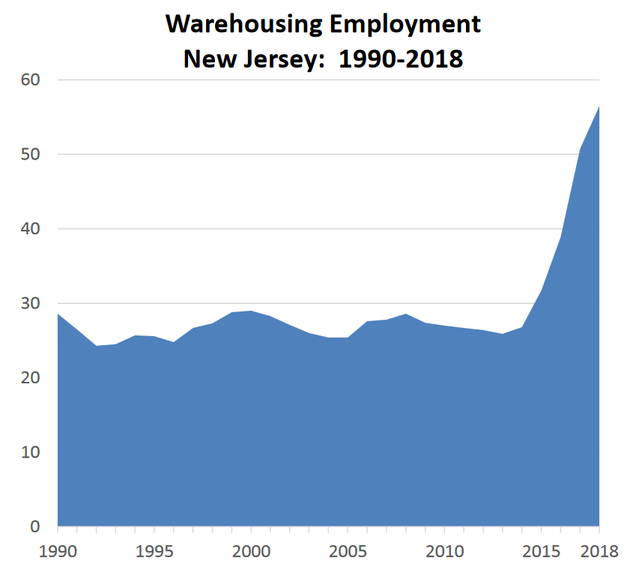
Growth of Warehouse Industries in NJ
New Jersey is the “warehouse state”, as it is a 24-hour drive to 40% of the total US population
Warehouse jobs have exploded in recent years, nearly doubling from 2013 to 2018 (NJDOL)
Warehouse jobs are expected to grow by another 42% through 2026
Laborers and Freight, Stock, and Material Movers, (Hand) make up 16.7% of this sector, the highest proportion of all occupations
The average salary for this occupation is $30,275

Slide 13




Business Plan
Research
Operations
Fine tune the solution and research funding streams
Set up logistics to oversee the program
Waze to Work
Outreach and Marketing
Funding
Businesses, grant opportunities
Create plan to engage business, gov’t, community, and consumers

Slide 14

Summary
Concept Is:
Affordable
Flexible
Low cost investment
Worker Benefits:
Access to Employment
Income
Improved opportunity for Upward Mobility
Win – Win For Workers and Employers
Driver Benefits:
Extra Income
Helping Others
Camaraderie
“Without adequate transit for the less-advantaged, opportunity will tend to pass them by, like overcrowded buses on a cold winter day.”
    -Rosabeth Ross Kanter, PhD Move: Putting Americas Infrastructure Back in the Lead
Employer Benefits:
Improved recruitment and retention
Reduced tardiness
Employee benefit

