Slide 1
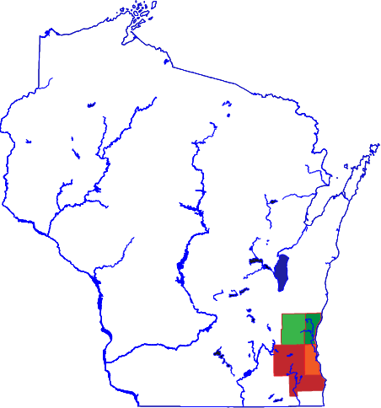

Project Daedalus:
Transforming Transportation for Seniors in Southeastern Wisconsin
We’re here
Prepared by Matthew Manes
Mobility Manager
April 30th, 2020
NCMM Pitch Presentation

Slide 2
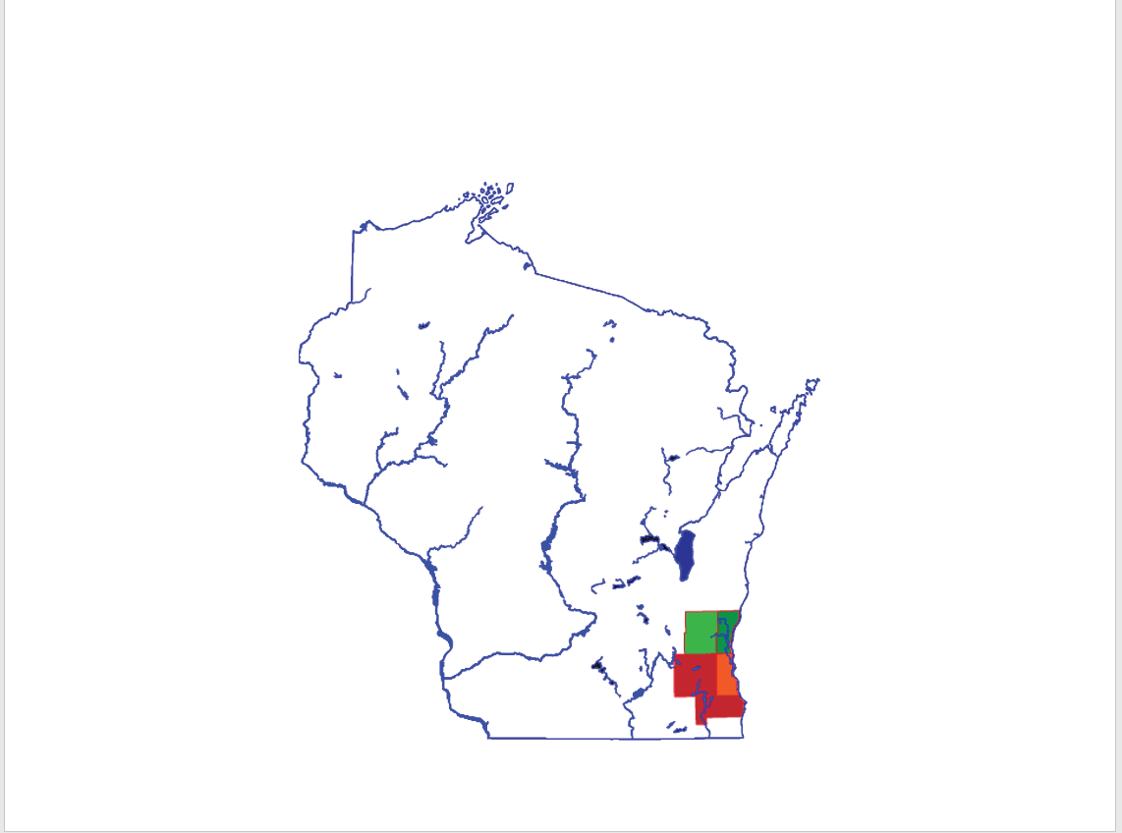












Team and Community
Membership has Evolved Throughout the Project
Original Submitting Members
Additional New Partners
Observers

Slide 3
Focus Question
How might we create more transportation capacity to serve (ALICE) older adults?
Asset-Limited Income Constrained Employed (ALICE)
Includes about 42,000 seniors in Ozaukee and Washington Counties
19 out of 20 residents spend at least 22% of their household income on transportation
30 individual providers, all require 2 days to 2 weeks notice

Slide 4
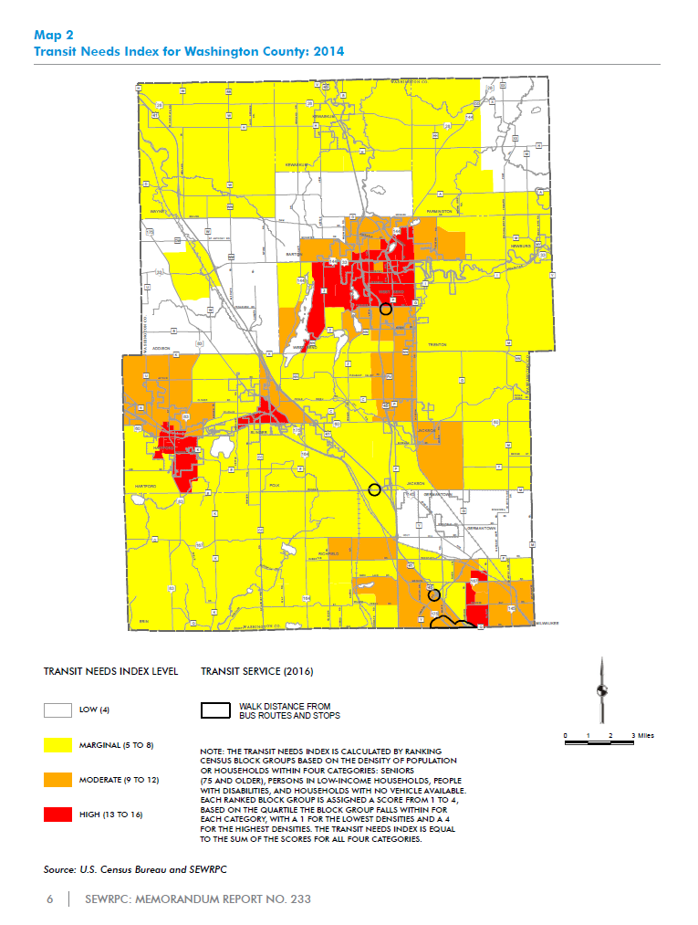
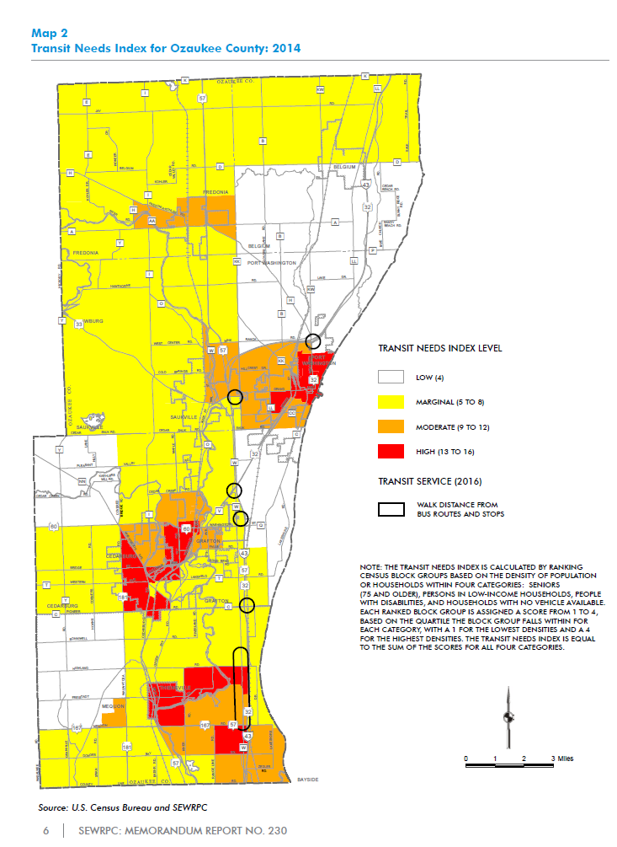
Focus Question
How might we create more transportation capacity to serve (ALICE) older adults?
Sources
Public Transit - Human Services Transportation Coordination Plan for Ozaukee County 2016, Memorandum Report No. 230 https://www.sewrpc.org/SEWRPC/Transportation/HumanServicesTransportationCoordination.htm
Public Transit - Human Services Transportation Coordination Plan for Washington County 2016, Memorandum Report No. 233 https://www.sewrpc.org/SEWRPC/Transportation/HumanServicesTransportationCoordination.htm

Slide 5
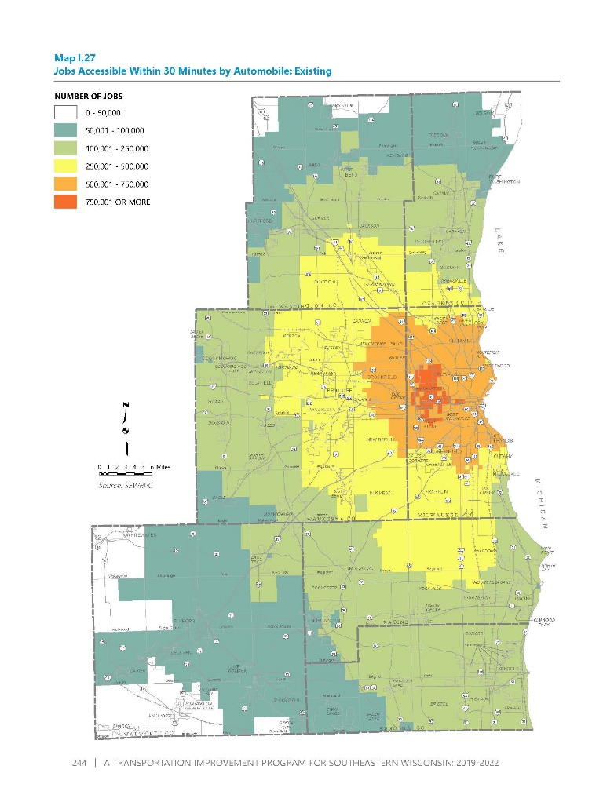
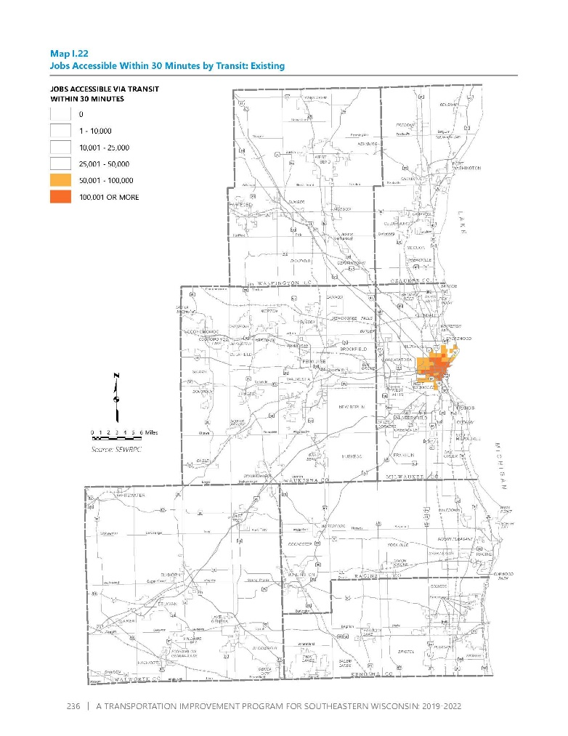
Focus Question
The True Scale of the Problem (by proxy)
Jobs accessible within 30 minutes by Automobile¹
Jobs accessible within 30 minutes by Transit - Scale Corrected²
Sources
A Transportation Improvement Program for Southeastern Wisconsin: 2019-2022, SEWRPC, p. 244
A Transportation Improvement Program for Southeastern Wisconsin: 2019-2022, SEWRPC, p. 236, digitally altered by Interfaith Caregivers of Ozaukee County

Slide 6
Insights
We’ve learned a lot
Insights from Interviews
  No single organization can address the unmet needs in their county or between counties
  No single model being used has the ability to solve the problem
  No single project can deliver the outcomes required
  No single county can do it without an adjacent one
  No implementing organization has the technical capacity to independently develop such a solution
Insights from Workshop
  We need a “better tower”, and to give it away
  A box of office supplies is the perfect analogy/gold herring for interorganizational capacity building

Slide 7
Insights
We’ve learned a lot
Insights from Assumption Testing and Prototyping
  People are waiting for this; they just don’t know how to pull it all together
  They’re willing to try
  People are more optimistic than you might suspect
  We are capable of securing the resources and cooperation necessary to build this progressively
  The partners are there – the framework is not
  Our project is on the leading edge of this problem in our state – there isn’t another of these projects we’ve found.

Slide 8
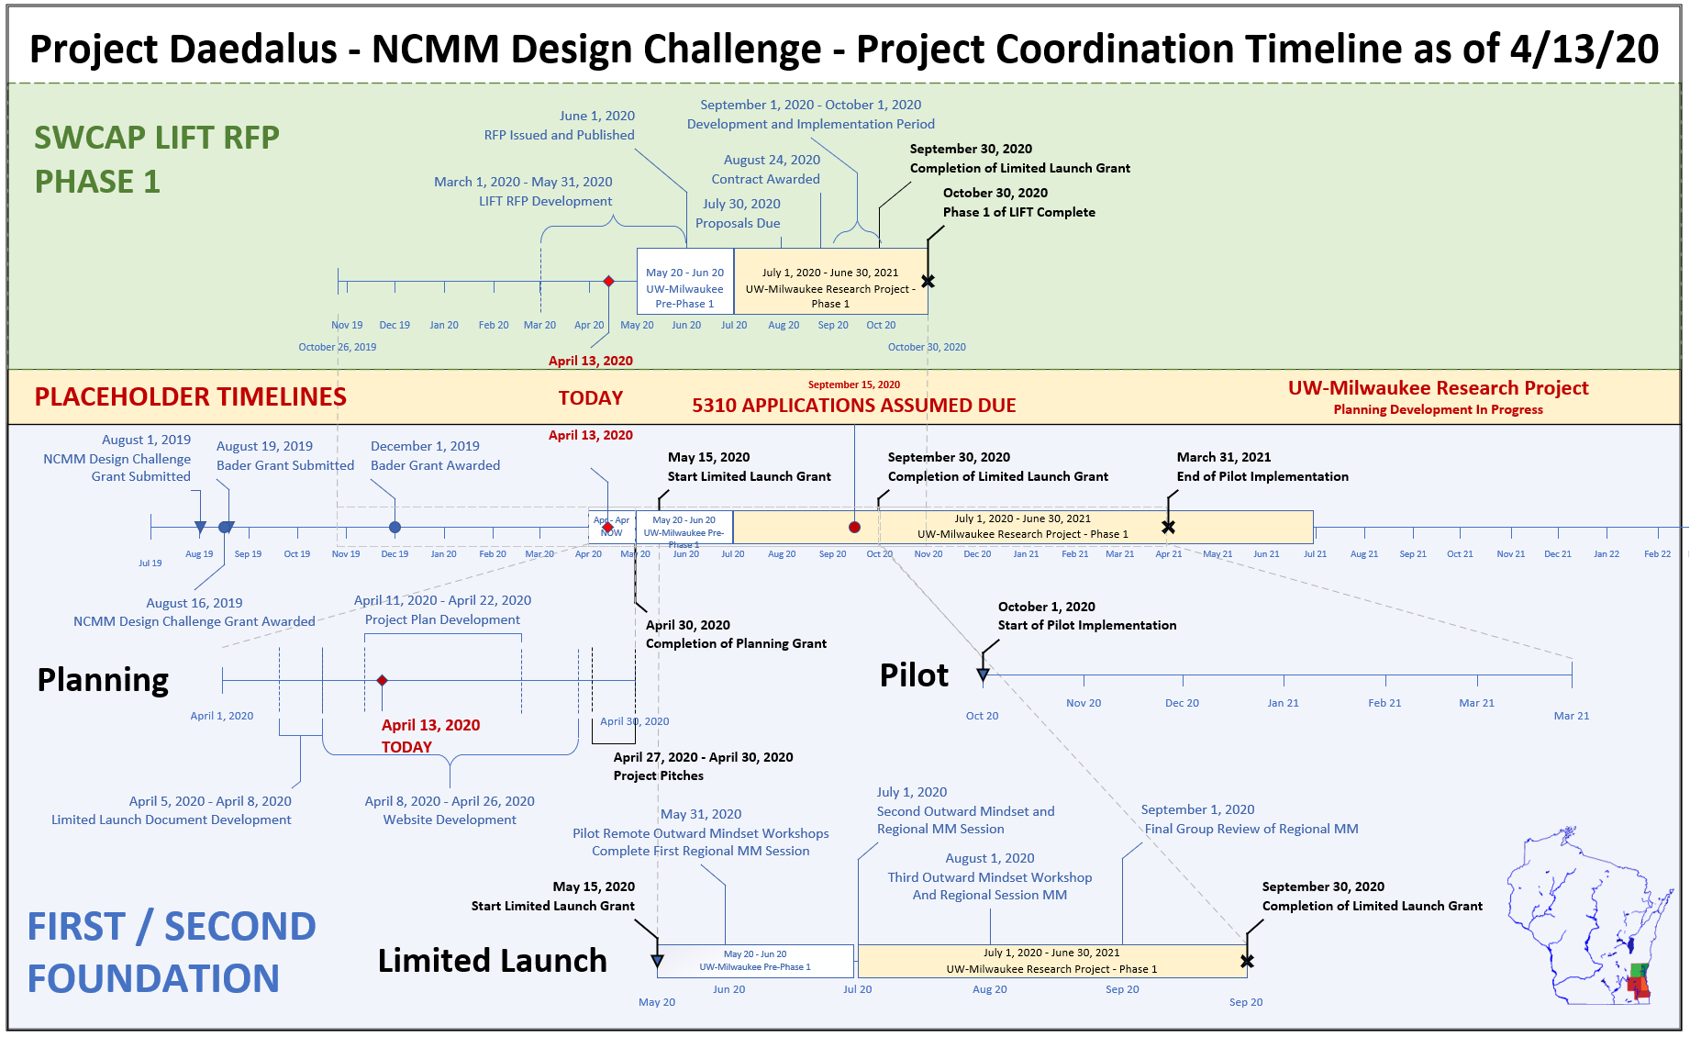
Our Concepts
The Simple Overview – It’s Complicated
This was our timeline as of 2 weeks ago. Let’s break it out.

Slide 9
Our Concepts
Overview - Concept
This is the level at which everyone is trying to operate – tech deployment, interorganizational coordination of transportation, direct stakeholders - what we actually want.
FIRST FOUNDATION
Person-Centered Capacity
SECOND FOUNDATION
FOUNDATION
This is the level at which the expertise and funding coexist together – the means to operate with more capacity - the means to what we want.
This is the level at which the community is interacting – address the feeling that “your organization doesn’t matter like mine does”. The means to the means – working together

Slide 10
Our Concepts
Overview – Assumption Testing
Select assumptions tested
Partnering orgs will be willing to use a different scheduling software for rides to what they use now.
Software exists or can be purchased to coordinate rides across partner orgs.
Partners are technologically able to interact
SEWRPC needs to be impartial
Matt can continue
People want Matt to continue
This is necessary
There is a host willing to shoulder this project
FIRST FOUNDATION
Person-Centered Capacity
SECOND FOUNDATION
FOUNDATION
A foundation will be effective in aligning its goals with shifting initiatives
The foundation will be able to be coordinate across all partner orgs.
Orgs will be willing to share funding with other partners.
Orgs will be willing to tie their identity to the foundation.
Orgs will be willing to have their activities coordinated through the foundation
We don’t need formal structure
People want to be at the table
We can all find the time to participate
This doesn’t need funding

Slide 11
Our Concepts
Overview – Prototypes
SWCAP LIFT RFP
UW-Milwaukee Research Project
Collaborative Work Environment and Tech Solutions/Proposals
Tier 1 USDOT University Research Center application in partnership with Rutgers, UW-Milwaukee, and Washington State
Tested or attempted, these prototype elements we want to carry forward for Learning Launch development
FIRST FOUNDATION
Person-Centered Capacity
SECOND FOUNDATION
FOUNDATION
Box of New Office Supplies – Tech Development and In-Kind Asset Transfer, “Pay it forward”
The “Labyrinth” – A compendium of rules and regulations
A Coordinated Grant Application Process for Us as a Group
Regional Mobility Manager – Application Development
Regional Mobility Manager – Host Organization
Outward Mindset Workshops
Collaborative platform to build a Regional Mobility Manager Application together

Slide 12
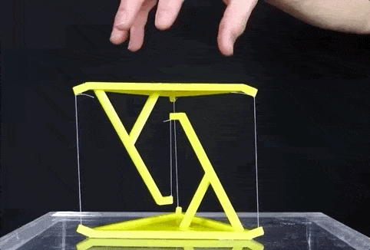
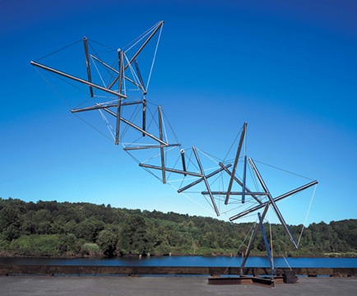
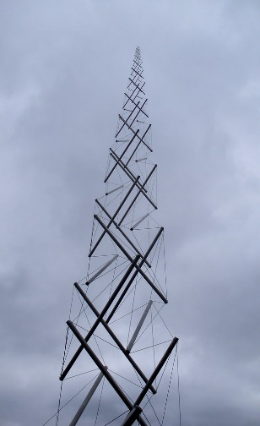
Our Concepts
How they work together
The stratification of customer, operation, and fiscal viability along the axis of the challenge points of our various partners and sectors provides natural support from the others in the ways each are weak.
Just like a tensegrity structure – a better tower design using minimal materials with self-leveraging loads to reach new heights, in ways previously unattainable.

Slide 13
Our Concepts
How they work together
We could see this stratification in the analysis of our self-assessments.
Not all partners can participate at all levels – and they shouldn’t.
We now have a framework with which to handle that.

Slide 14
Value our concepts will provide when implemented
Adding Value at every level and every interface of the supply chain
Funders – Public and Private
  Better use of funds, solutions that can scale
Transportation Providers – Public and Private
  Access to funds, equipment, and direct technical assistance
Human Services providers
  Facilitation for at risk clients
Healthcare Providers
  Better health outcomes, less work for overloaded staff
Managed Care Organizations
  Facilitation of streamlined payment, ride coordination
Regionally
  A system that can scale in a decentralized, distributed manner

Slide 15
Value our concepts will provide when implemented
Adding Value at every level and every interface of the supply chain
Future Partner?
Future Partner?
Our END Customers and Clients - Seniors who fall under the ALICE threshold – have new capacities built by providers together to help them.
Future Partner?
Future Partner?

Slide 16
Business Model
Working together in ways that are only possible working together
By providing centralized complexity, technological, and coordination costs, we collectively qualify for and can compete in every funding opportunity
The organization willing to host Second Foundation gets access to its services as collateral benefits – first access and facilitation to grant writing, technology, regulatory compliance, and the combined efforts of all of our partners
These funds and capacities are distributed amongst participating partners to increase our overall capacity directly with new funds and the coordination to use them.
The “paying forward” and temporary management of funds allows for secondary monetization of the cashflow through the system for further capacity building

Slide 17
Market Size and Opportunity
It’s Big – Go back to the value added slide
42,000 seniors in Ozaukee and Washington Counties
7 regional counties
Dozens of potential providers
Millions of dollars in collective federal and private funding
Anyone who’s stuck regionally with a system that can’t seem to grow - with a way of doing that – as an example people can see working.
    A replicable model people can use has virtually no limit to market size and opportunity.

Slide 18
Conclusion
Thank you for the opportunity to present.
Questions now and after the session are welcome.

