Slide 1
NCMM Presents Mobility Management Connections:
“Mobility on Demand: Turning Innovative Pilot Projects into Sustainable, Long-Term Programs”
September 30, 2021
Notes:
Hello Everyone and Welcome to today’s webinar Mobility on Demand: Turning Innovative Pilot Projects into Sustainable, Long-Term Programs. My Name is Brandon Roccio, I am a project associate for the National Center for Mobility Management, a technical assistance center at Easterseals

Slide 2
Some Things to Remember
Please add your name and affiliate in the chat
Please mute yourselves if you are not speaking
A recording will be available on the NCMM website
Please add your questions to the chat box
Closed captioning is turned on for this session
Enjoy and learn from each other!
Notes:
I wanted to take a few moments to go over some session housekeeping items..

Slide 3
nc4mm.org
Who We Are
Our Mission
A national technical assistance center funded through a cooperative agreement with the Federal Transit Administration and operated through a consortium of three national organizations
To promote customer-centered mobility strategies that advance good health, economic vitality, self-sufficiency, and community.
We work to promote cross-sector partnerships and help communities create/improve transportation options – “mobility management”
Notes:
NCMM, founded in 2013, is a national technical assistance center funded through a cooperative agreement with the Federal Transit Administration and operated through a consortium of three national organizations, which include, the American Public Transportation Association, the Community Transportation Association of American, and Easterseals.
The center works to promote cross-sector partnerships, and assists in supporting innovative and integrated transportation services by building capacity in communities and improving transportation options.
This includes: Planning and implementing grants, customized technical assistance, training for mobility management professionals, facilitating collaboration among transportation and non-transportation organizations, and providing expertise on a number of various subjects related to mobility management.

Slide 4
What is MMC? Who is it for?
A platform to share ideas and mobility management strategies related to building transportation connections and identifying mobility solutions
This community is for mobility management practitioners who are actively advancing mobility management in their communities, regions and states
Notes:
Part of our mission is to bring together Mobility Managers from across the country to engage one another on best practices, share insights and collaborate on issues important to them. Mobility Management Connections is just that.
It is:
A platform to share ideas and mobility management strategies related to building transportation connections and identifying mobility solutions
And This community is for mobility management practitioners who are actively advancing mobility management in their communities, regions and states

Slide 5
How to sign up for MMC
SIGN UP at https://learn.pyd.org/ - Tell us about your role as mobility manager, interest areas, and contact information
ENGAGE - Share experiences, network, and ask questions of peers with experience in the field
LEARN - From your peers, NCMM technical assistance, and other national resources
Notes:
So please, if you haven’t already, sign up for Mobility Management Connections at learn.pyd.org.
Tell us about your role as a mobility manager and your areas of interest, share your experiences, network, and learn from you peers.
We have recently added additional member benefits curtesy of Partners for Youth with Disabilities own resource library, such as eLearning courses, access to webinars and other informational toolkits and guidebooks.

Slide 6
Mobility Management Champions
Each champion acts as a facilitator of monthly community activity by:
Sharing questions and issues of their choice that are relevant to mobility management activities;
Disseminate resources and tools that pertain to this topic; and
Respond to questions posed by other mobility management professionals via the MMC discussion forum.
Notes:
MMC is proud to have three Mobility Management Champions who support and advance our mission:
Amber Simmons, Grants and Budget Coordinator for Plan Hillsborough, in Tampa, FL
Sheila Holbrook-White, Mobility Coordinator, Washington County Community Services
And Sarah Hidalgo-Cook, General Manager of the Southwest Area Regional Transit District
All of them are experts in their field who work to strengthen communities through coordinated transportation.

Slide 7
Today’s Moderator
Sheila Holbrook-White

Slide 8
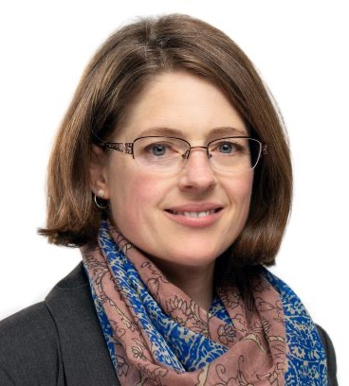
Today’s Panelists
Matt Fyten
Penny Grellier
Al Benedict

Slide 9
Matt Fyten

Slide 10
SouthWest Transit’s Microtransit Service

Slide 11
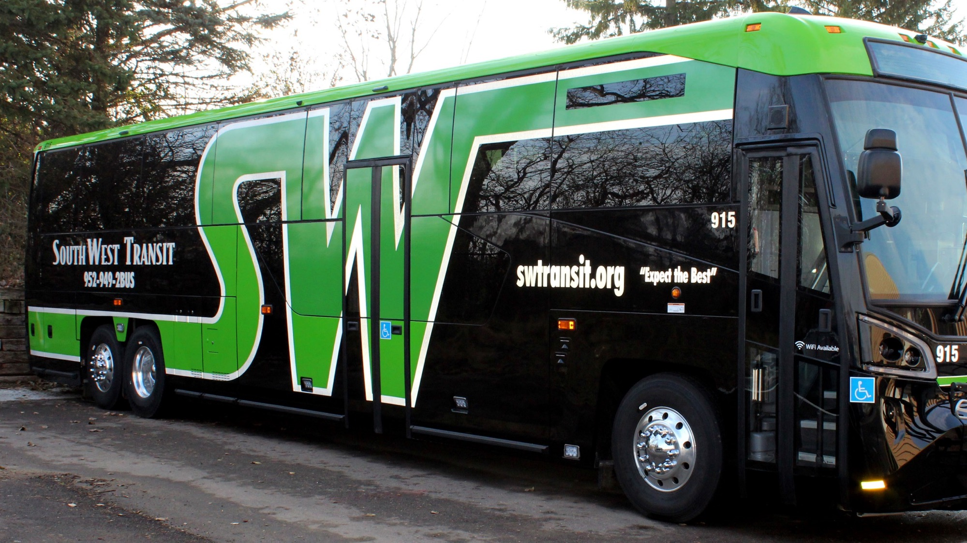
SouthWest Transit (SWT) Overview
Public transit provider for southwestern suburbs of Minneapolis - Eden Prairie, Chaska, Chanhassen, as well as Carver and Victoria (contracts).
Governed by a commission consisting of six individuals appointed by the member cities and one rider representative.
Suburban provider established by State Legislative action in 1983 due to the fact that the existing structure was not responsive or meeting the needs of the growing suburbs.
SWT was formed in 1986.
Pre-COVID: Operated over approximately 160 trips per day with 75 buses.
Major routes bring commuters to Downtown Minneapolis and the University of Minnesota
National leader in innovation, technology, and transit-oriented development.
Introduced one of the nation's first microtransit operations – SW Prime
Provider of choice to many special events.
Has over $60 million in assets.
Pre-COVID: Annually provided over 1.2 million rides.

Slide 12
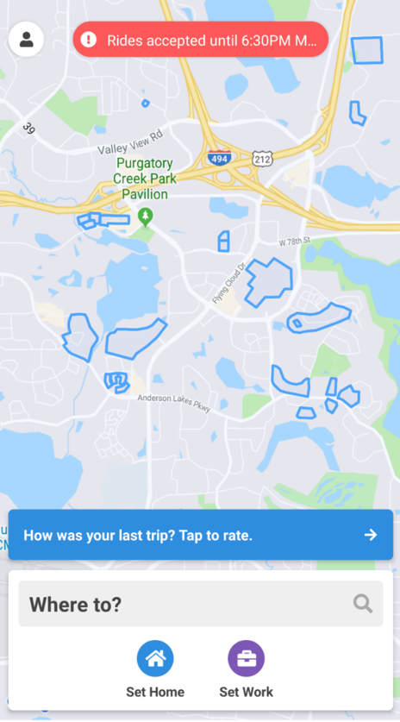
WHAT IS SW PRIME?
First of its kind shared ride microtransit service in Minnesota (possibly the U.S.). Service began operating in 2015.
The general public can request a ride on demand only.
Scheduling is allowed for out of service area trips to limited locations.
Curb-to-curb service.
Serves our entire service area plus select locations outside our service area.
Scheduling software (Spare) used to book and route the rides.
Current Fares
General Public: $4/ride
TAP/Senior Days: $2/ride
Mall of America: $6/ride
MSP Airport: $8/ride
SW Prime MD: $5/ride

Slide 13
WHY PRIME?
Suburban land use always difficult to serve efficiently.
Service area >80 square miles.
Need for a lower cost local service option.
Prior attempts at traditional circulators/demand-response services were cost prohibitive.
Increase in demand for first mile/last mile services.
Need for local service with minimal support staff.
Technology evolution.
Tech-savvy service area population.
Long track record of service innovation.
Willingness to take a risk (Political Champions).

Slide 14
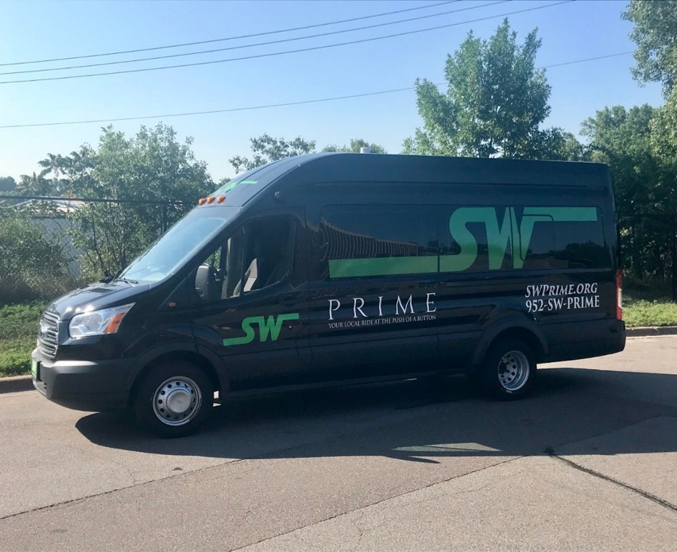
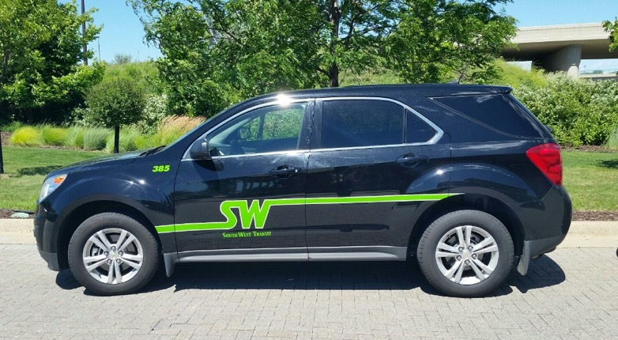
SW PRIME FLEET

Slide 15
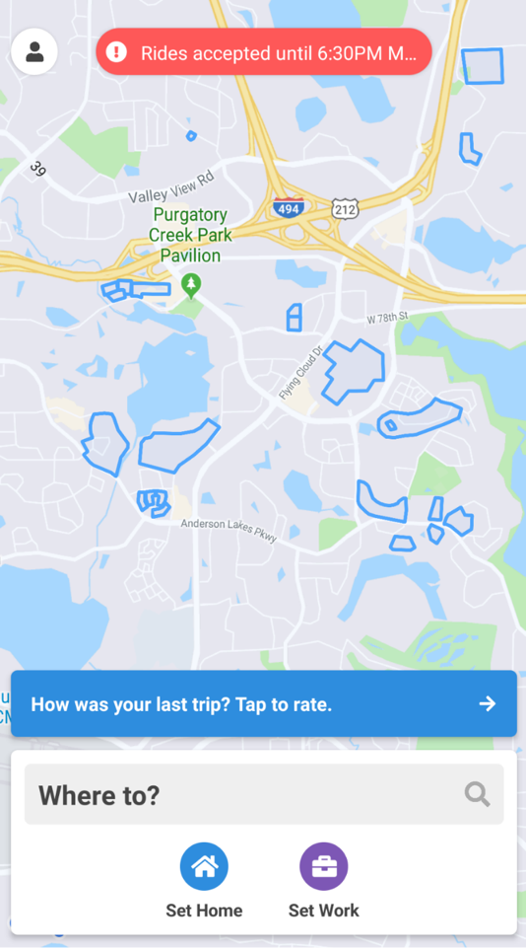
How do I book a PRIME ride?
1. By Phone (952-SW-PRIME)
2. Using your app
Rides booked within 20 seconds.
Rides are confirmed automatically via SMS message.
Track vehicle location live using the app.
Notifications sent automatically upon vehicle arrival.

Slide 16
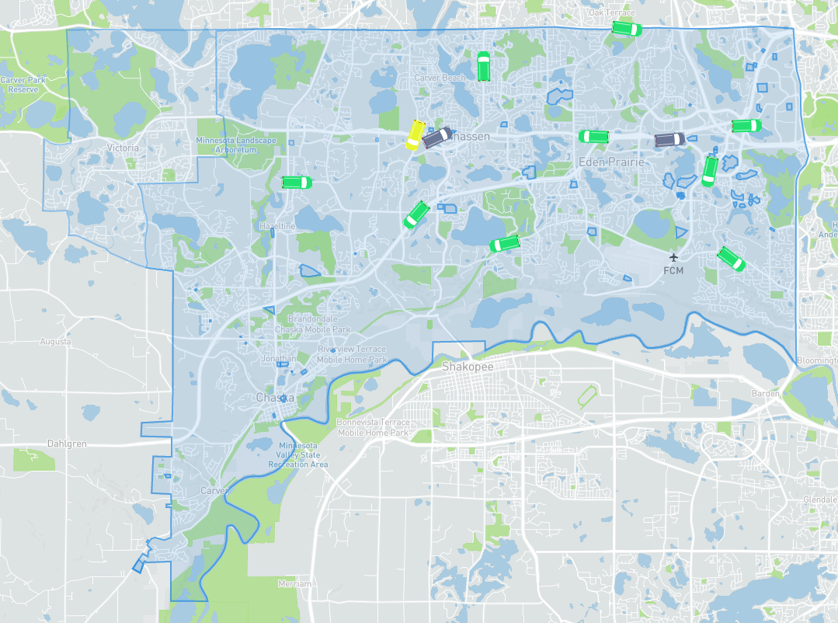

Slide 17
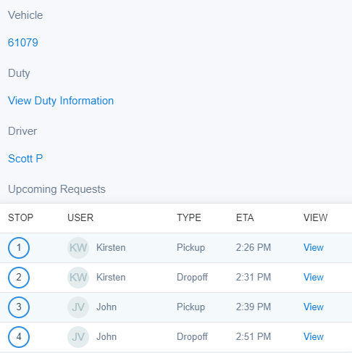

Slide 18
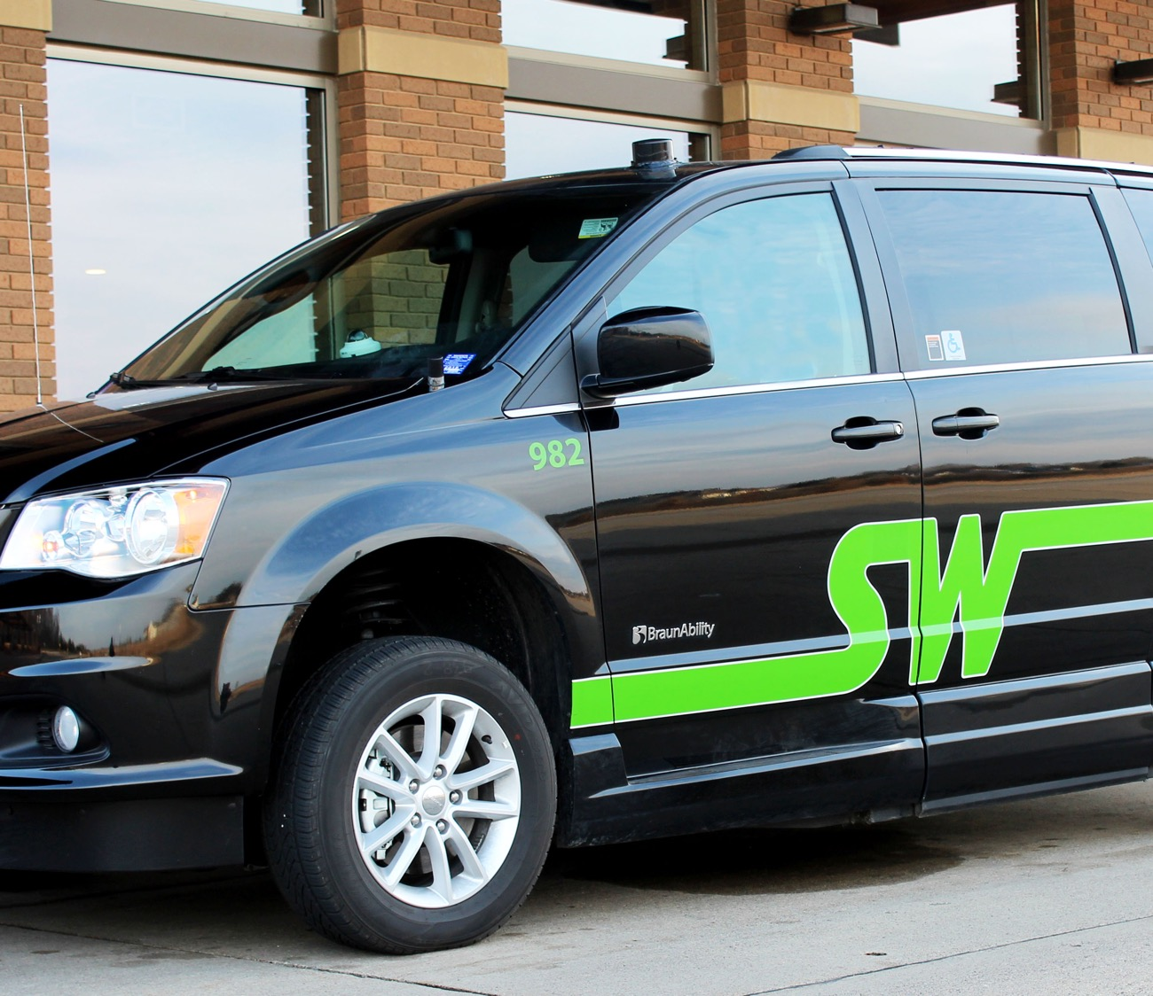
Prime Performance Pre-COVID
Average Ride Time: 9.43 minutes
Average Wait Time:18.62 minutes
Average Daily Riders: 378
Average Trip Distance: 5 miles
Passengers Per In-Service Hour: 2.29
Peak Buses Used: 14
Avg Subsidy Per Passenger: $8.63
Ride Booking Method
65% Online
35% Phone
Customer Reviews: 4.8 out of 5
Ratings received immediately after completion of rides.

Slide 19
Lessons Learned
The Algorithm Is Important
Suburban vs. Urban
One size does not fit all
Service Area – Don’t Be Too Restrictive
Operating On-Demand and Scheduled Rides Together Can Be Problematic
Administration
Increased negative customer interactions has led to increased admin staff time
Less staff required compared to traditional Dial-a-Ride
Ensure proper fraud protections are in place
Ridership Demographics Are Similar to Dial-a-Ride
Don’t let First Mile-Last Mile Be the Only Consideration
No Standing Orders
Strict No-Show policies help efficiency
Microtransit Can Be the Public Transit Form of TNCs (Depending On Service Area)
Think Dial-a-Ride and Taxis
Be Willing To Take Risks
Trial and error
Make changes on the fly

Slide 20
What’s Next?
Electric Vehicles
Autonomous Demonstrations
Suburb-to-Suburb Service
Mobility as a Service (Microtransit/Fixed Route)

Slide 21
Sheila Holbrook-White
Matt Fyten

Slide 22
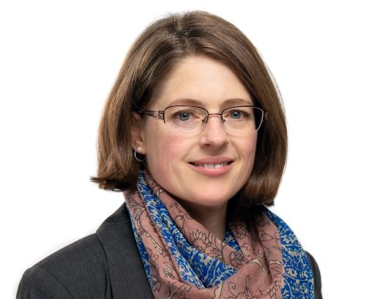
Penny Grellier

Slide 23
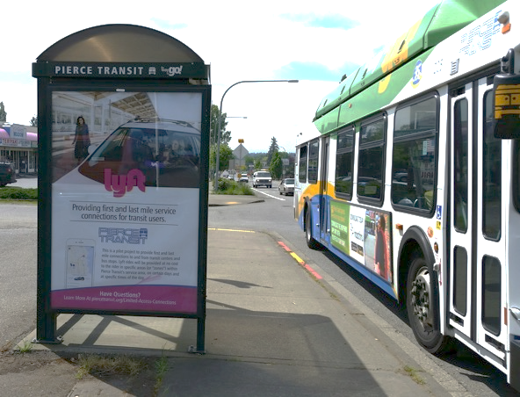
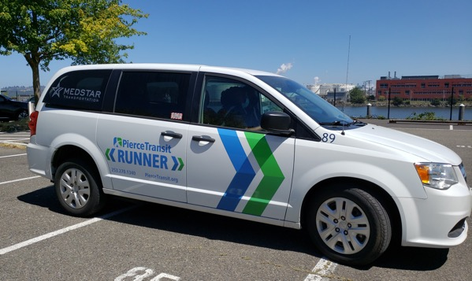
Pierce Transit on-demand services:
Pilot to Permanent Penny Grellier
Communications Administrator
September 30, 2021

Slide 24
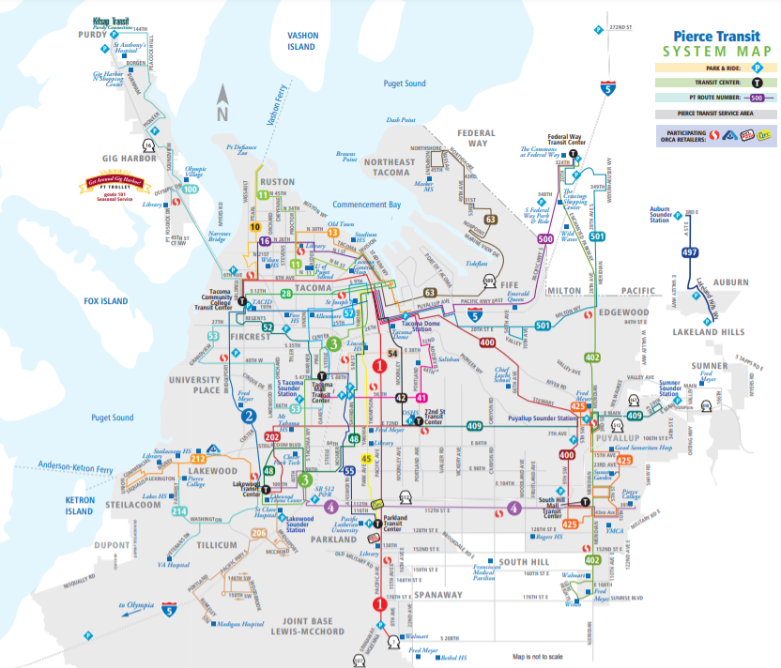
Pierce Transit Service
292 square miles
13 cities and towns and portions of Unincorporated Pierce County
Joint Base Lewis McChord
70% of Pierce County’s population
342 buses, 90 SHUTTLE buses, 360 vanpools
Operate Sound Transit Express regional service

Slide 25
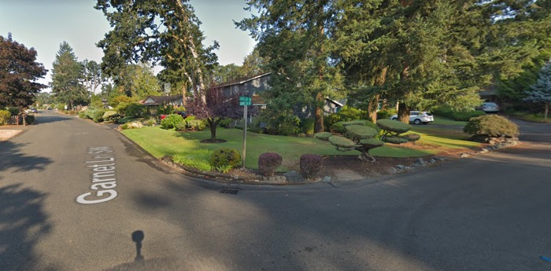
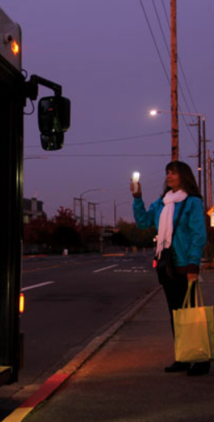
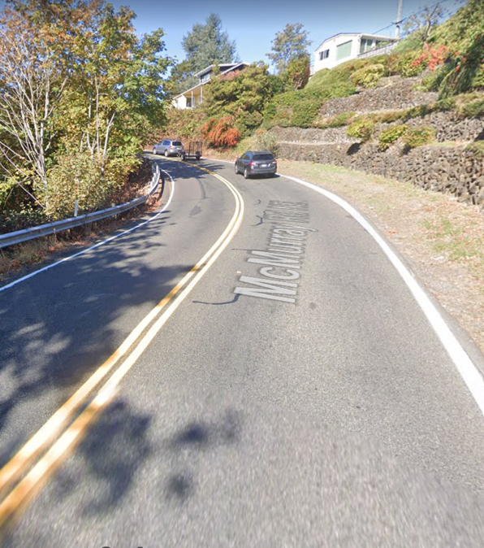
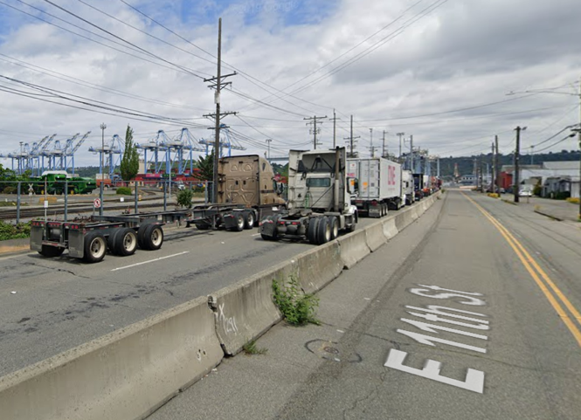
Lack of infrastructure
Cul de sacs
Weather, darkness
Industrial centers
Notes:
Away from main routes, infrastructure is poor
Cul de sacs and neighborhoods are designed for cars
Inclement weather, hours of darkness limit access
Industrial centers are congested with truck traffic, not pedestrian-friendly

Slide 26
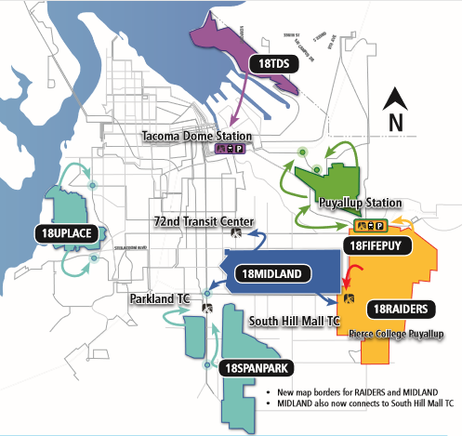
Limited Access Connections
Goal: to provide first and last mile connections to transit hubs and bus stops in areas/times of limited service.
$205,000 in FTA MOD Sandbox grant funds
May 15, 2018 through December 31, 2019
Testing various access issues
Fully-subsidized trips
App or phone access
Provided by Lyft

Slide 27
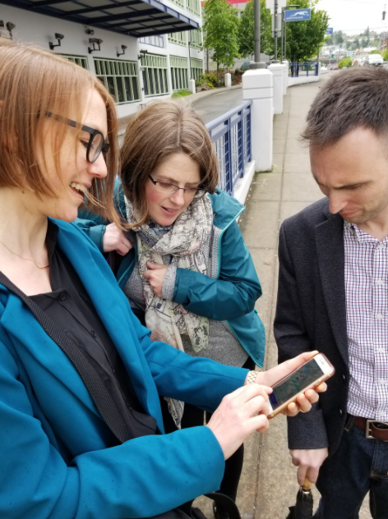
Limited Access Connections Results
Total trips: 8,827
Unique users: 330
Average trip duration: 10 minutes
Average trip distance: 4 miles
Average cost per trip: $11.47
Notes:
Tell story of Richard S, NE Tacoma

Slide 28
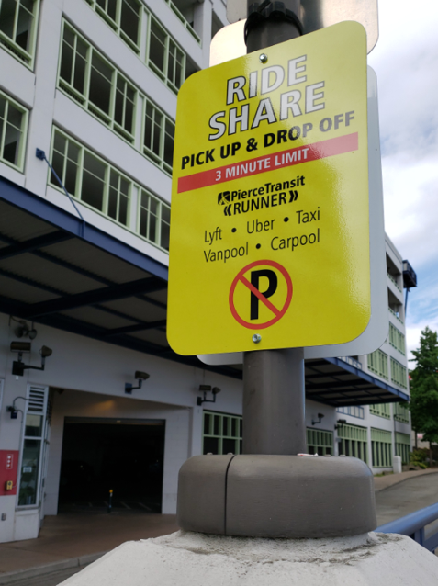
Limited Access Connections Lessons Learned
User contact information
More granular trip data
Wait time data
Provide accessible option (WAV, phone)
Provide flexible use within zone
Prioritize shared rides
Notes:
Tell story of WAV procurement issue

Slide 29
What came next
Continue service in top LAC zones
Consider on-demand for other hard-to-serve areas
Choose service model(s)
Find funding for services

Slide 30
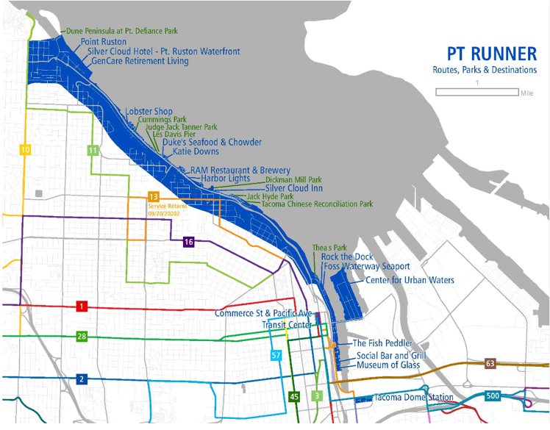
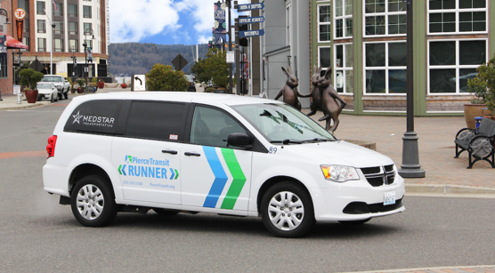
Runner pilot
Ruston waterfront
Contracted to Medstar
Connect to transit hubs
Standard fare/payment methods
August 1, 2020- February 28, 2021 (paused due to pandemic impacts)

Slide 31
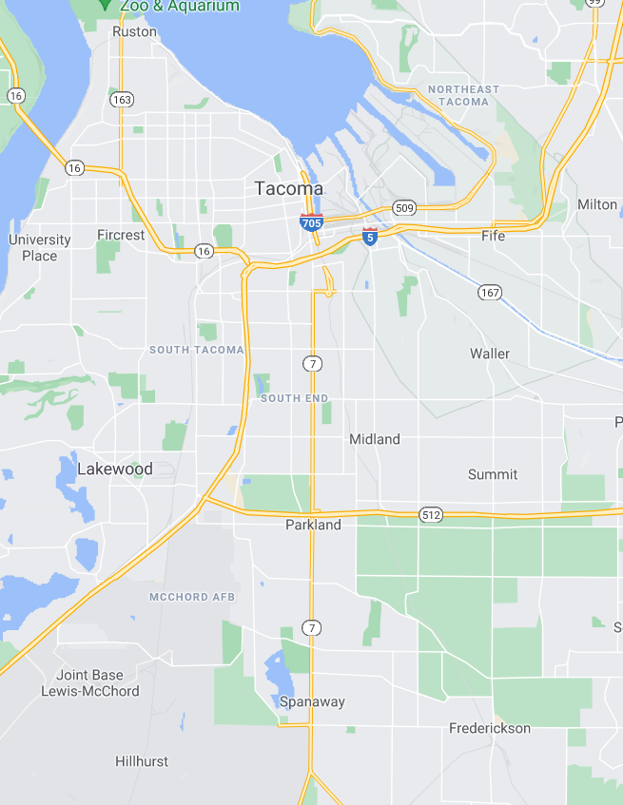
Runner continues…
Relaunch Ruston Runner
Rebrand JBLM Connector to JBLM Runner
DOD and military personnel
Tideflats Runner for industrial commuters
WSDOT Regional Mobility grant (4 years)
Port of Tacoma, other large employers
Spanaway/Parkland/Midland Runner
WSDOT Special Needs grant (4 years)
Bus Rapid Transit connection in 2024
Notes:
Note that Midland and SpanPark zones both had several habitual customers booking trips through our Concierge service

Slide 32
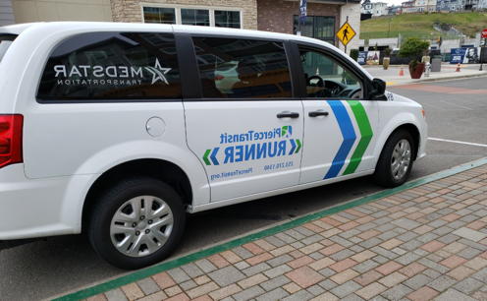
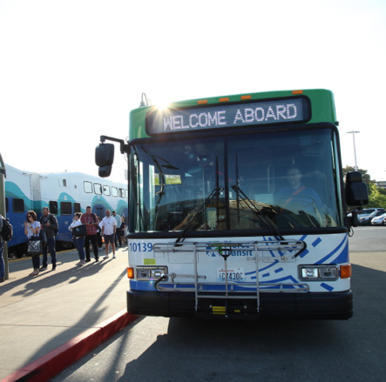
Goals
Feed fixed route transit
Provide equitable access to services
Test markets for fixed route potential
Provide more service options

Slide 33
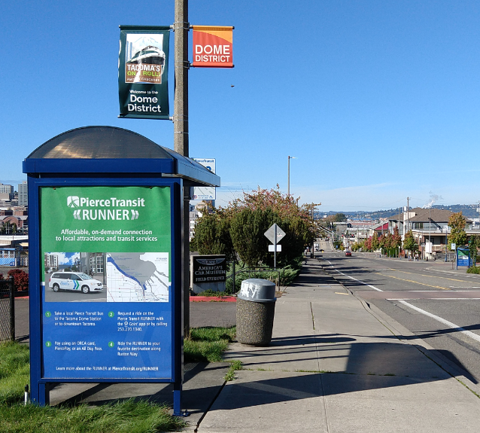
Contact info
Penny Grellier
pgrellier@piercetransit.org
253.589.6886
Thanks!

Slide 34
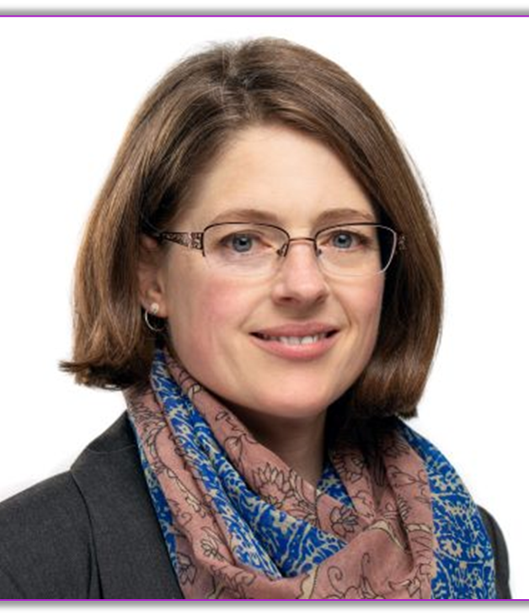
Sheila Holbrook-White
Penny Grellier

Slide 35
INSERT HEADSHOT
Al Benedict

Slide 36
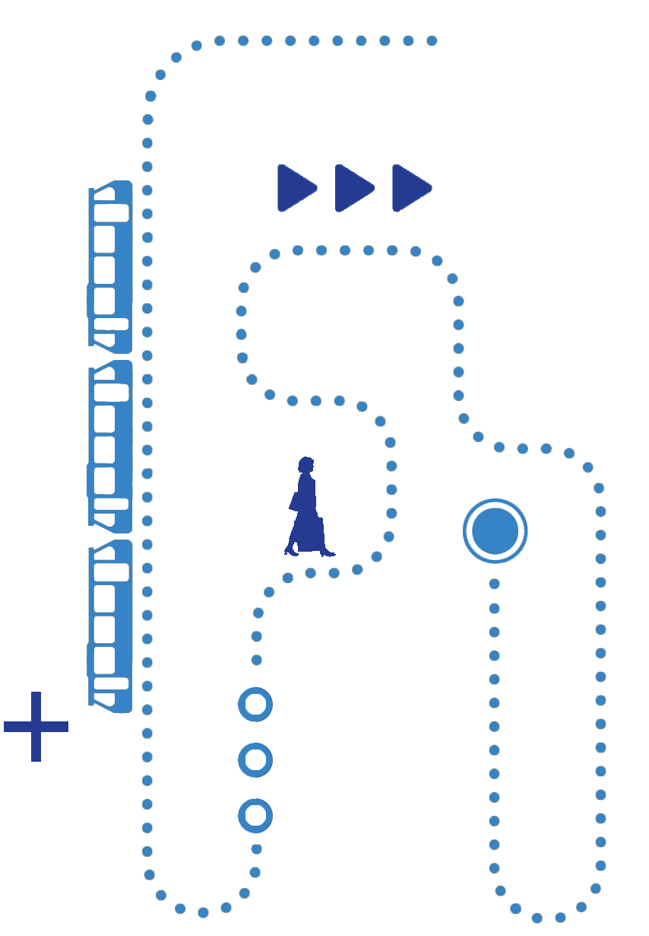
Mobility on Demand
Moving from Pilot to Permanent
September 30, 2021

Slide 37
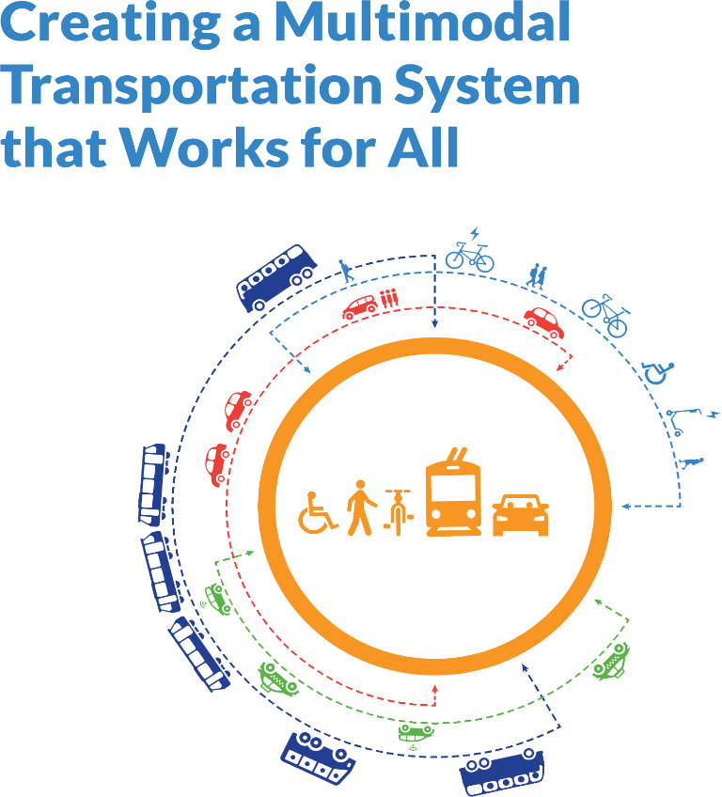
Who we are:
Non profit organization working in the public interest.
Values:
Connected
Universal
Equitable
Environmental
Notes:
Were from the shared use mobility center and we work to promote an equitable multi-modal transportation system that is accessible to all. We feel that with this service there can also be environmental benefits through reduced GHG emissions as people shift from SOVs to shared modes.
In our model of shared mobility we see transit serving as the backbone to that system and then the other modes help to create a complete mobility ecosystem.
Just a little bit about our work, we work with the FTA and provide TA to the MOD pilot projects and another larger project that we are involved in is to work with the CARB Clean Mobility Options pilot projects, where shared mobility pilots are funded through Carbon Tax Credits.

Slide 38
Mobility on Demand Considerations
Program Planning
Goals & Evaluation
Building Partnerships
Community Engagement
Service Integration
Photo Credit: Cowlitz Indian Tribe
Notes:
Project considerations and steps include:
Planning and Goal Setting
Procurement
Training
Marketing
Evaluation
Service Integration and Scaling

Slide 39
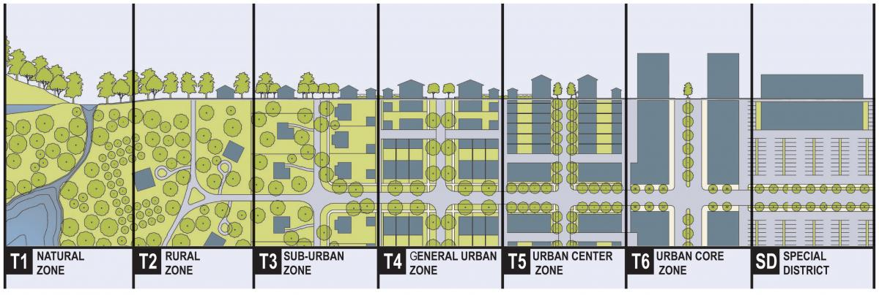
Planning
Planning for a Complete Trip
Modes
Microtransit
Rideshare
Micromobility
Volunteer Transportation
Carpool/Vanpool
Carshare (P2P)
Trip Purpose & Need Varies
First/Last mile with transit
Medical related trips
Day-to-day needs
Social activities
Employment
Notes:
Different modes based on location, trip purpose, and need/goal
Understanding service type - is this replacing service or supplementing it? What is the service area - is it big enough to draw from enough people but not too big to pilot a project? Do you understand the travel needs and does the service meet those needs? Have you reached out to the community and work with them? What is the purpose of the project? --- understanding scaling ---- if something is popular are there resources for it to grow or will it drain the resources?

Slide 40
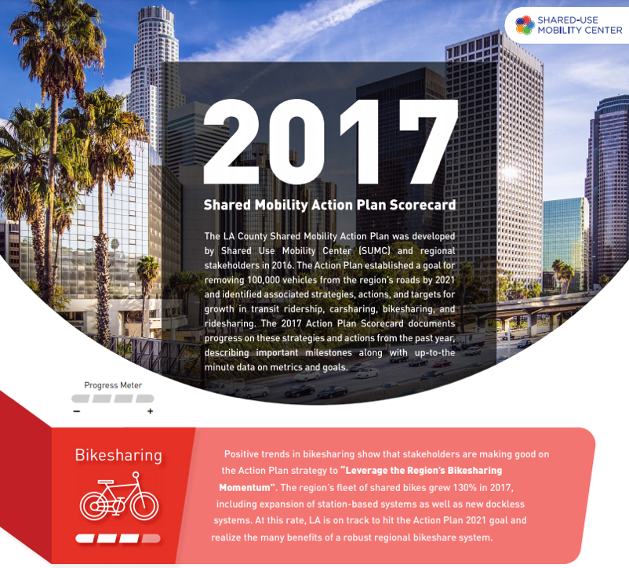
Planning
Needs Assessment - Identify where improvements need to be made
Define upfront with the project team:
Objective
Goals
Budget
Community engagement plan
Partnership building
Supply model
Drivers
Data reporting requirements
Vehicles types
Marketing opportunities
Ride limits
Schedule
Funding source
Service area
Program duration
Pricing
Integration of services
Notes:
It’s a long list and these are questions that the project team should answers upfront - sit down work through these questions with the project team - and revisit them throughout the project. Some of these I’ll touch on in more detail in this presentation.
What is a needs assessment?
An evaluation of transportation access gaps that identifies mobility needs, preferences, and priorities of local residents through meaningful and representative community engagement.
All of these factors play a role in the long term success of a project. If a project grows too fast too quick you could quickly find yourself tapped of resources - but not enough ridership then there might be something else going on with the transit option and you should ask yourself what need is it providing and is it meeting the needs of the community? Community engagement will help with this to better understand the needs. It could be as simple as people not knowing the program exists or understanding how to use it?
One option is to test small and have a plan to scale.

Slide 41
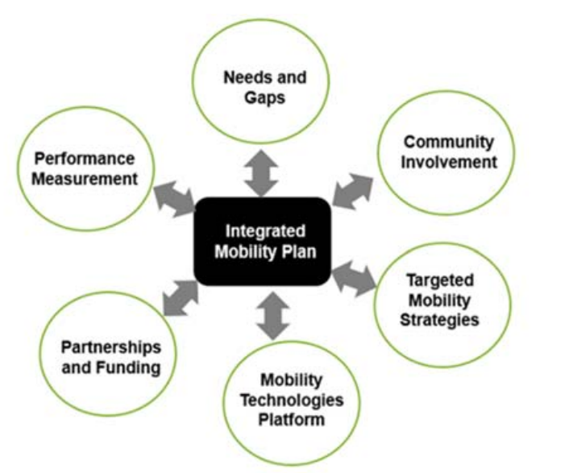
Goals & Evaluation
Clearly stated goals
Long Term
Short Term
Collaboration tools
Budget and cost of service
Data collection needs
Setting realistic expectations
Evaluation:
Data collection schedule
Performance scorecards
Notes:
Discussing what your goals are early on in the project is important. Continuing to check in so it is an iterative process.
Expectation setting
Iterative process

Slide 42
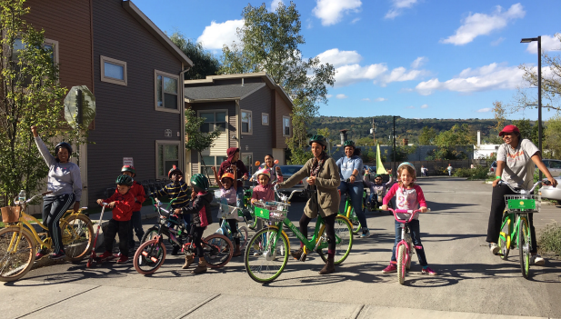
Partnership Building
Be intentional about the path to building trust with key stakeholders
Build diverse partnerships
Cross government agencies
Community partners
Private sector
Notes:
What is a needs assessment?
An evaluation of transportation access gaps that identifies mobility needs, preferences, and priorities of local residents through meaningful and representative community engagement.

Slide 43
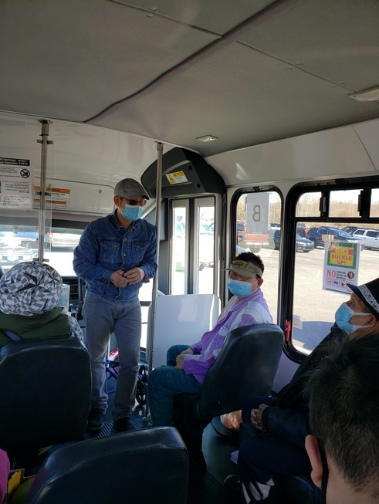
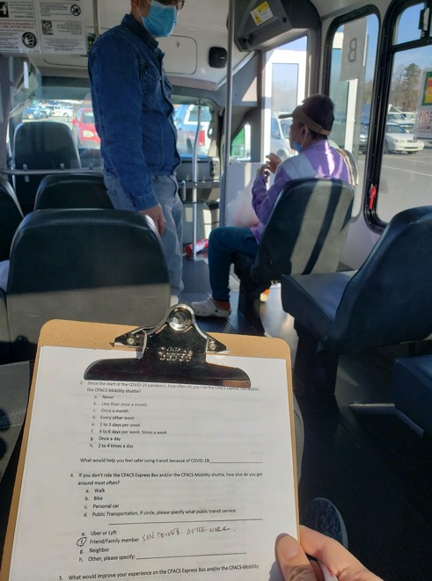
Community Engagement
Develop a flexible community engagement plan from the start of the project - revisit and revise throughout
Meet transit users on their terms
Understand cultural differences
Don’t resist unconventional ideas
Notes:
What is a needs assessment?
An evaluation of transportation access gaps that identifies mobility needs, preferences, and priorities of local residents through meaningful and representative community engagement.

Slide 44
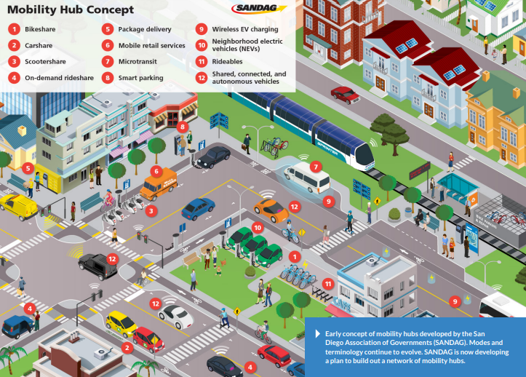
Service Integration
Physical and Technology Integration
Service type
Replacing service
Supplementing it
Service area
Mobility Hubs
Multimodal
Wayfinding
Vary in size
Integration of Services
Discoverability
Trip Booking
Payment Integration
Transactional
Standardized data & regulatory framework
Mobility as a Service
Notes:
Integrating services physically and through technology.
Physically, mobility hubs are a way to centralize services so that they are in one place, such as rail station, bus stop, taxi/TNC stand, ticketing, and access to bikeshare. They can range in size from a dense mobility hub with with mixed use to smaller in scale, where maybe there is a bench, signage, and bus and bikeshare. Wayfinding and signage is important regardless of the size of the mobility hub. Pictured here is a mixed use moderate density hub, you can see carshare vehicles parked, LRT station, bikeshare, scootershare and other modes.
Another way to integrate services is through technology, and these are categorized by Discovery or Transactional. Discovery apps, like google maps, allow users to look at travel options but you can not schedule or pay for those services. Transactional data are the information that needs to be exchanged so that users can schedule and pay for a trip all in one location.
These are important pieces to developing a MaaS system where users have a seamless experience using transit.

Slide 45
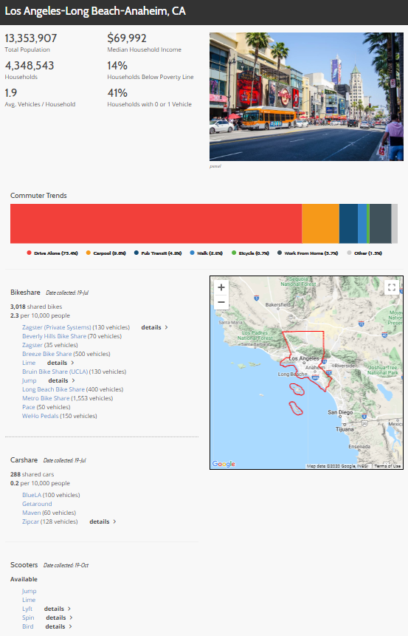
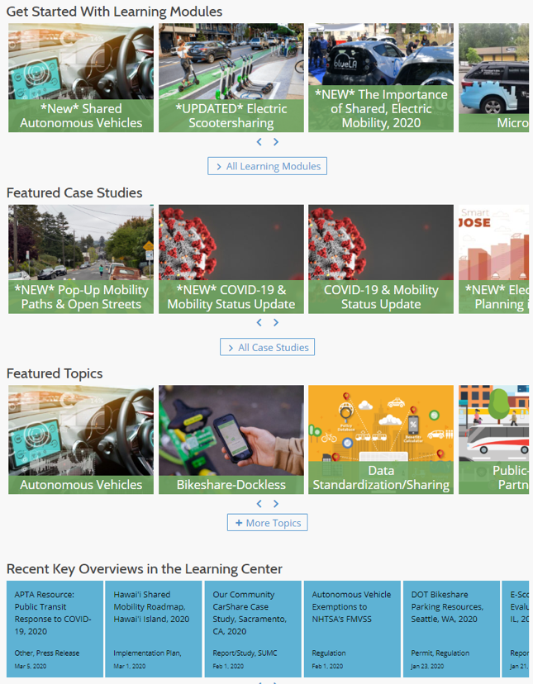
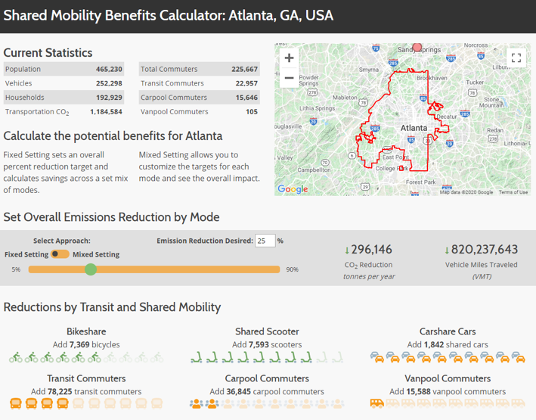
Clearinghouse: The Learning Center
Learning Modules
Case Studies
Policy/Project Overviews
Metro Area Profiles
Benefits/Emissions Calculator
https://learn.sharedusemobilitycenter.org/

Slide 46
TACL: The Transportation Technical Assistance Coordination Library
The Transportation Technical Assistance Coordination Library (TACL) provides a sustainable methodology and platform to access resources across a diverse range of transportation technical assistance centers and the Federal Transit Administration (FTA).
The FTA-funded technical assistance centers participating in this ongoing work with links to their coordination resources are:
National Aging and Disability Transportation Center (NADTC)
National Center for Applied Transit Technology (N-CATT)
National Center for Mobility Management (NCMM)
National Rural Transit Assistance Program (National RTAP)
Shared-Use Mobility Center (SUMC)
http://transportation-tacl.org

Slide 47
Al Benedict
albert@sharedusemobilitycenter.org

Slide 48
Sheila Holbrook-White
Al Benedict

Slide 49
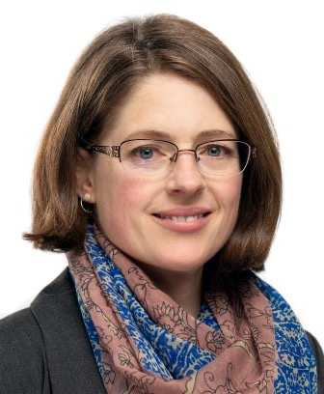
Panel Discussion / Audience Q&A
Sheila Holbrook-White
Matt Fyten
Penny Grellier
Al Benedict

Slide 50
Please take a few moments to fill out the evaluation which has been posted in the chat box

Slide 51
Thank You!
We’re here to help!
Contacts:
Judy Shanley
Jshanley@easterseals.com
Brandon Roccio
Broccio@easterseals.com

