Slide 1
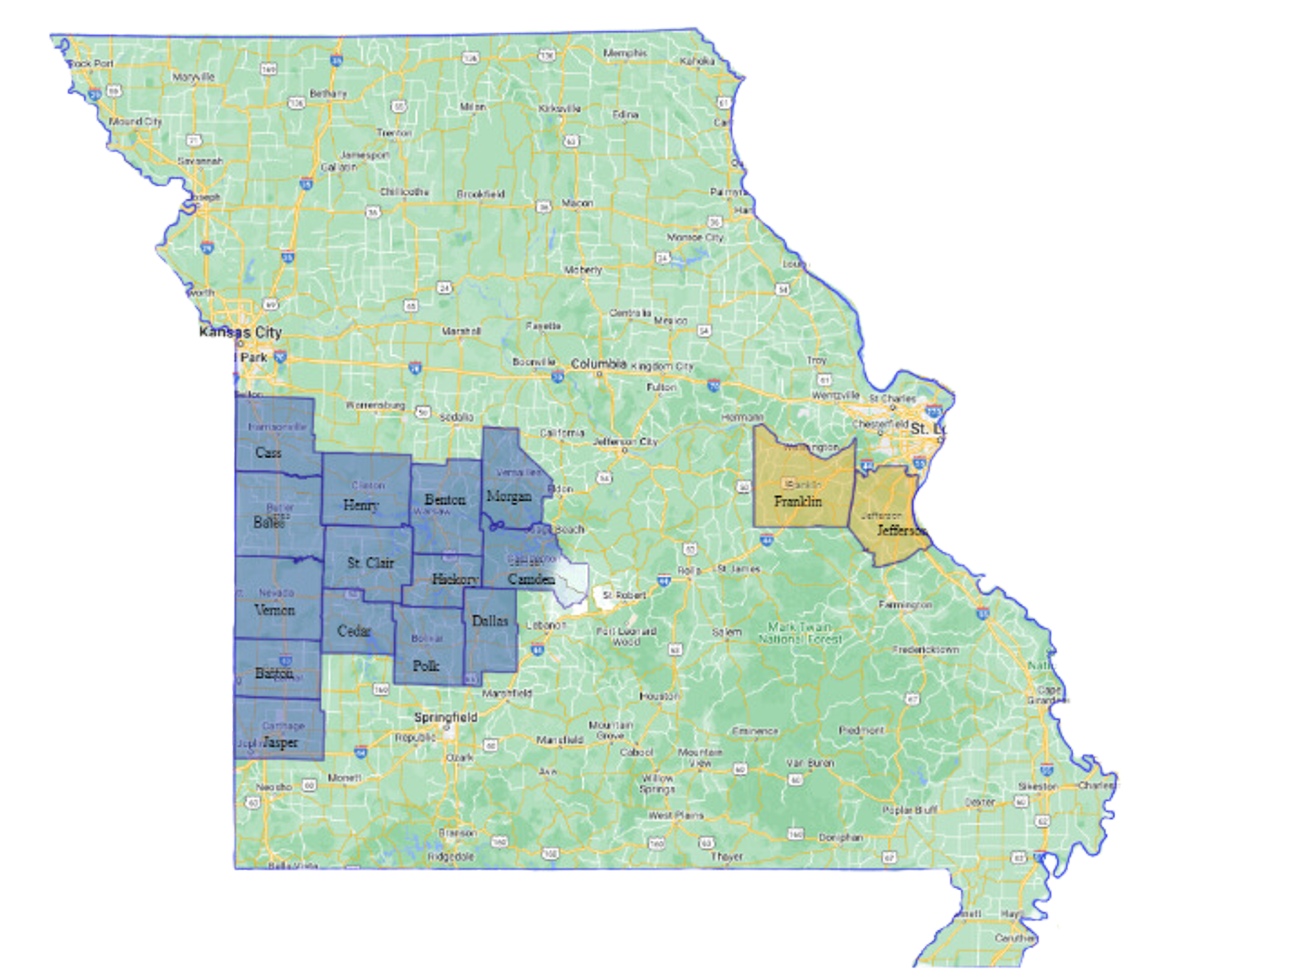
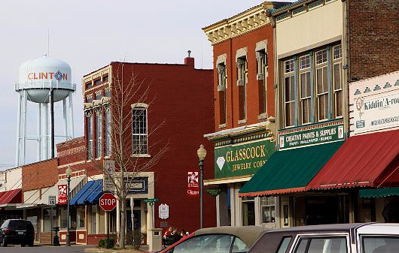

New Growth Transit:
Developing Transportation Solutions for Rural Missouri

Slide 2
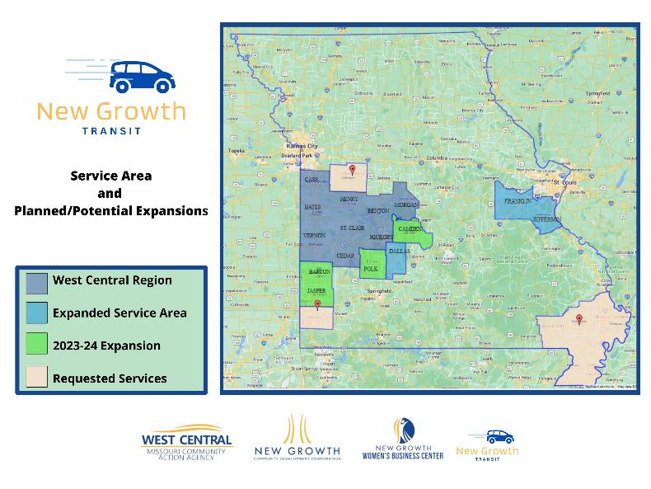
VISION AND MISSION:
  West Central Missouri Community Action Agency envisions a region where people and communities are thriving.
  New Growth community development corporation is a West Central affiliate that strengthens rural communities by connecting, cultivating and catalyzing rural assets and entrepreneurs.

Slide 3




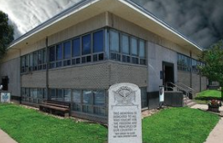




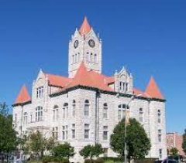

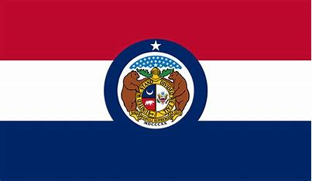

New Growth Transit Development =
Public and Private Investment Partners
Dallas County
Commission &
Dallas County
Community Foundation
City of Nevada &
Vernon County Commission
Missouri State Appropriations
’22-’24
Finis M. Moss Trust

Slide 4
Model Development Timeline
2019-2020: Health Resources and Service Administration Network Strategic Plan
  Completed 40 regional partners
  Missouri Rural Health Association supported Mobility Management.
2020: Missouri Foundation for Health grant support
2020-2021: Rural volunteer driver transit network launched with
CARES Funding and Community Services Block Grant Support
2021-present: Private funding Patterson Family Foundation
2022- 2024: State of Missouri appropriations

Slide 5


Kelly Ast
  New Growth Transit Chief Officer
  wcmcaa.org/transportation/
  660-476-2185 ext. 3162
  kast@wcmaa.org
  Office location in El Dorado Springs, MO
Bill Wagner
  National Center for Mobility Management Deputy Director
  nc4mm.org
  wagner@ctaa.org

