Slide 1
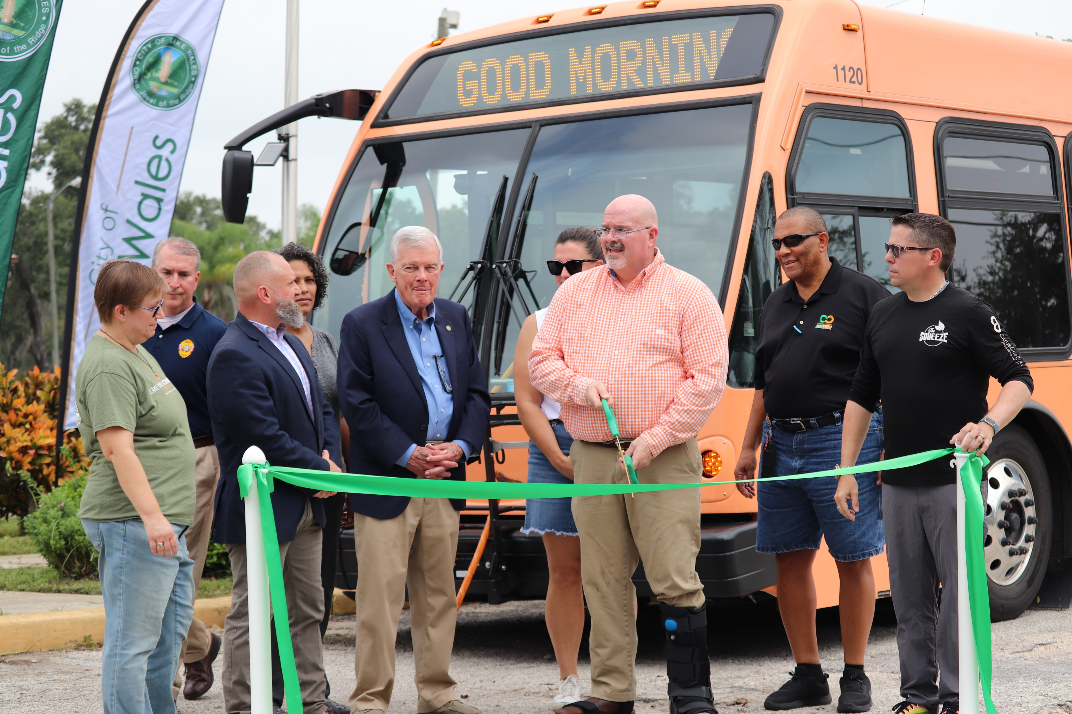
Ensuring Access to Healthy Food with Transit
City of Lake Wales
Nicole McCleary, AICP
Director of Strategic Planning and Innovation
Citrus Connection
June 2024

Slide 2
Lake Wales Food Insecurity
The Lake Wales PACE EH
Local task force formed to conduct a community-based environmental health assessment of the Northwest Lake Wales neighborhood (census tract 143.01) regarding food access.
What They Found
Social Vulnerability Index = 0.9242 (highest value = 1)
SocioNeeds Index (highest value = 100):
Food Insecurity: 95.2
Health Equity: 99.2
Mental Health: 97.8
Notes:
Protocol for Assessing Community Excellence in Environmental Health Task Force

Slide 3
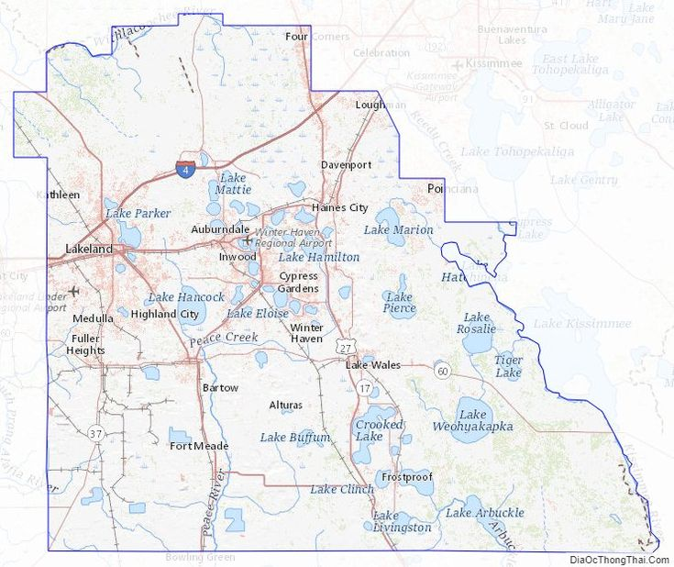
Lake Wales Census Tract 143.01

Slide 4
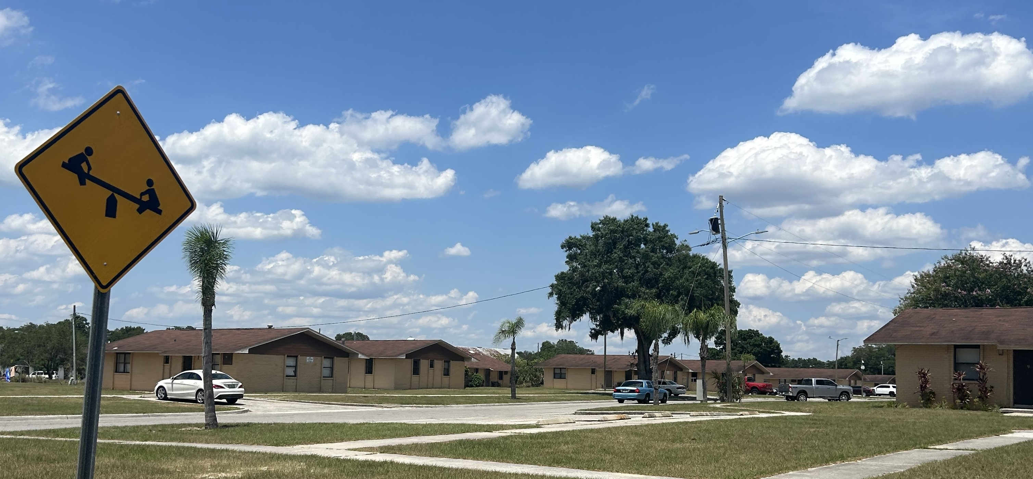
Lake Wales Census Tract 143.01
1.3 Square Miles
Population 1500
81% African American
Median Household income $27K
Poverty Rate 37%
Notes:
This 1.3 square mile census tract has a population of approximately 1,500 and is one of 19 Opportunity Zones in Polk County.
Median Household Income $27K which is 54% lower than the median household income for the state of Florida of $59,000.
Poverty Rate 37%. The percentage of households below the poverty line in this Opportunity Zone is 37%, which is 24% higher than the rate for the state of Florida of 13%.
With much of the population identifying as Black/African American (81%) and high rates of adults diagnosed with High Blood Pressure (52%), Obesity (48.9%), a Disability (23.4%), Diabetes (22.6%), COPD (13%), and Asthma (12.2%).

Slide 5
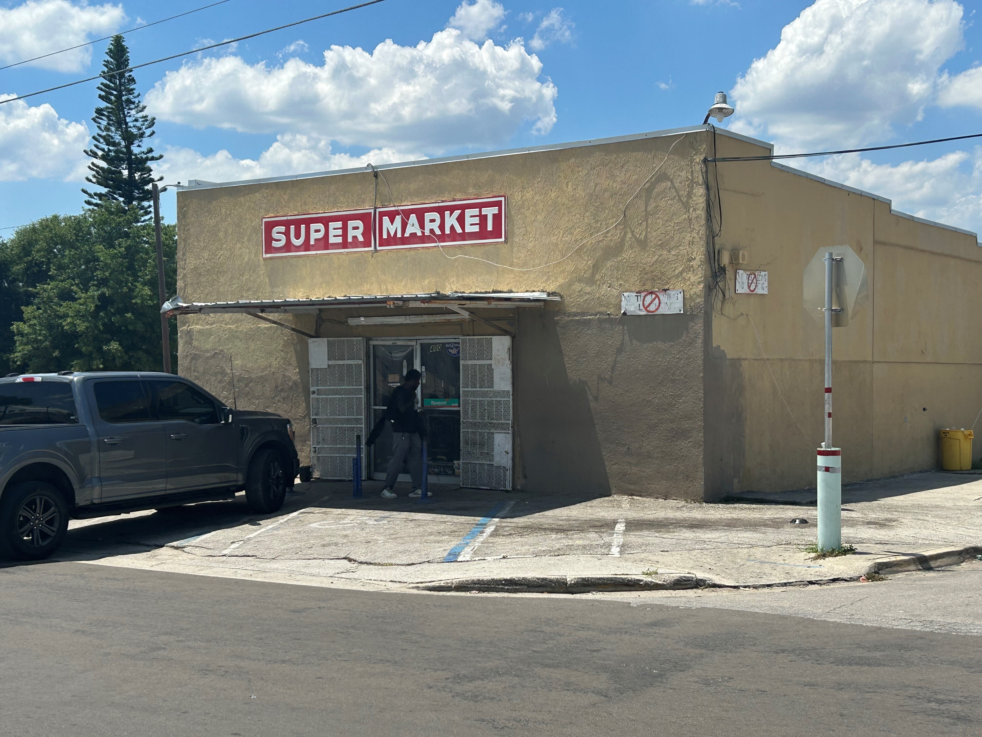
Key contributing factors to food inaccessibility
The Task Force identified the following 3 key contributing factors
to food inaccessibility among residents:
Lack of Knowledge about food distribution
Transportation Limitations
Lack of Access to Healthy Food Options
Notes:
Lack of knowledge about available food distribution and other community resources that can help to address their own individual and community health concerns
Transportation limitations:
10% of households have no access to a personal vehicle (US Census, 2020)
Public transportation challenges, including a limit to the number of items a rider can bring on the public bus, poor bus stop conditions making public transportation inaccessible/unsafe for persons with disabilities, and long bus routes.
Lack of access to healthy food options - there is only one “grocery store” located within the neighborhood; however, it more closely resembles a convenience store with no healthy food options.

Slide 6
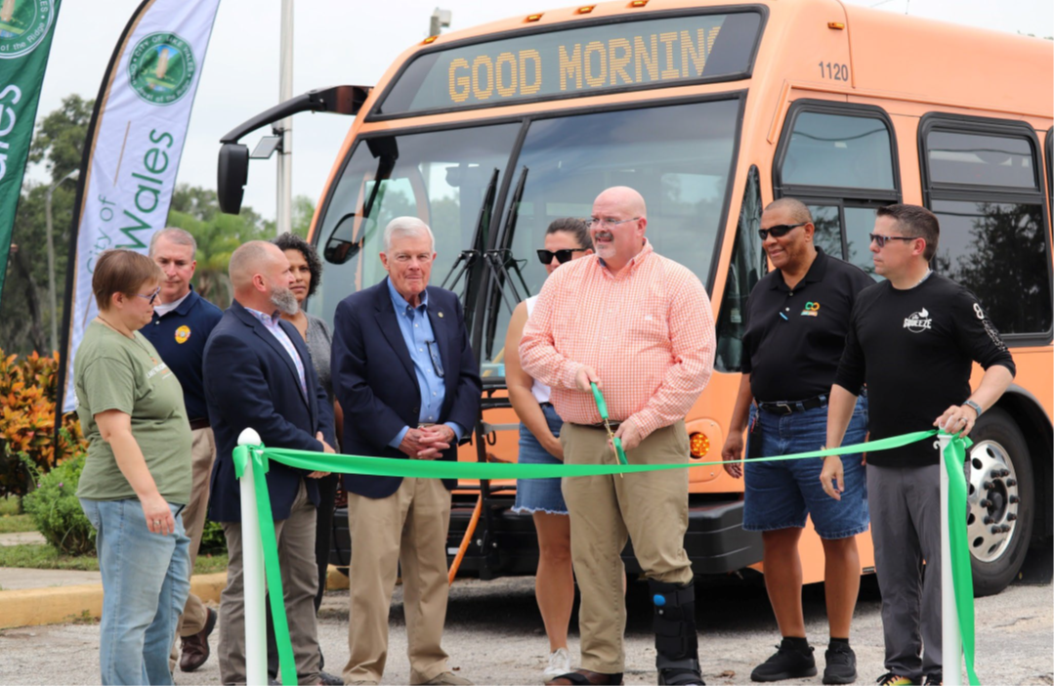
Lake Wales Circulator
Citrus Connection answered the call.

Slide 7
Previous Service in Lake Wales
Ridership
Old Route 35
Oct. 2022 – Sept. 2023
931
Circulator Ridership
Since Inception
Oct. 2023 – April 2024
5,036
5.4X increase in ridership

Slide 8
Lake Wales Circulator
The Lake Wales Circulator was created through state grant funding to address the high rates of food insecurity, behavioral health concerns and health inequity in NW Lake Wales.

Slide 9
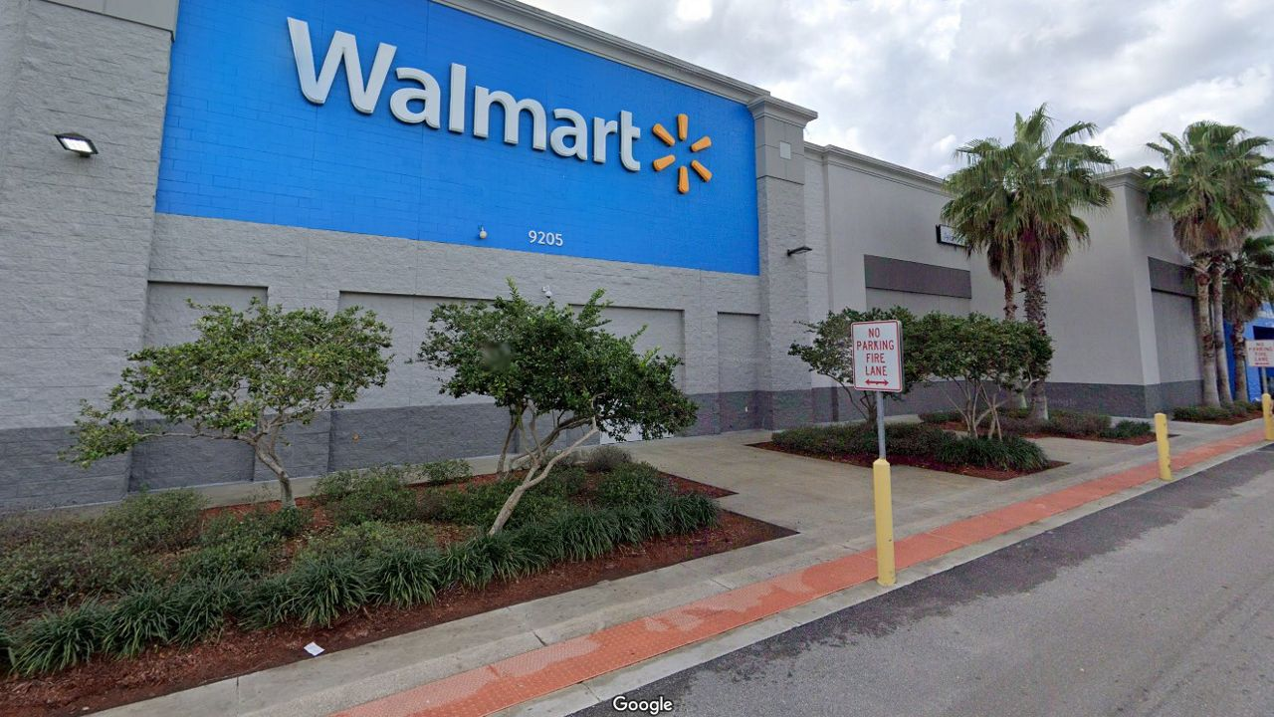
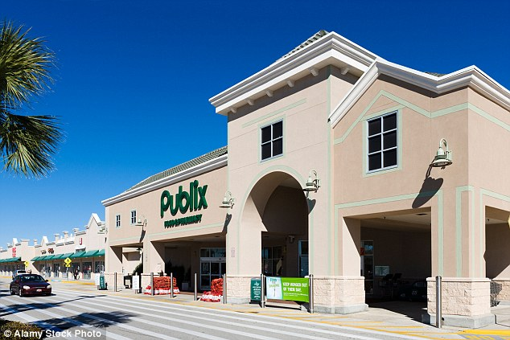
Lake Wales Circulator
This route connects people to food distribution points and health services.
Walmart, Publix and the Polk County Health Department are part of the bus route advancements.

Slide 10
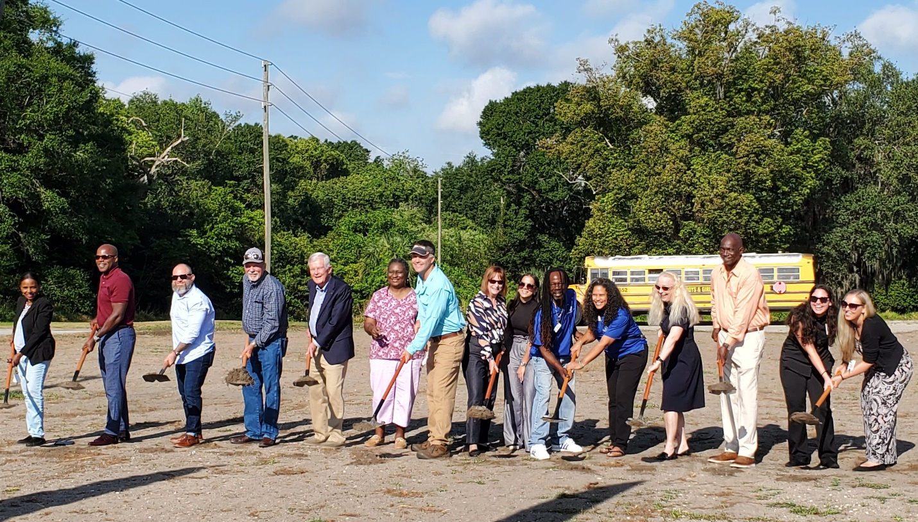
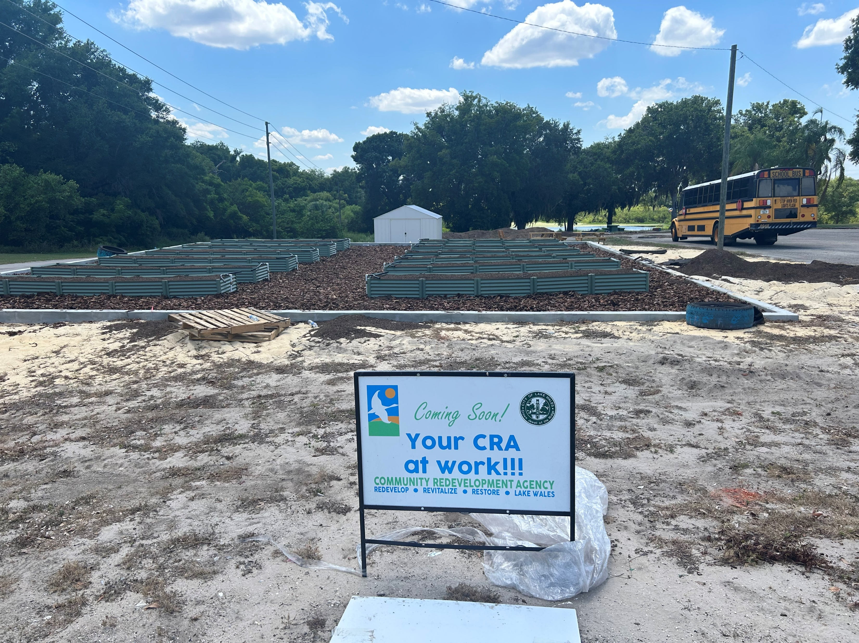
It takes more than transit
The project entails the development of a community garden, to be utilized as an “outdoor classroom” where local community members can come and learn about growing various herbs and produce, as well as proper nutrition and food preparation, among other topics

Slide 11
It takes more than transit
Community Partners advancing health equity
Florida Department of Transportation
KidsPACK, inc.
Central Florida Health Care
United Way of Central Florida
UF IFAS Polk Extension Office
B Street Community Center
Roosevelt Academy
City of Lake Wales
Boys & Girls Club – South Ridge Unit
Lake Wales Care Center

Slide 12
Questions
Nicole McCleary, AICP
nmccleary@ridecitrus.com
Director of Strategic Planning and Innovation
Citrus Connection

