Slide 1
2024 Mobility Management Forum
Medicaid-Funded Transportation:
More than Just NEMT
June 10, 2024

Slide 2
Introduction to MTAC
Diverse, multi-stakeholder coalition founded in 2017 with a mission to educate about the benefits of NEMT and preserve and enhance access to the service.

Slide 3
What are Medicaid Waiver Programs?
States have broad flexibility to design their Medicaid programs within the parameters of federal Medicaid “state plan” requirements
Section 1115 of the Social Security Act provides even further flexibility
Allows the Secretary of Health and Human Services to “waive” program requirements in order to carry out a demonstration likely to further the goals of Medicaid
Examples of how Section 1115 demonstrations are used:
Provide federal Medicaid funds for costs not otherwise matchable
Expand benefits
Expand coverage to populations that are not otherwise Medicaid-eligible
Implement managed care delivery systems

Slide 4
Where Does Transportation Fit In?
Obama and Trump eras: Section 1115 was generally used to restrict medical transportation
Allowed a small number of states to exclude coverage for non-emergency medical transportation (NEMT) services for either:
Adults newly covered by Medicaid due to income eligibility (e.g., IN, IA, GA, KY) or
Parent caretakers with dependent children (e.g., UT)

Slide 5
Current CMS policy on Transportation Waivers - Twofold
Sunset Section 1115 waivers restricting NEMT*
Expand access to transportation and services to address health-related social needs (HRSNs) through Section 1115
“Covered Connecticut” demonstration provides Medicaid-funded NEMT to certain Qualified Health Plan enrollees
December 2022 HRSN guidance outlined ways that states can cover services to address HRSNs under Section 1115 demonstrations
Allows states to provide transportation to non-medical services in certain circumstances
*Per Nov. 1, 2023 letter from CMS to the Oklahoma Health Care Authority

Slide 6
Section 1115 HRSN Demonstrations
“HRSNs are an individual’s unmet, adverse social conditions that contribute to poor health.”
Covered services include medically appropriate:
Housing supports
Nutrition supports
HRSN case management
Transportation can be provided under the umbrella of one of these categories, or outside the framework of this demonstration opportunity
Target vulnerable populations which vary by state (e.g., experiencing homelessness, substance use disorder, serious mental illness, justice-involved, pregnant or postpartum, foster care youth, etc.)

Slide 7
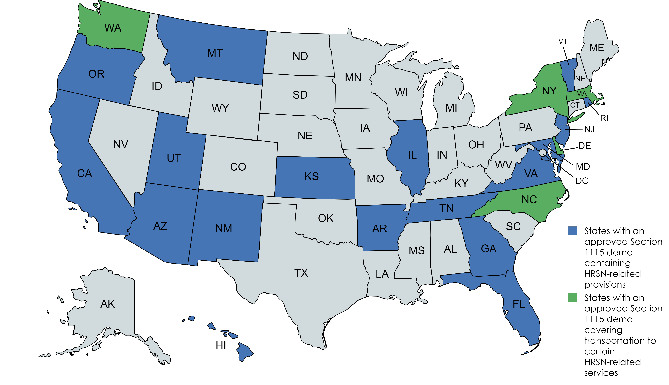
State Landscape of HRSN Demonstrations
As of May 22, 2024, 21 states have received approval from CMS to provide some level/type of SDOH-related services
At least 5 states (DE, MA, NC, NY, WA) explicitly decided to cover transportation to HRSN-related services (i.e., not medical services)

Slide 8
Examples of How States are Using HRSN Demos to Address Transportation Needs
New York will cover private and public transportation to transport members to covered HRSN services and case management activities
Transportation to meet with a case manager, to tour available housing units, etc.
How to get it?
Contracted entities (Social Care Networks) provide HRSN screening and referral services to target members

Slide 9
Examples of How States are Using HRSN Demos to Address Transportation Needs
Massachusetts will cover transportation to services for tenancy supports and nutrition supports
Transportation to nutrition counseling, healthy meal preparation classes
How to get it?
Through Accountable Care Organizations (which also deliver most medical services)

Slide 10
Thank You and Questions
Tricia Beckmann
Principal, Faegre Drinker Consulting
Advisor to Medical Transportation Access Coalition
Tricia.Beckmann@faegredrinker.com
202-312-7009

