Slide 1
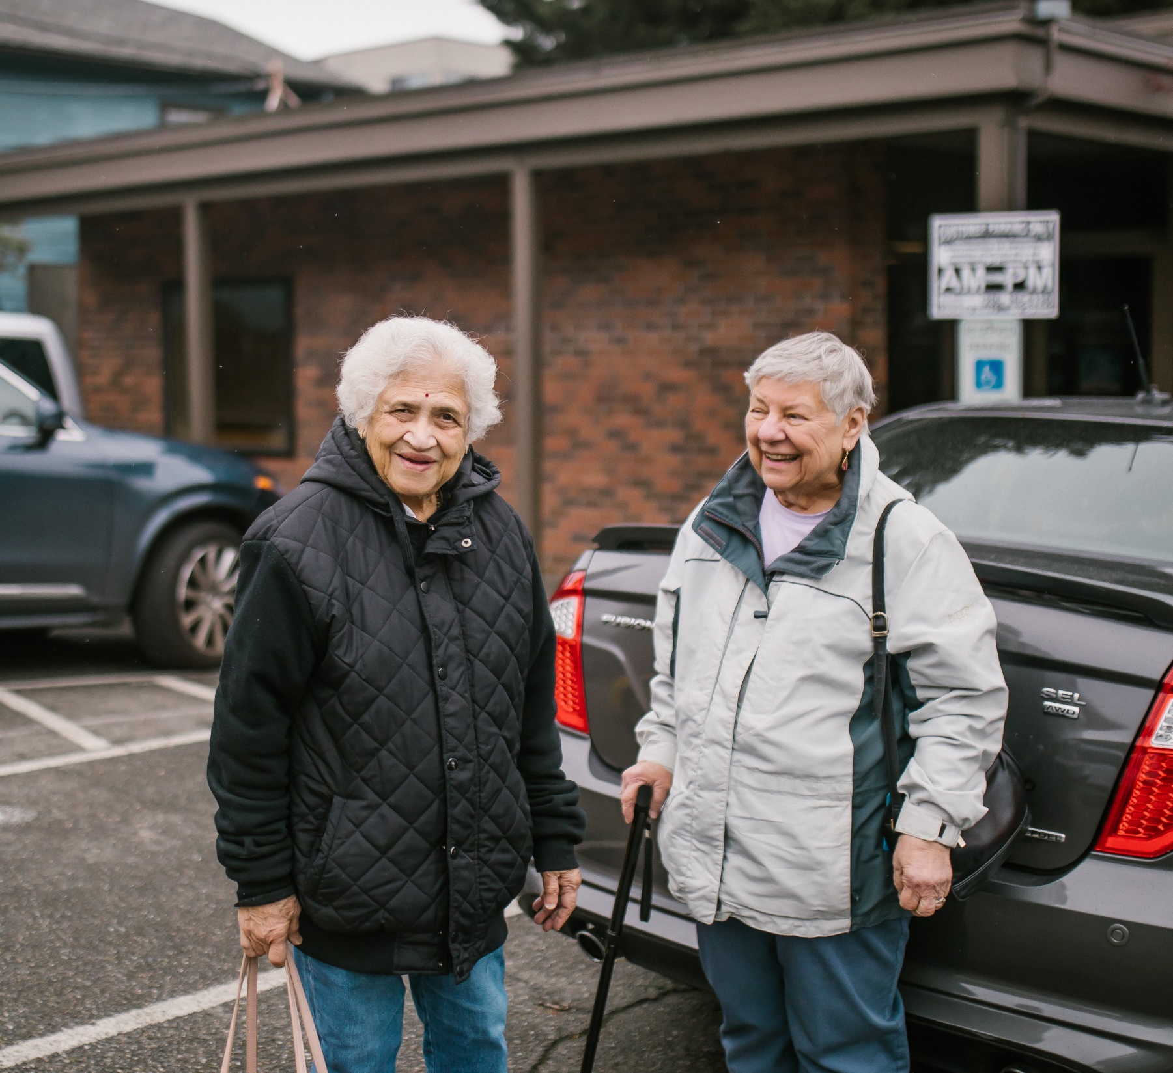
Rides & Smiles
Enhancing Mobility for Our Community

Slide 2
Brief Overview
Phirun Lach – Director of Transportation
Welcome everyone, today I'll be discussing the 'Rides & Smiles' pilot project, aimed at enhancing mobility for our community's older adults and people with disabilities.
This project was initiated to address the pressing mobility challenges faced by these groups.

Slide 3
Focus Question
How might we meet culturally appropriate transportation needs, including the need for spontaneous trips, and address social isolation among the most impacted older adults in Kirkland, Redmond and Bellevue?

Slide 4
Design Criteria
Affordable, door-to-door transportation to all types of destinations: medical, food-related, shopping, family, friends, cultural and religious events.
Safe, sheltered from adverse weather, no long walks to bus stops.
Able to make same-day reservations. Booking by phone, online and in multiple languages; full accessibility for people with disabilities.
Serves older adults 55 and older, and adults with disabilities. Companions allowed.
Rides provided across the cities of Kirkland, Redmond and Bellevue; plus, other essential destinations.
No long waits. On time arrivals and departures.
Compassionate, caring drivers and call center staff trained to work patiently with older adults, new immigrant groups, and non-English languages as well as English speakers.
Vehicles able to accommodate all mobility devices.

Slide 5
Key Concept Elements
Free (donations encouraged) demand response transportation, door-to-door service to all destinations within three cities. Same-day reservations. Booking by phone, online and via app in multiple languages; full accessibility. Adults 55 and older and adults with self-declared disabilities are eligible. Companions allowed. Rides provided across the cities of Kirkland, Redmond and Bellevue. Special arrangements for transporting riders to destinations beyond the three cities for non-emergency medical trips. Ten-minute maximum pickup and drop-off time waits. Drivers and call center staff trained to work compassionately and patiently with older adults, new immigrant groups. Training in cultural competence, listening skills, and awareness of the needs of older adults is essential. Shuttle vans accommodate all mobility devices. Partnerships with CBOs – especially senior and cultural organizations Additional “charter” service to provide fee-based rides to special events including festivals, music and cultural events, casinos, religious gatherings, etc.

Slide 6
Market Size and Opportunity
Bellevue 152,000. Redmond 74,000. Kirkland 93,000. 41 percent of population in three cities were born in over 90 different foreign countries. 44 percent speak a language other than English at home 65 years and older constitute 14 % of population. 56% of respondents surveyed report that transportation is a challenge for participating in social and/or recreational activities. About 13% of all households headed by someone age 65 or older did not have a vehicle and 39% of renter households headed by someone age 65 or older did not have a vehicle. Lack of personal transportation is one of the main reasons older adults miss medical appointments and are less likely to participate in social, family, and/or religious activities which can result in physical fragility and social isolation. Free (donations encouraged) demand response transportation, door-to-door service to all destinations within three cities.

Slide 7
Project Background
Prior to 'Rides & Smiles', many in our community struggled to access essential services and social opportunities."
Target Population
Our target population includes older adults and individuals with disabilities, who often face significant barriers to mobility.

Slide 8
Community Impact
Reduced social isolation among older adults, especially people with low incomes, new immigrants, and people of color.
Permits aging in place and continuation of independent lifestyle.
Culturally intelligent transportation service builds trust.
Ridership is strengthened by partnerships with CBOs.

Slide 9
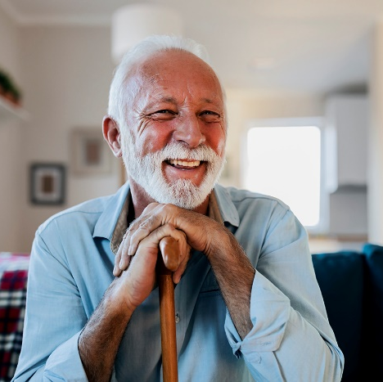
Rides & Smiles has served
165 new riders
Denied less than 2% of ride requests
We provided
1,326 one-way trips
15,572 miles
1,335 driving hours
Ride Purpose
Medical – 28%
Nutrition – 30%
Personal – 42%

Slide 10
Surekha L.
Ride & smiles Shuttle is very nice. I am using it daily going for my Hydrotherapy, going to NBCC, Dr’s appointment. Driver is very friendly. On Thursday 40 people are riding for senior’s center. It is very popular now. not much waiting period. They have one bus so doing 2 shifts for pickups & drop off. few people are using for grocery store & malls & going for Dr’s appointment. Right now, they have one bus & same driver. They are sending me yellow cab many times. People in registration & dispatch are very very cooperative. Sometimes if we comes out from Dr’s office bus waits. They are working very hard to manage it. In my knowledge everybody is very happy for their services & facilities. thanks 🙏🏽
Pradip Dave
Hi,
My name is Pradip Dave and my wife's name is Rupal Dave.
We are really thankful to Rides and Smiles for providing us the facility for our requested rides.
We have been getting these services very regularly in a well-organized way and we are grateful for that.
We are living in south Bellevue, and we have no access to any public transport facility and Rides and Smiles have been giving us such a nice service and made it possible for us too to have good mobility.
Thanks again.

Slide 11
Participating Organizations
We couldn’t do this without our partners!
NCMM (National Center for Mobility Management)
IASC (Indian American Community Services)
JFS (Jewish Family Services)
CISC (Chinese Information and Service Center)
Each partner played a crucial role, from funding and planning to providing volunteer support.

Slide 12
Key to Additional Funding
_
Funding Achievements: The success of ‘Rides & Smiles’ helped us secure an additional 2 years of funding, ensuring the sustainability and expansion of the project.
Future Plans: We plan to continue growing our services and reaching even more community members.

Slide 13
Challenges & Solutions
We faced several challenges, including initial logistical issues and managing increased demand.
Need more shuttles
(One was not sufficient)
Reduce time on shuttle
(Some riders trip(s) were more than 90 minutes)
Translation accessibility
Peak Travel Times between 10am – 2pm
Large area of travel
By adjusting our strategies and working closely with our partners, we overcame these hurdles.

Slide 14
Lessons Learned
Operational Feasibility: We learned the importance of flexibility and responsiveness. Travel times are much longer covering 3 cities.
Financial Viability:
Financially, securing diverse funding sources was key to our viability. Demonstrating to funders this service is needed was key.
Client Desirability: Rider feedback was instrumental in shaping and improving our services. It helped us become much more efficient in our routing.

Slide 15
Conclusion and Q&A
In summary, 'Rides & Smiles' has significantly improved mobility for our target population, thanks to the support of our partners and community.
We look forward to your questions and further discussion on how we can continue to enhance our services.

