Slide 1
CTAA Expo: 2024 Making Innovation Work for Communities: A Retrospective on NCMM Grantees
Carol Kochhar-Bryant, CKB Evaluation Consulting
West Palm Beach, FL June 10, 2024: 11:30 Hilton West Palm Beach Convention Center 600 Okeechobee Blvd, West Palm Beach, FL

Slide 2
NCMM’s 5 Capacity-Building Measures Year 1-4
Results and outcomes viewed through 5 capacity building
measures:
Supporting FTA and CCAM agencies in cross-sector partnerships
Delivering universal, targeted, and intensive TA
Building capacity for mobility management (MM) transportation coordination networks
Building and sustaining statewide MM networks
Implementing demonstration grants that contribute to innovation and improve peoples’ lives

Slide 3
A focus on capacity-building measure #5: Demonstration grants that contribute to innovation and improve people’s lives

Slide 4
Value of learning from HCD process: Learning cycle (Learning what makes it work so we can do it better)
How do we create a plan and a trial run?
How do we build a durable team?
How do we sustain the trial?
How do we accelerate the process?

Slide 5
Making a difference: Where’s the evidence?

Slide 6
We studied the former grantees: The data
Interviews with grantee teams and leaders
Project operational plans
Monthly and final reports of accomplishments
New quantitative and qualitative performance data
Project surveys of customers served
Customer feedback on project services

Slide 7
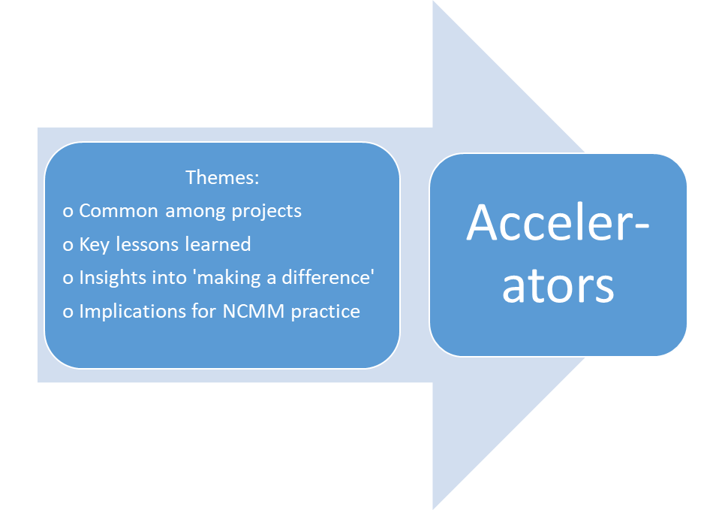
2023 Learning Launch and Ready-to-Launch Grantees: From Themes to Accelerators
Themes have potential for accelerating preparation and confidence of teams for successful innovation.
More we know, the more we can accelerate the process and help projects survive and thrive.

Slide 8
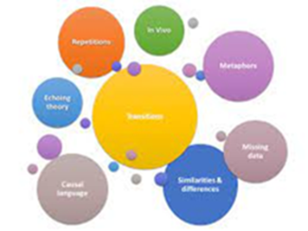
Theme 1: Talk with and get to know the people you will serve!
Solicit customer feedback all the way along.
Customers can help discover the ‘unknowns.’
One team leader shared: “We learned during focus groups that we had to modify the schedules over time. We also learned that the smaller bus, while nicer for riders did not have enough cargo space for them to carry loads of groceries. We knew we needed larger buses with more cargo space, and ones that could carry more than 15 passengers. Through constant feedback we also learned that for people with limited mobility we had to pay close attention to accessibility – the stairs involved, availability of ramps, obstacles at destinations, etc.”

Slide 9
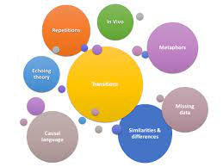
Theme 2: Forge strategic partnerships to blend and integrate services
We asked --what makes human-centered design solutions work? -- #1 answer is -- PARTNERSHIPS!
Represent all key stakeholders
Multiple perspectives on solutions
Shared operations
Shared problem solving
Makes for stronger outcomes
Builds potential for sustainability

Slide 10
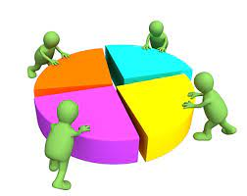
Theme 2: Grantees told us…..
Partnerships are more than a collection of partners coordinating separate services and roles.
Partners had to think outside the box and do things differently.
“First-of-its-kind” intersectoral collaboration among mobility managers, transportation professionals, health agencies, social services, employers, rehabilitation and other agencies in their localities.

Slide 11
Theme 2: We asked --what makes for effective partnerships? Commitment!!
Committed partners made the difference
Collaboration falls on a spectrum -- from ‘cheerleaders’ to ‘MVPs’
Committed partnerships = key measure of success
Commitment science is a thing

Slide 12
Theme 3: Be politically astute and engage local leaders
Learn from others how ‘doing the politics’ can accelerate the project growth and success.
As one project reported, “All of the mayors showed up at our meetings because they were invited (and we fed them). They remained engaged and supported us throughout because they understood what we were doing. And they were essential for our expansion.”

Slide 13
Theme 4: Pilot model serves as a springboard into the future: build in data gathering from the start
Successful projects regularly evaluate effectiveness and seek feedback from stakeholders.
Define and communicate the life changing nature of the work – giving people real choices in their lives to age in place, access food security, access medical and behavioral health care, actually complete their courses of treatment, and increase human interaction.
Build data gathering into your design, planning, implementation, and justification for sustaining the project.
Capture qualitative data on impacts for highly remote communities where no previous services existed.

Slide 14
Theme 4: Build data skills in operational metrics and performance measurement
Analysis of regional needs, barriers, and
pent-up demand for transportation services
Value of community data and performance measurement to track services
Qualitative data on partnerships and the development process.
Grant writing skills that integrate performance data.

Slide 15
Theme 5: Identify existing resources and plan early for sustainability.
Move beyond a patchwork of grants or bartering to find a way to integrate the community.
Include sustainability planning from the start (Sustainability Assessment Tool/MM-SAT).
Learn how others have integrated with the community:
state and local grants;
innovative local collaboration;
political engagement;
shared resources.
Learn how others have replicated their project in surrounding communities.

Slide 16
Theme 6: Make sure they know you are there! Prioritize early marketing to broaden your reach to target audiences.
Remove obstacles to marketing (e.g., complex approval processes).
Marketing reflects the whole partnership, not just one organization.
Increase ‘observability’ – a new thing is happening.
Communicate to all (both customers and partners) -- how they will be better off with the new services.

Slide 17
Theme 6: Broaden your reach: Engage new riders with little experience with public transit
Many people are fearful, with little experience with public transit beyond high school buses.
One project used the holiday season to engage new riders -- “We were able to launch a Christmas shopping event; we decorated the vans, our drivers wore Santa hats and everyone just felt really welcome. We played music and had hot cocoa on the vans for them when they first got on just to make them feel a bit more welcome. It worked!”

Slide 18
Theme 7: Recognize the value of on-site visits by NCMM staff
Project teams said: “We were ‘boosted’ by having the NCMM team come on-site to work with us….. “They contributed in ways we only realized later, upon reflection, were responsible for our continued motivation and resilience.”
“It was amazing for NCMM staff to spend their time and come to us for that week long training. Even though we are this little town in Idaho, they brought so many resources and gave us a week of their time during a blizzard, working from sunup to sundown, with a 45 minute drive from us to their hotel. They did everything they could to make sure that we felt comfortable moving forward. The biggest thing that kept us going was knowing we had outside people pay attention and help us and really care.”

Slide 19
Theme 7: What we learned from grantees: Years 1-4
NCMM serves a key advocacy role in building mobility management capacity in communities.
Capacity just emerging in rural and remote regions that lack the infrastructure available in more urban areas.
NCMM’s engagement helps communities leverage local, state and federal resources.
Any community, regardless of size or resources, can be a wellspring for innovation and modernization, as long as they are willing to try.

Slide 20
Theme 8: Document how you are making a difference in communities
Document how you are making a difference – for immediate customers, and lasting changes in the wider community.
Document broader ‘systemic’ changes in infrastructure, collaborative partnerships, or political support that helps grow and sustain the projects.
Help us all learn what works.

Slide 21
Theme 8: Making a difference
“Due to the systems changing around us and a collective approach in our community to building capacity to address transportation, transportation has been named as 1 of 4 main sectors of focus for the Phillips County team. Before the implementation of NCMM learning launch, during our community accelerator meetings, transportation was noted as a barrier to all resources in our community, but many felt it was "too out of reach" for their organizations. After the learning launch, many organizations felt that not only was focusing their resources and efforts to address transportation necessary, but achievable.”

Slide 22
Theme 9: Connect and engage with other pioneer providers from across the country!
Many people are working on similar goals and visions.
Learn from one another.
Conferences, E-learning, MyNCMM

Slide 23
We want to continue to learn…
Go deeper to learn all we can about success factors for cross-sector partnerships and MM networks.
Go deeper to learn about the impact on the lives of individuals and communities touched by innovation.
More we learn, the more we can expand our contribution to mobility management for people and communities.

Slide 24
Thank you for making a difference!

