Slide 1
Ride to Recovery:
Helping Transform Lives One Ride at a Time
Ryan Henry, CPRS
Mobility Manager
June 10, 2024

Slide 2
Upper Cumberland Region

Slide 3
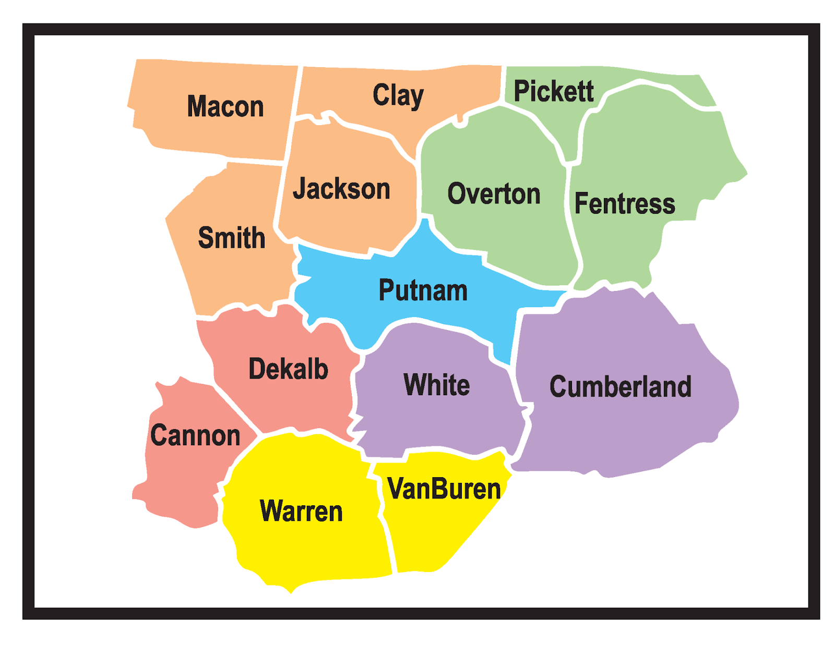
Upper Cumberland Region

Slide 4
The Recovery Mobility Manager
Mobility management focuses on the unmet needs of stakeholders and always returns to the stakeholders' needs, insights, and feedback while educating, coordinating, and promoting public transportation.
A Certified Peer Recovery Specialist (CPRS) is someone who has self-identified as being in recovery from mental illness, substance abuse, or co-occurring disorders of both mental illness and substance use disorder. To become certified, a CPRS has completed specialized training recognized by the Tennessee Department of Mental Health and Substance Abuse Services on how to provide peer recovery services based on the principles of recovery and resiliency.

Slide 5
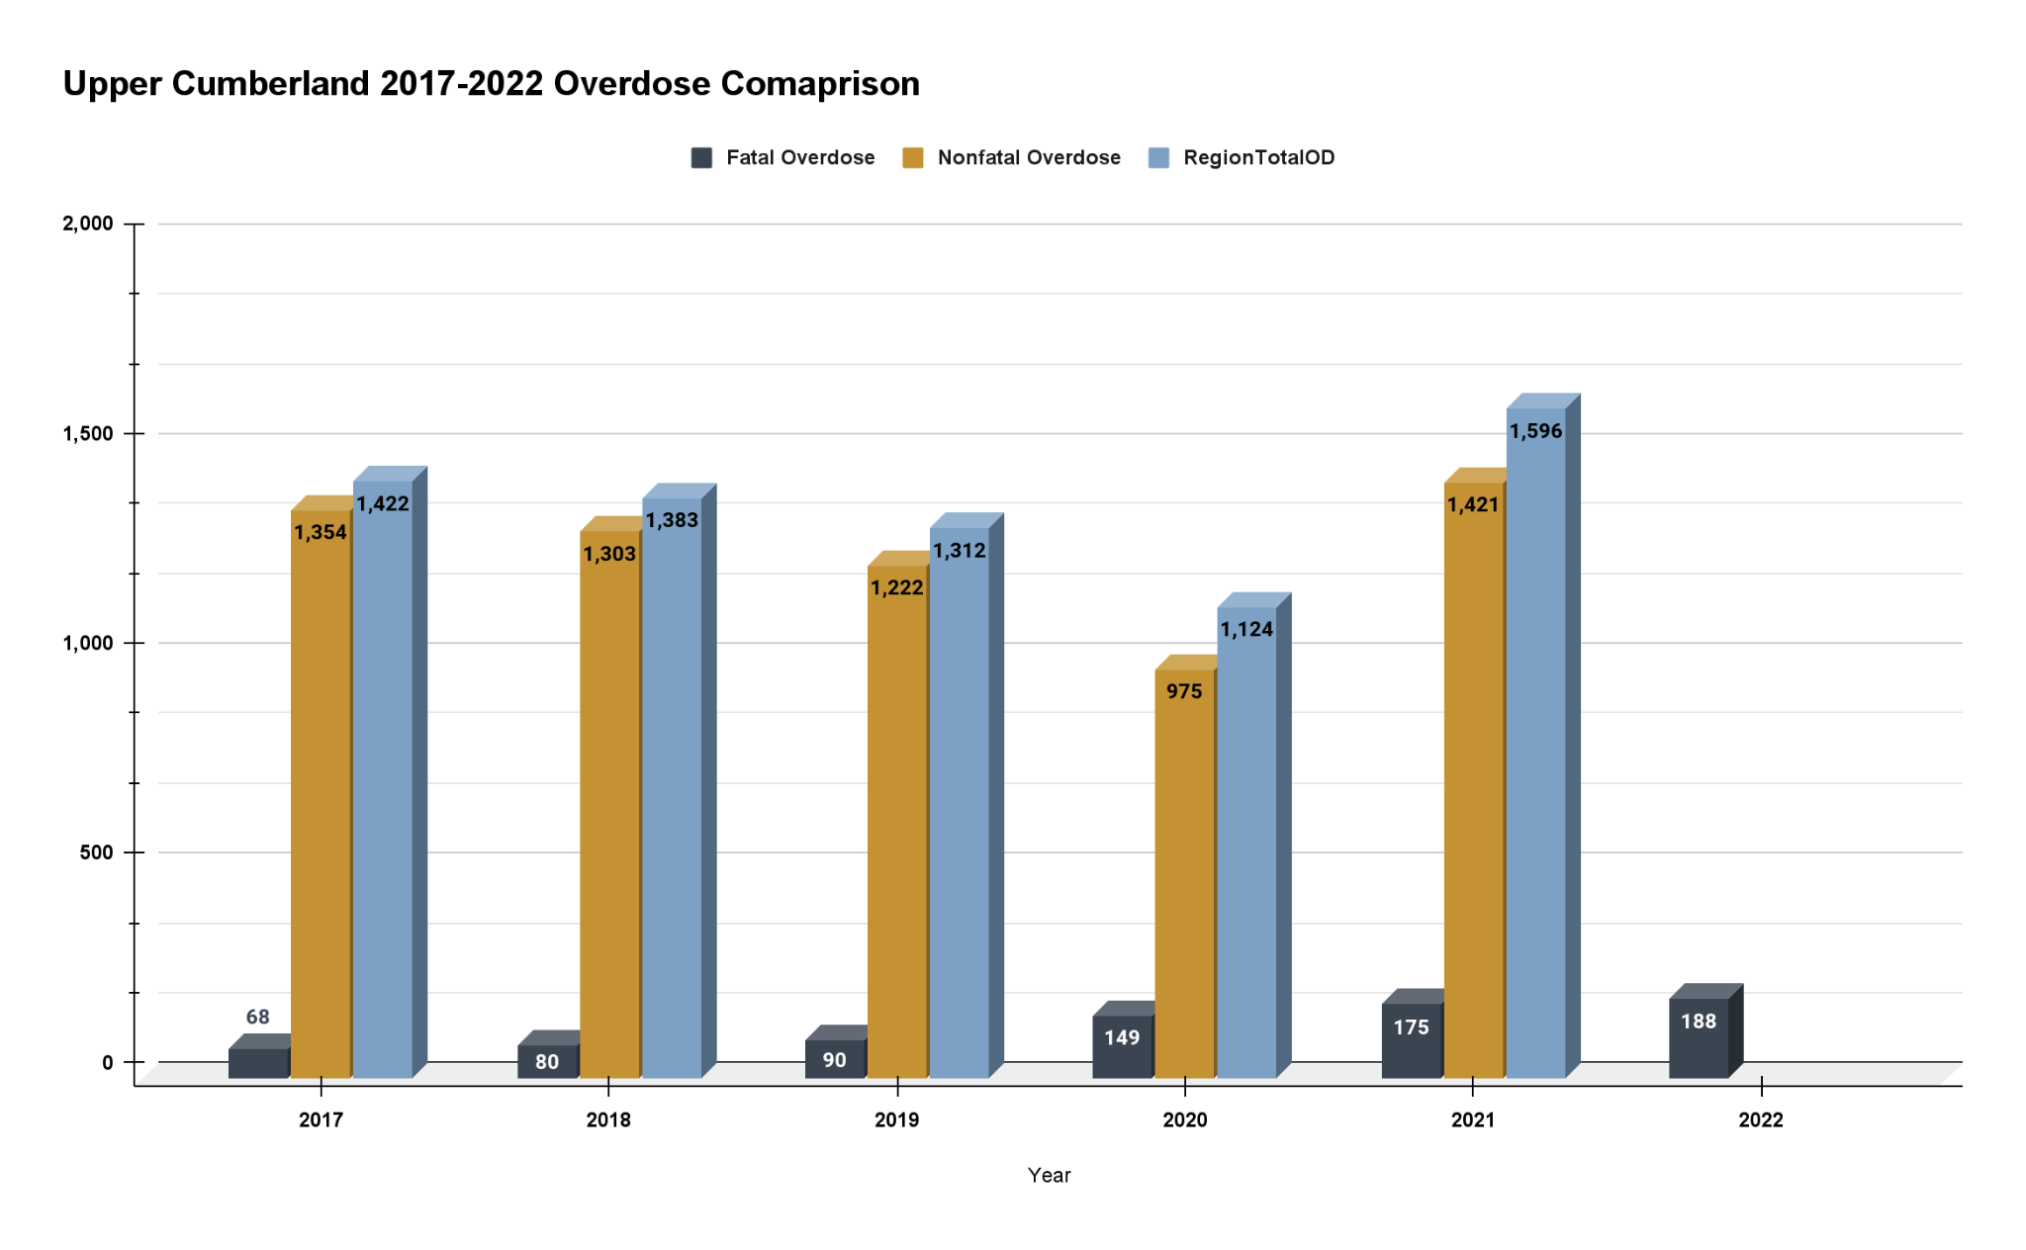

Slide 6
The Impact of Ride-to-Recovery
April 2023 to December 2023, R2R provided 137 trips to 54 riders
March 2022 to June 3, 2024, R2R provided 1,901 trips to 276 riders
36% of all rides utilized a CPRS Driver

Slide 7
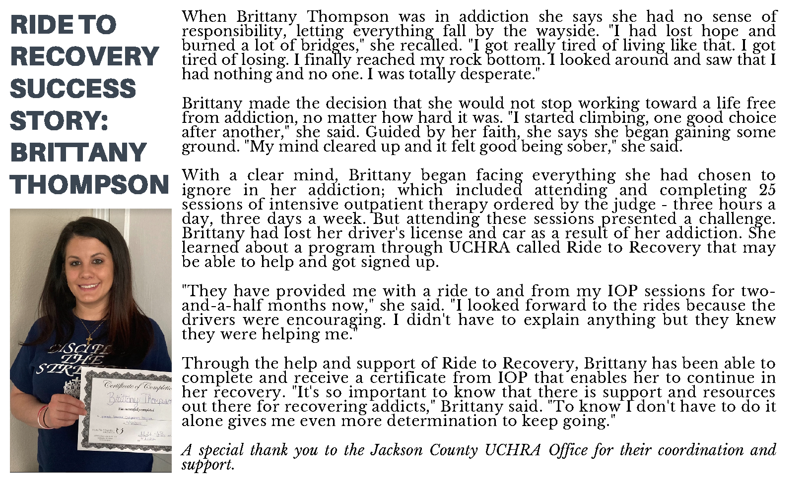

Slide 10
Colby Lane, TN Lifeliner
Dylan Johnson, TN Recovery Navigator

Slide 11
What’s next
Hire 14 CPRS that will be Public Transportation Certified Drivers Covering Every County of the Upper Cumberland
Provide Peer Support Services Throughout the Region
Access to Any Type of Transportation at Any Time

Slide 12
Our transportation decisions determine much more than where roads or bridges or tunnels or rail lines will be built. They determine the connections and barriers that people will encounter in their daily lives, and thus how hard or easy it will be for people to get where they need and want to go.
— Elijah Cummings
U.S. Congressman

