Slide 1
Service Coordinators in Affordable Housing
Connect residents to services and resources to assist them with aging well in their communities
5,000+ HUD Section 202 properties for older adults with service coordinators
500 Public Housing sites serving families with self sufficiency service coordinators
Notes:
Service coordinators assess residents, determine needs and build partnerships for programming.

Slide 2
Transportation Assistance By the Numbers
Transportation is the most-searched-for resource in My Community Directory powered by FindHelp
Service coordinators using AASC Online to track resident interactions in senior housing assisted 47,000 residents with transportation more than 143,000 times in 2023.
Most commonly they were connecting them to public transit (30,000+ times last year)
Most common reasons were to assist with shopping, errands and appointments
Service Coordinators using Family Metrics to track resident interactions in Public Housing assist with transportation often, too

Slide 3
Transportation Access in Affordable Housing
Residents are very low income and as a result less likely to have access to reliable personal transportation
Average income in HUD senior housing is ~$1,000/month
50% of Area Median Income is what most Public Housing residents earn annually
Lack of transportation can lead to reduced opportunities and social isolation
Average number of residents per HUD Senior Housing Property is 1.1 per unit
Notes:
I’m going to talk specifically about Section 202, which is subsidized housing for older adults ages 62 and older or indviduals who are disabled. This is the largest federally subsidized program specifically for older adults. But I should note there are other communities that are specifically for older adults.

Slide 4
Older Adults in Affordable Housing
75 years old
Lives alone
Average monthly income of $1,000
4 chronic health conditions

Slide 5
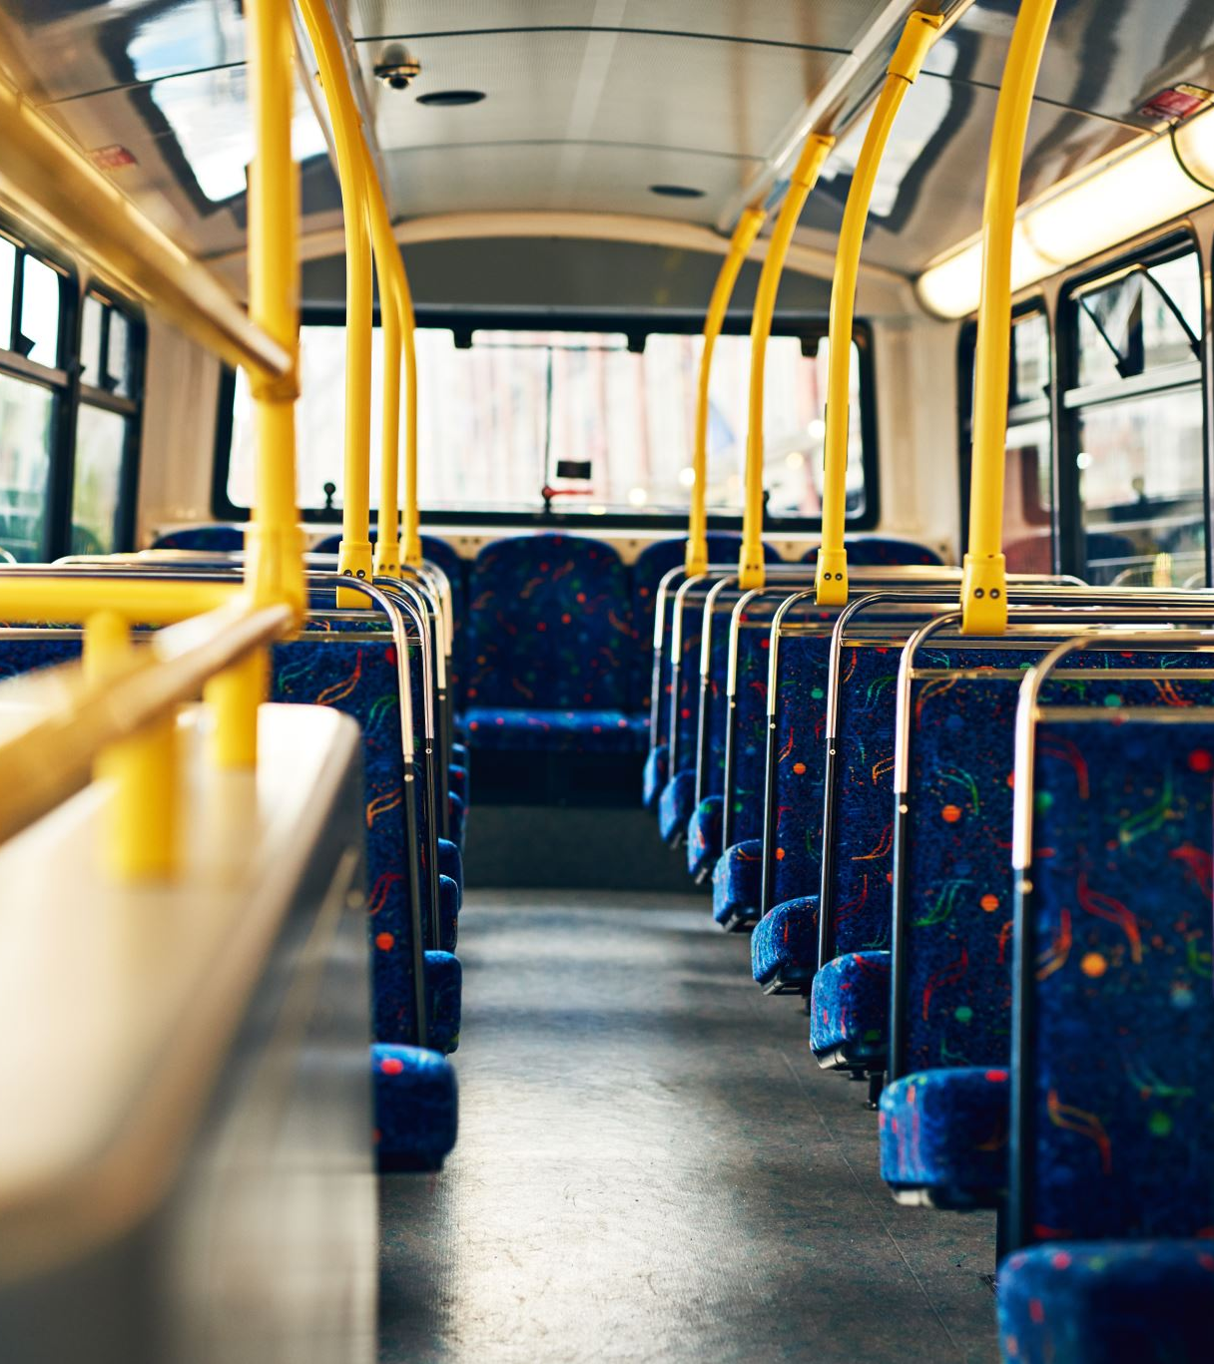
How Service Coordinators Help
Educating residents on public transit schedules and routes
Acquiring and disseminating reduced-cost or free bus passes
Advocating for public transit options within the community

Slide 6
Bringing Housing and Transportation Together
Find Service Coordinators in your Community
Connect with Developers Early
Build a strategic plan with housing in mind

Slide 7
Resources
Find Properties in Your Community
https://resources.hud.gov/
Making Transit and Affordable Housing Work Together
https://www.huduser.gov/portal/pdredge/pdr-edge-featd-article-061323.html
Connected Communities: Linking Affordable Housing and Transportation
https://www.huduser.gov/portal/pdredge/pdr_edge_research_071414.html
Notes:
There is no funding for programs, so they turn to partners in their communities to assist with these things. Examples include fire fighters calling bingo, teaching about health cooking. Culturally appropriate is important.

