Slide 1




SERVICE COORDINATION
X
TRANSPORTATION

Slide 2


CONTENTS
01
02
03
04
SC’s Role
Assessment
Education
Partnerships
05
06
07
08
Local Transit
Ride Share
Re-Assess
Questions?

Slide 3
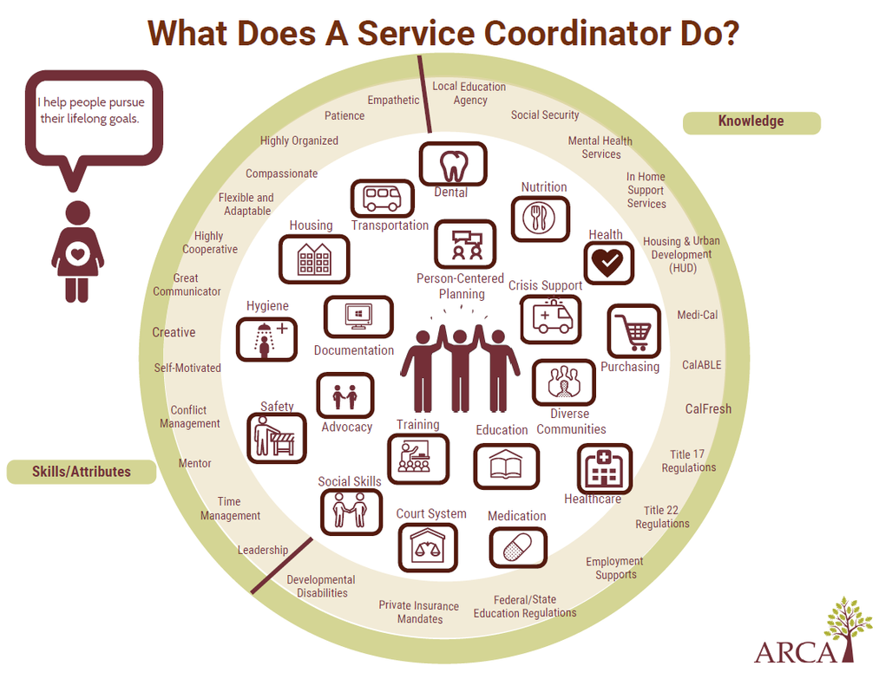
ROLE OF THE SERVICE COORDINATOR
Notes:
Advocation
Empowerment
Isolation Prevention

Slide 4





ASSESSMENT
Needs
Finances
Physical Ability
Technological Ability
As a service coordinator, we are required to complete needs assessments upon move in and each year afterwards.
We review the resident’s income, expenses, and financial stability,
We assess the resident’s disabilities, physical abilities, and assistance that is currently in place to assist with ADLs and IADLs.
We review the resident’s ability to use technology and which devices they currently posses.

Slide 5
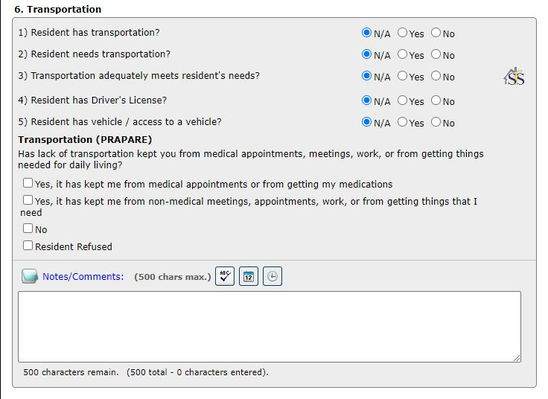

Slide 6



EDUCATION AND ADVOCATION
01
After completing an assessment, SCs address areas where needs were reported.
02
SCs educate residents on available resources and advocate for their needs with various agencies and companies.
03
Resident Service Need Goals are created with a time frame for completion.

Slide 7






PARTNERSHIPS
County Resources
City Resources
Community Resources
Various counties have transportation resources, including but not limited to, free transportation and transportation passes for public transportation.
Contact City Hall to inquire about local transportation.
Review resources provided by one’s company or property.
State Wide
District Resources
Town Resources
Review state-wide transportation legislation, as well as, insurance companies providing services in your state.
Contact Local Representatives to inquire about their platforms and available resources, especially concerns regarding the elderly.
Contact the Town Hall to discuss short distance transportation options.
Notes:
-Speaking to commissioners
-Advocating for Side Walks/Street Crossings
-Churches
-Some Towns have programs for Elderly individuals which they provide transportation or are aware of transportation services that they would be able to refer you to.
-Contact with Go Connect, discuss changing location to inside the property.
-Clinics often provide transportation as well.

Slide 8
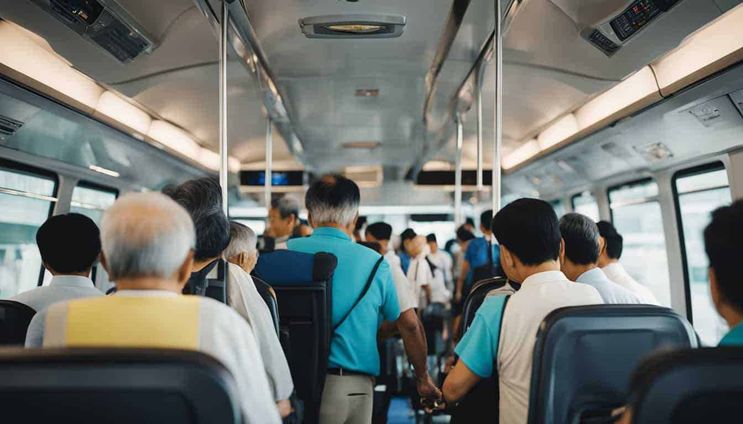
Pros
Cons
LOCAL TRANSIT
  Extensive Location options
  Accommodates most accessibility devices
  Physical Maps are provided
  Digital Option for Maps
  Has a Bus operator to answer questions
  Cost Effective
    Golden Passport/Easy Card
  Walk to and From Bus Stops
  Close Space with others
    concerns for transmission
  Security Concerns
  Concerns with Individuals with impaired memory
  Wait time on route
  Limitations to have rider assistance due to additional rider having to pay
For our more physically able residents, local transportation is a popular resource. There are pros and cons to using public transportation that must be discussed with the resident as well.

Slide 9
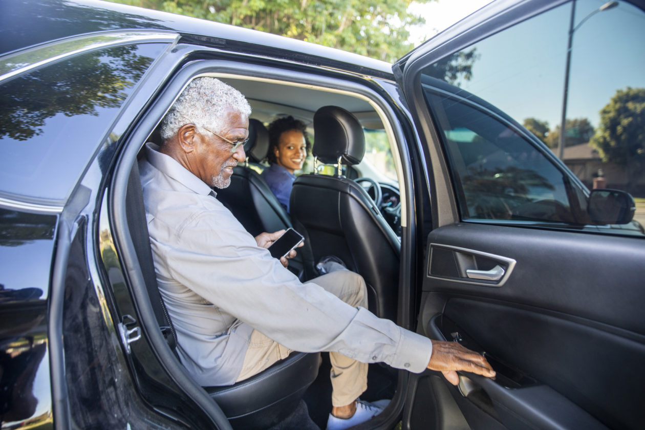



RIDE SHARE
For residents who are financially able to afford ride-share services, there are options available through their insurance or out-of-pocket cost. Below are examples of commonly used transportation methods.
  Insurance Based
  Uber/Lyft
  Go Connect
STS
  Can Travel to any desired location
  Can travel solo or with others
  Need understanding in using technology
  Often does not accommodate for accessibility devices.
  STS
  Clinic Transportation
  Medicaid or Medicare Specific Transportation
Local Transportation provided to any location within the boundaries of the Town of Cutler Bay
Notes:
Insurance
-STS
-Clinic Transportation
- Medicaid/Medicare Specific Transportation

Slide 10




RE-ASSESSMENT
Review if service needs were met in a timely manner
Inquire about any additional or new physical ailments impeding mobility.
Review the resident’s concerns or compliments regarding current transportation

Slide 11





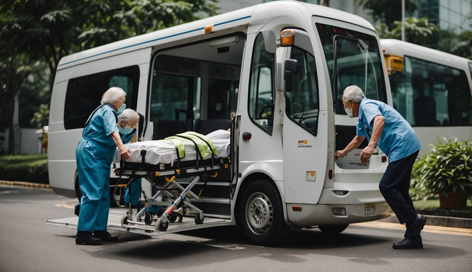
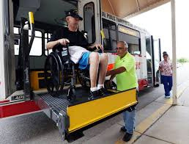

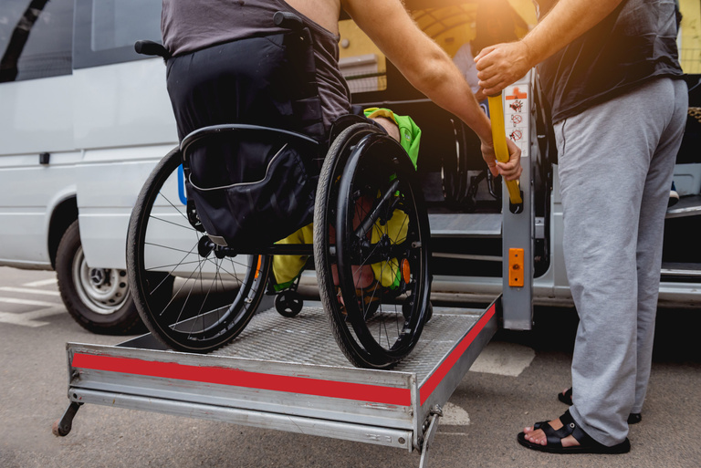

THANKS FOR WATCHING

