Slide 1
How Community Health Workers Can support transportation needs
Monique Allen,
CCHW, BS, GCDF
Board President, CACHW
Notes:
Introduction: Hello all I am Monique Allen a community health worker for a national team as well as the board president for the state of California community health worker association. I am also one of the authors on a published article with Stanford on “Exploring Individual Identity, Belonging, and Collective Organizing of Community Health Workers (CHWs) in California.”

Slide 2

Agenda
Introduction
Lived Experience
Community trust
CHW involvement

Slide 3
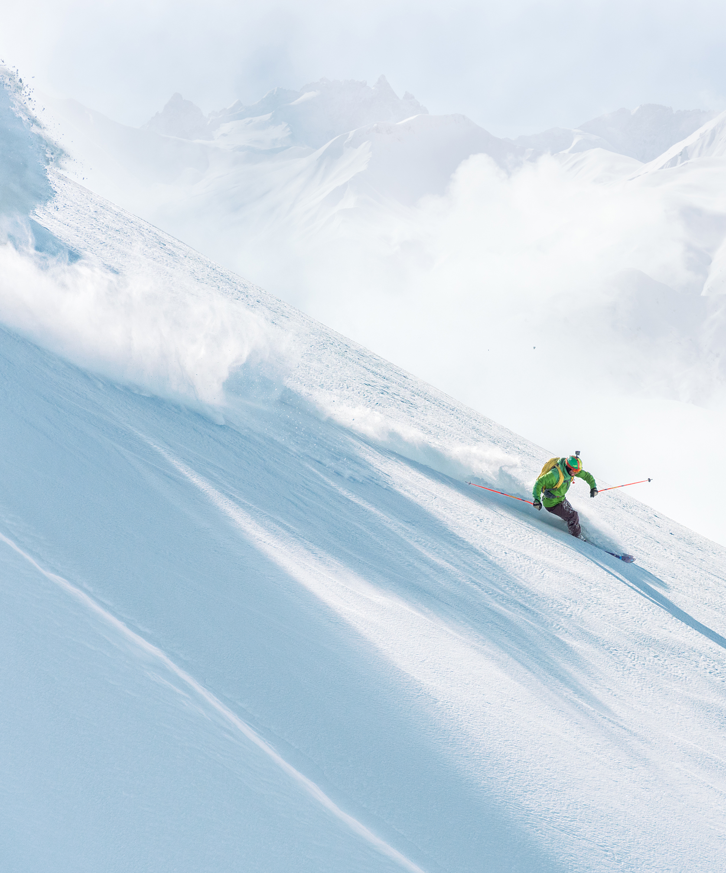
Who are CHWs?
A community health worker is a frontline public health worker who is a trusted member of and/or has an unusually close understanding of the community served. This trusting relationship enables the worker to serve as a liaison/link/intermediary between health/social services and the community to facilitate access to services and improve the quality and cultural competence of service delivery. (American Public Health Association)
A community health worker also builds individual and community capacity by increasing health knowledge and self-sufficiency through a range of activities such as outreach, community education, informal counseling, social support and advocacy. (National Association of Community Health Workers)

Slide 4
Lived Experience
Health care and services must bridge cultural and linguistic divides to serve all communities equitably. As trusted community members with lived experience, community health workers and promotores (CHW/Ps) have a long history of connecting those not well served by the traditional health care system with culturally competent health and social services.
In California, CHW/Ps are increasingly recognized as a critical part of the workforce. In 2019,The California Future Health Workforce Commission recommended scaling the CHW/P workforce to broaden access to preventive and social support services as well as team-based integrated primary and behavioral health care.
Notes:
My lived experience: When I move from LA to Victorville standing out waiting on the bus. As one example.

Slide 5
Community Concerns
Tribal/Rural area needs
  Roads
  Public transportation access
  Hours of operation
Notes:
Hours of operation: If you have a job and need to get home and live in a rural area most likely the buses stop at about 8 pm.
Addressing concerns: Holding community of practice meetings, hearing the concerns, and coming together to address those concerns looking at who needst to be involved and the steps that needs to be taken to get there
Locally working with the city to work on improving the health needs of community including safer streets for walking and cycling

Slide 6
CHW Involvement
State CHW associations
  Joining associations to learn the needs
  Become a board member
  Partner with local health Departments and Community based organizations
    Health needs assessments results (Health Dept)
    Address needs from results
Have a CHW on committees
  CHWs know the disparities in the local areas
  CHWs understand the communities they serve
  Utilize CHWs to conduct surveys and collect data on community needs

Slide 7
Example of CHW/Community impact
https://smartgrowthamerica.org/what-are-complete-streets/
Notes:
https://smartgrowthamerica.org/what-are-complete-streets/
This is an example of how a team came together and addressed safety…Complete Streets is an approach to planning, designing and building streets that enables safe access for all users, including pedestrians, bicyclists, motorists and transit riders of all ages and abilities. This approach also emphasizes the needs of those who have experienced systemic underinvestment, or those whose needs have not been met through a traditional transportation approach, such as older adults, people living with disabilities, people who don’t have access to vehicles, and Black, Native, and Hispanic or Latino/a/x communities.
This is just an example of how the community can come together and create change for the betterment of the community

Slide 8
Final tips & takeaways
Involve CHWs in the decision-making process
Get involved in local CHW associations
Partner with local health departments
CHW are trusted members of the community
CHWs know the disparities of the community

Slide 9
Thank you
Monique Allen
760 912-0542
myallen2@wisc.edu
Monique@fimswomen.com

