Slide 1
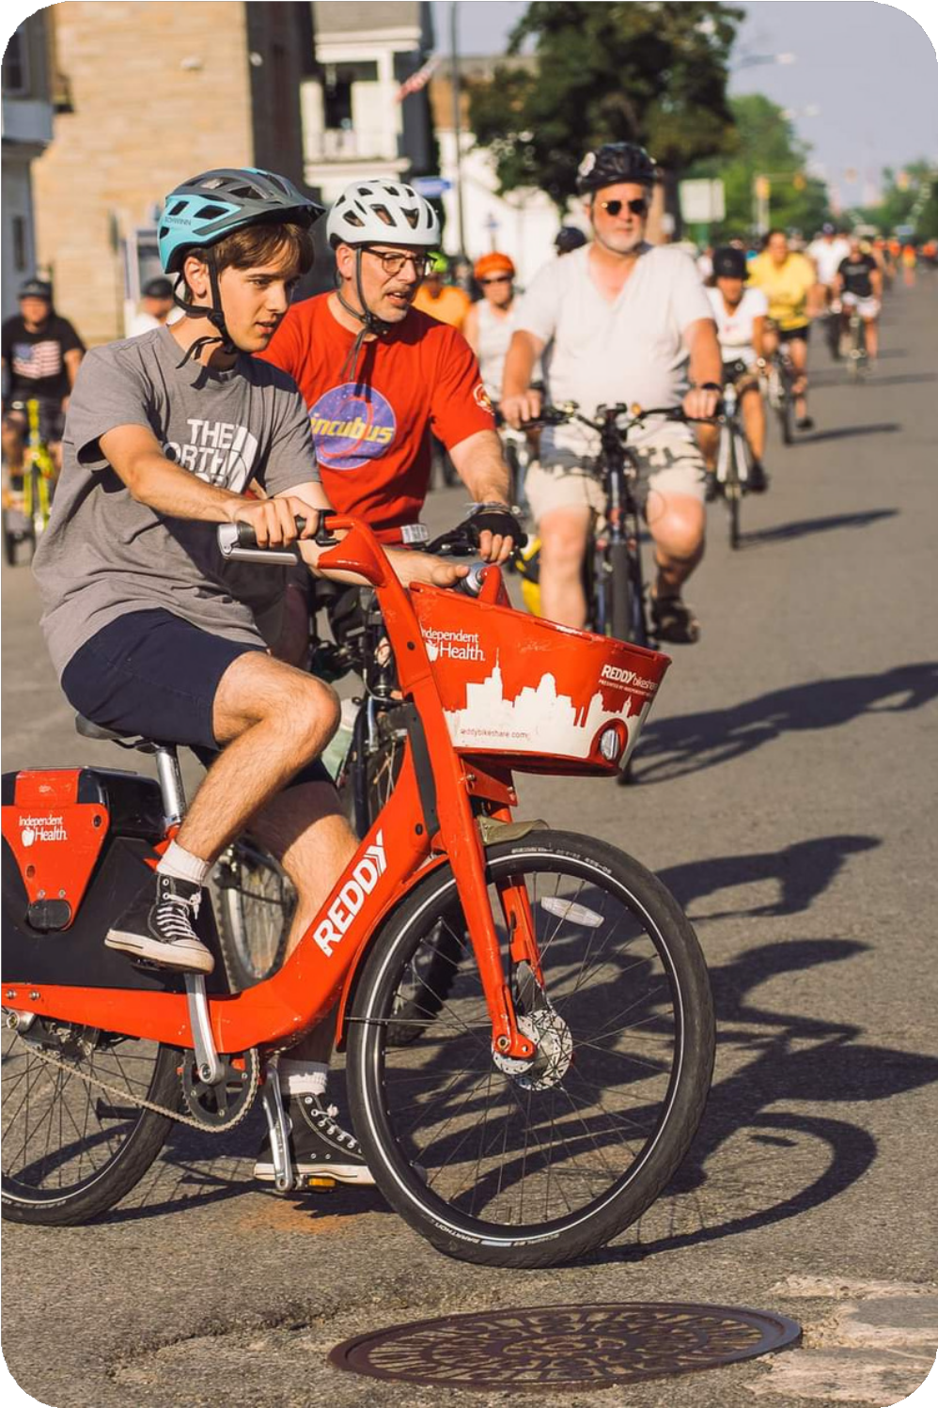


Community
Based
Micro Mobility
&
Transit Partnerships
Expanding the reach of transit by reducing barriers to e-bikes

Slide 2

Tyler
Madell
Program Director,
Shared Mobility Inc.

Slide 3
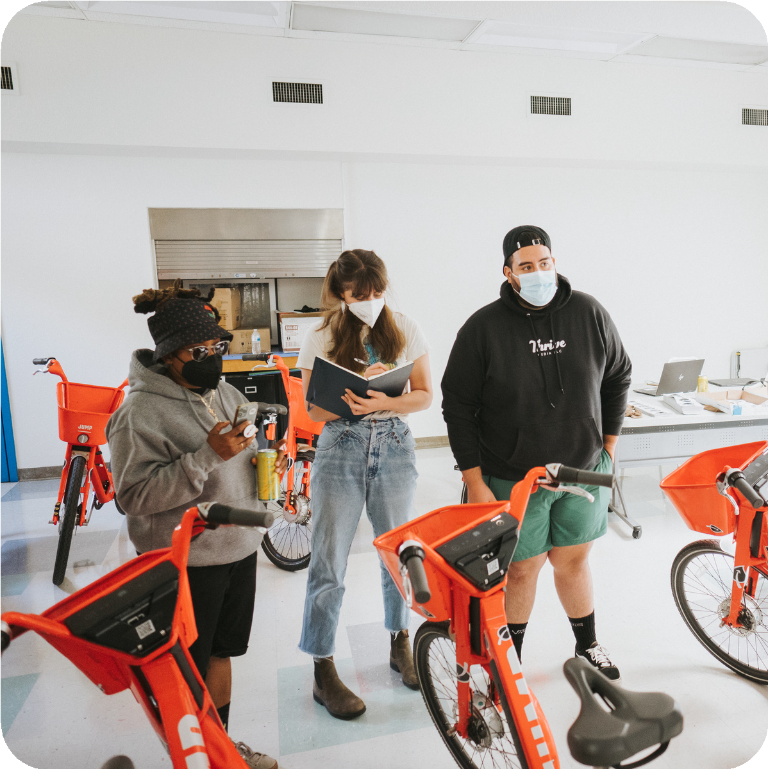
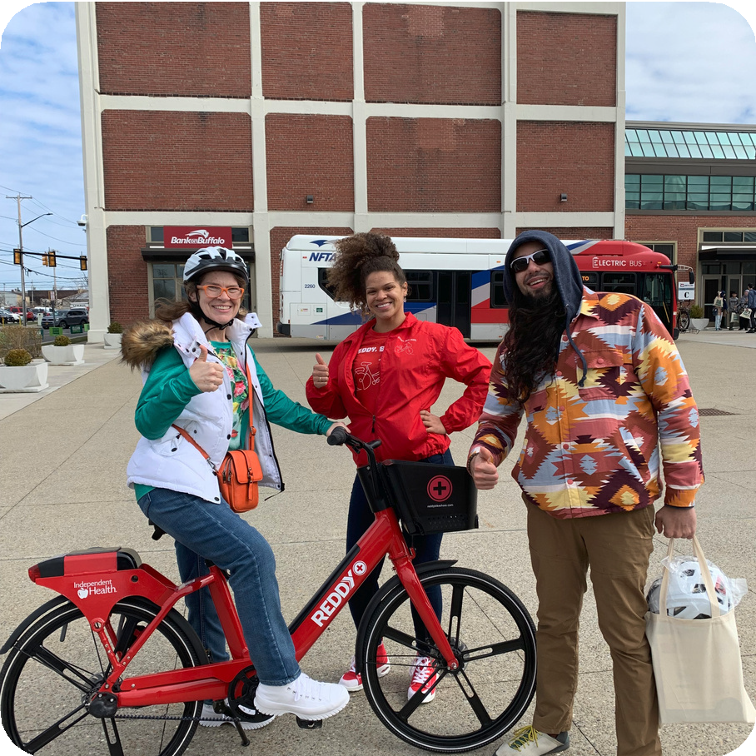
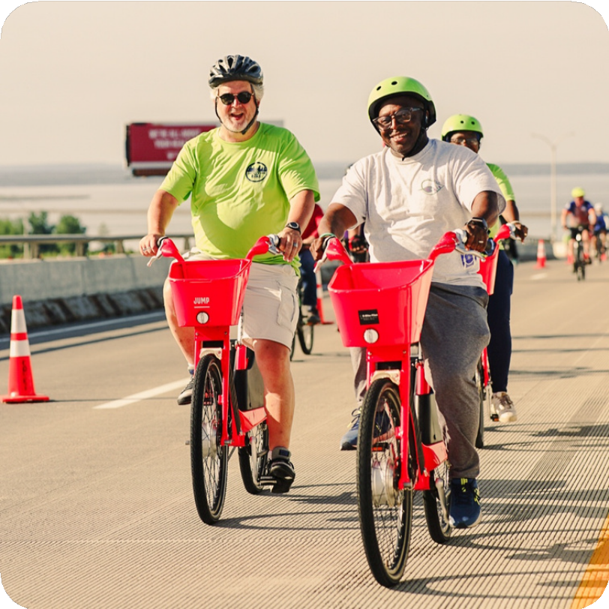
Shared Mobility Inc. Local ownership Why e-bikes?
Bikeshare
E-bike Libraries E-bike Incentives
Presentation Topics

Slide 4
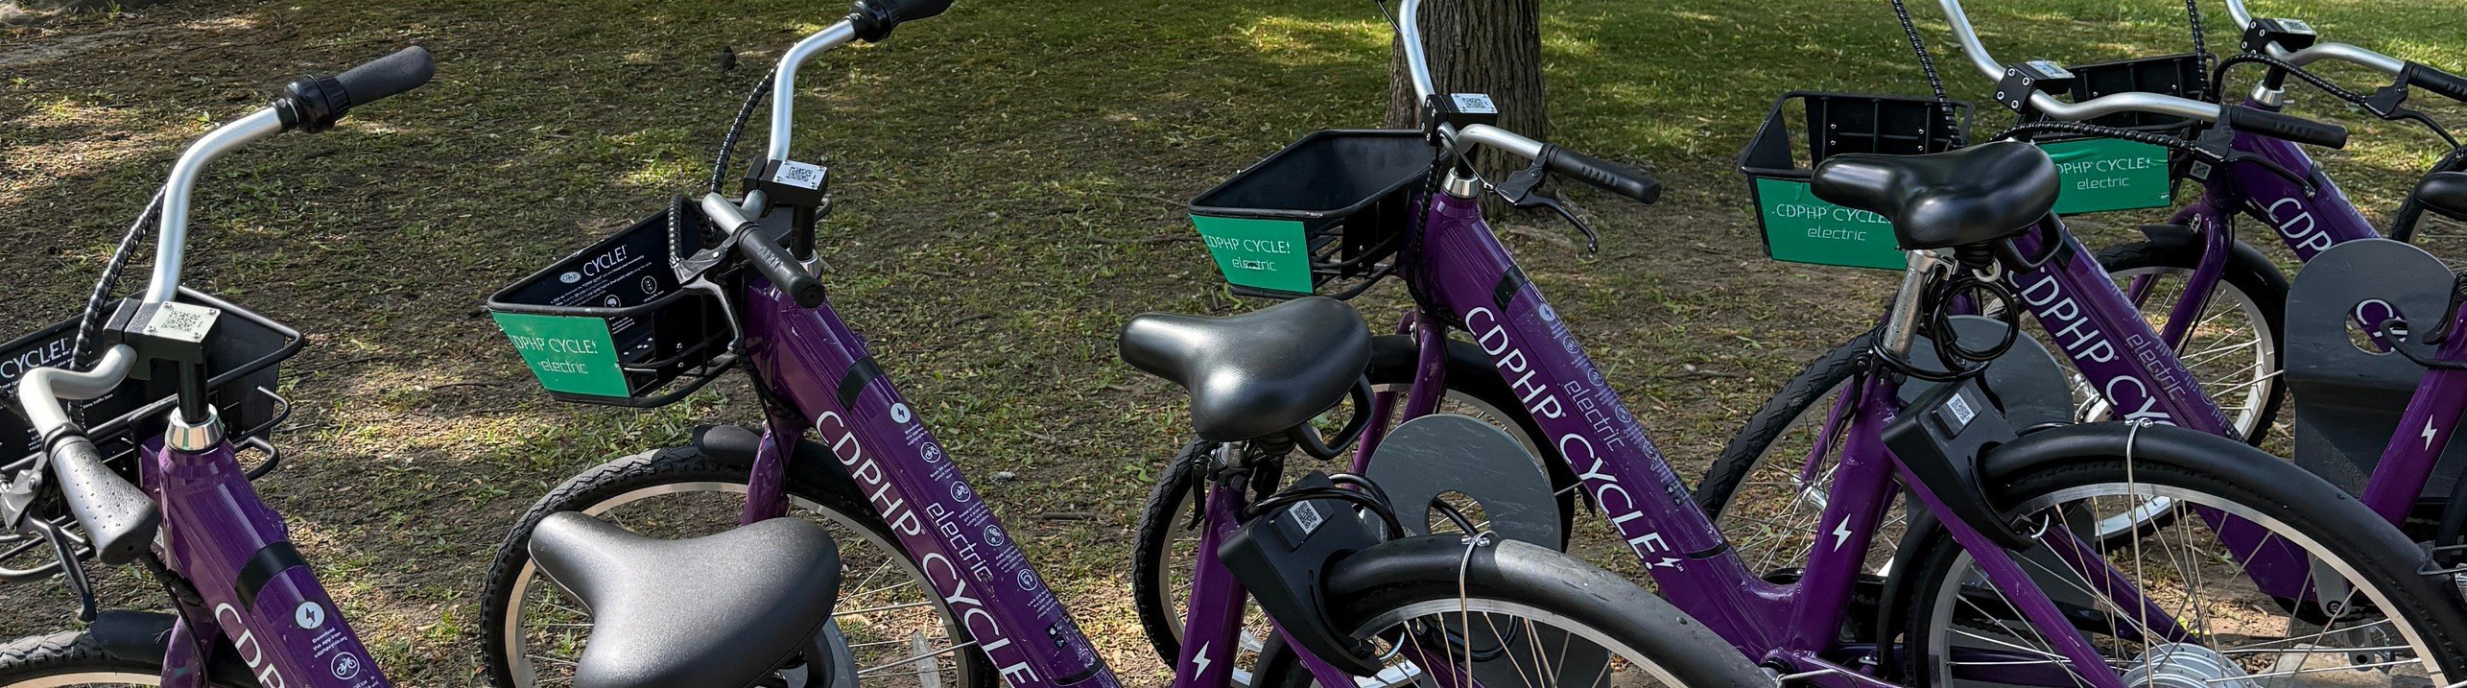

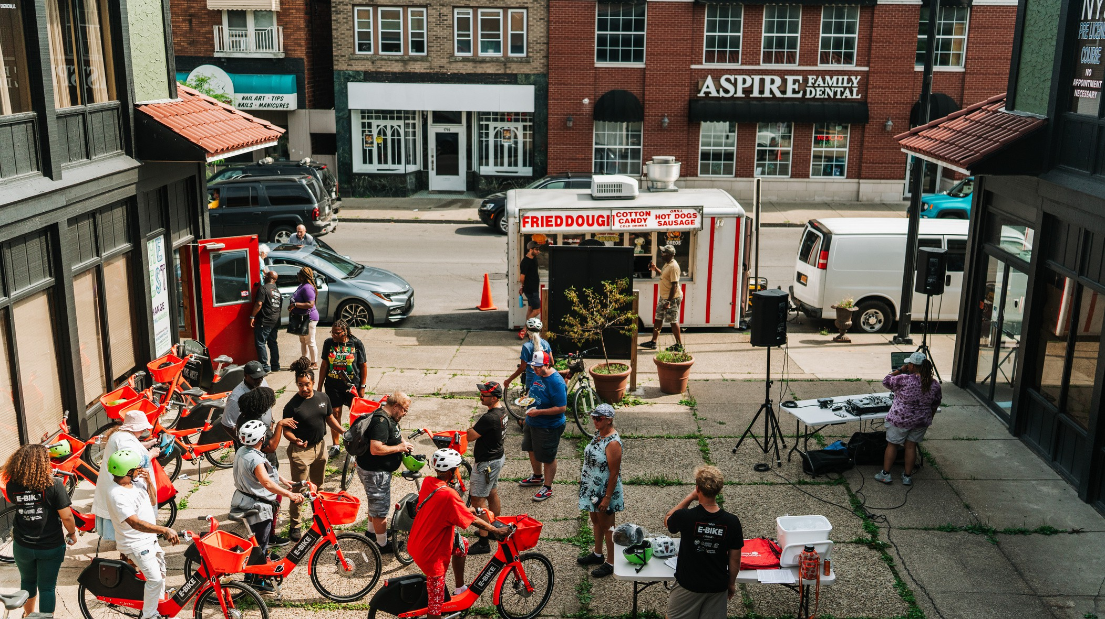
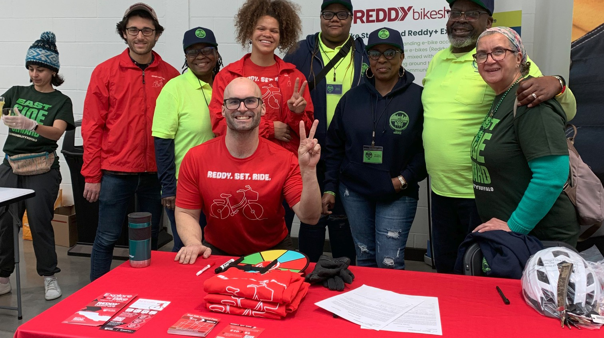
Shared Mobility Inc.
An upstate NY based nonprofit thatworks to build innvoative transportation programs with local partners nationwide.

Slide 5
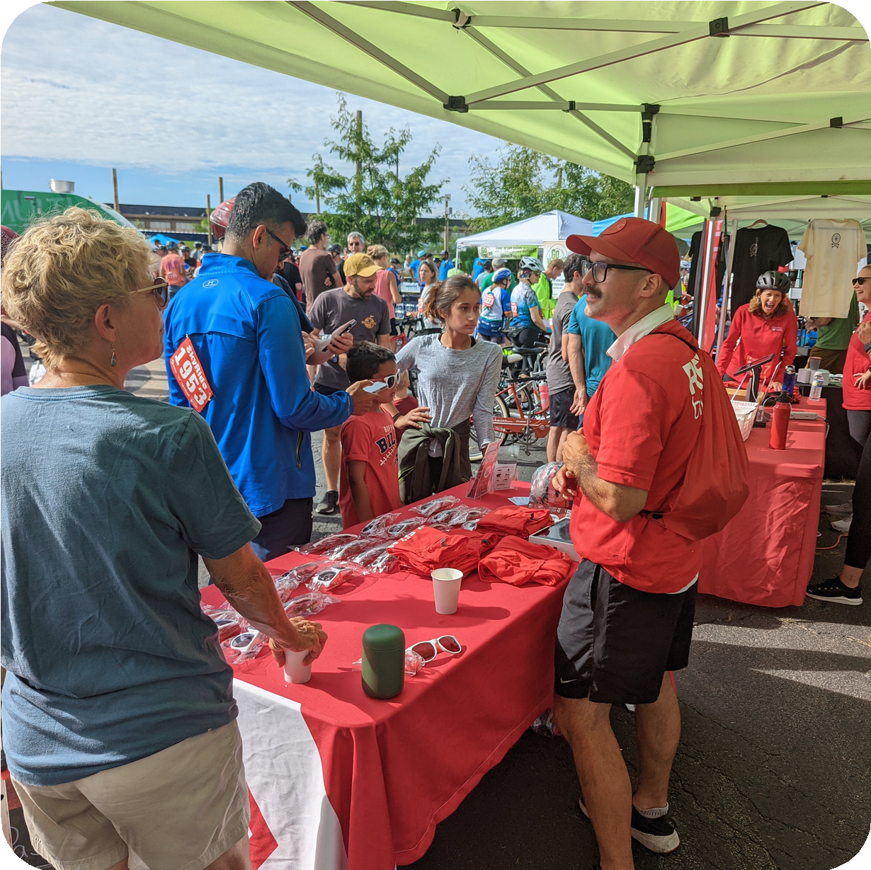
Why should micro
mobility be
community based?
Understanding the local
context
Affordability and sustainable
programming
Responsiveness to community
needs
Enhancing connectivity with
public transit and community
based organizations

Slide 6
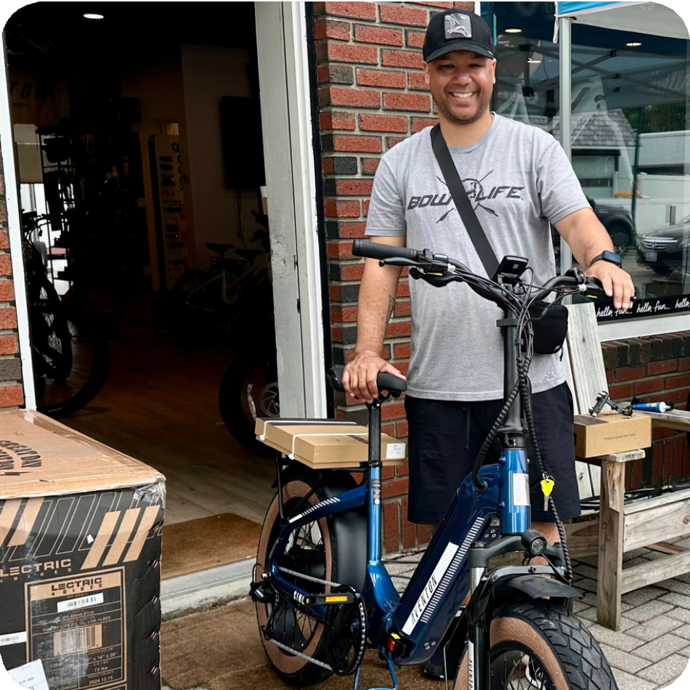
Why
e-bikes?
More versitle than regular
pedal bikes
Reducing barriers to bicycling
Newer technology has made
e-bikes more affordable

Slide 7
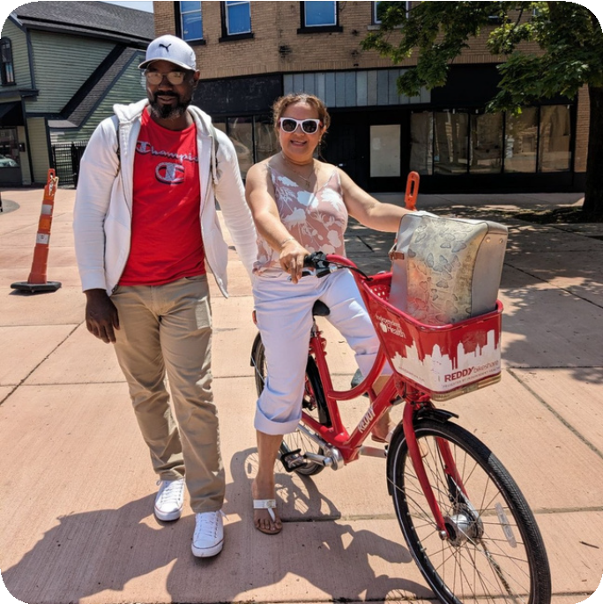
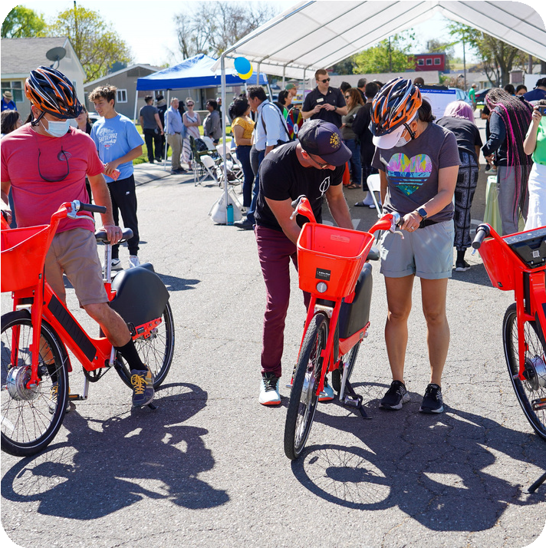
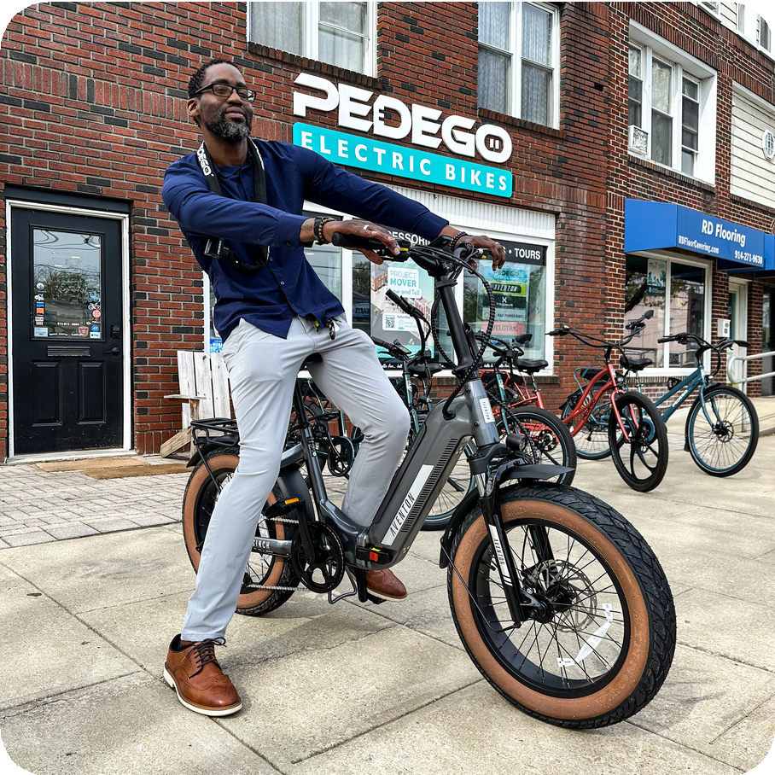
Community E-bike Programs
Three e-bike access programs that we’ve been working on at Shared Mobility Inc.
Bikeshare
E-Bike Libraries
E-Bike Incentives

Slide 8

Bikeshare
E-bikes are publicly available
for short term rental
First/last mile connections
Affordable way to try e-bikes
Historically has not
adequately served
disadvantaged communities

Slide 9
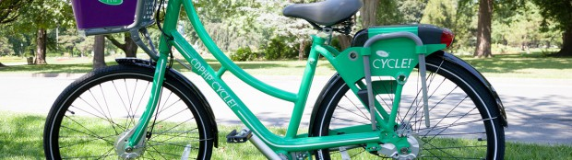
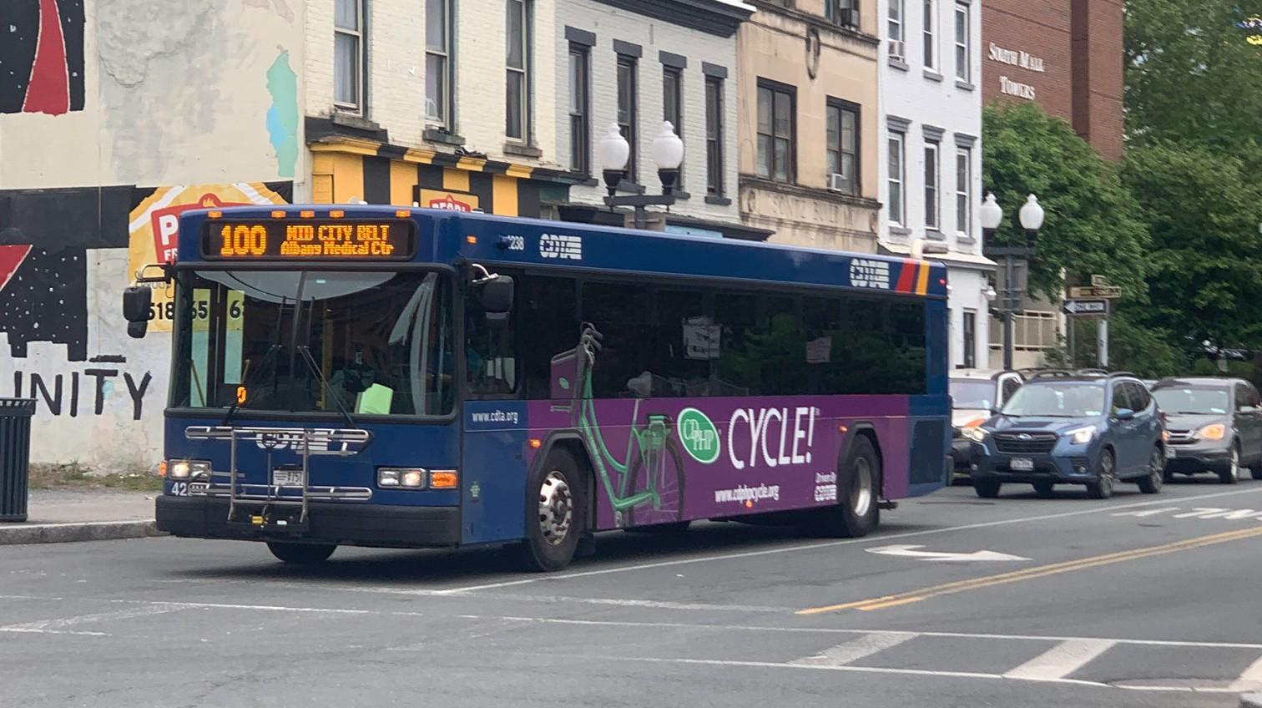
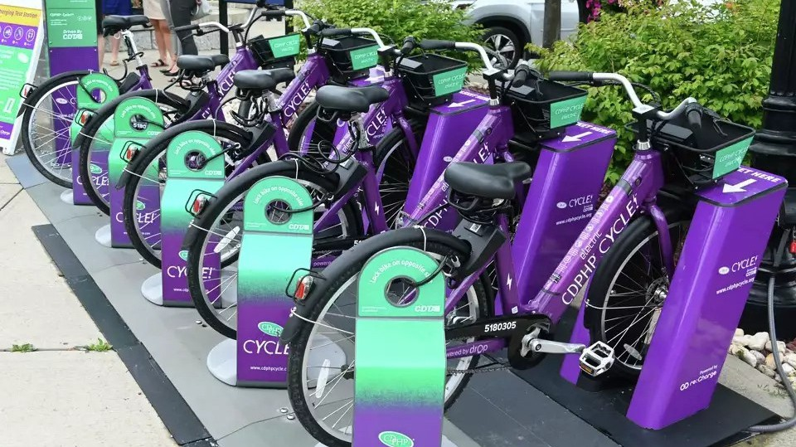
CDPHP Cycle! Capital Region, NY
Bikeshare program serving several upstate NY municiaplities, owned by the Capital District Transportation Authority (CDTA)

Slide 10

E-Bike
Libraries
Fleet of e-bikes based at a
CBO
E-bikes are free or ultra low-
cost to borrow
CBO programming around
bicycling and e-bike safety
Introducing bicycling to new
populations

Slide 11
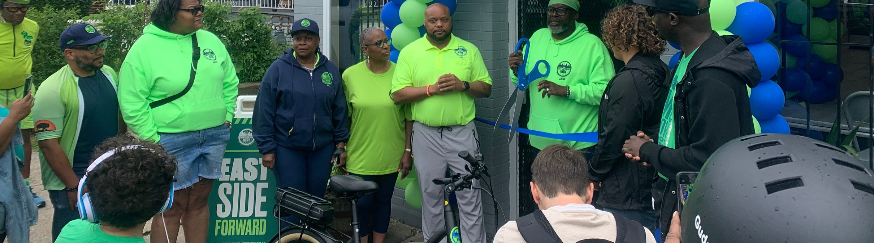
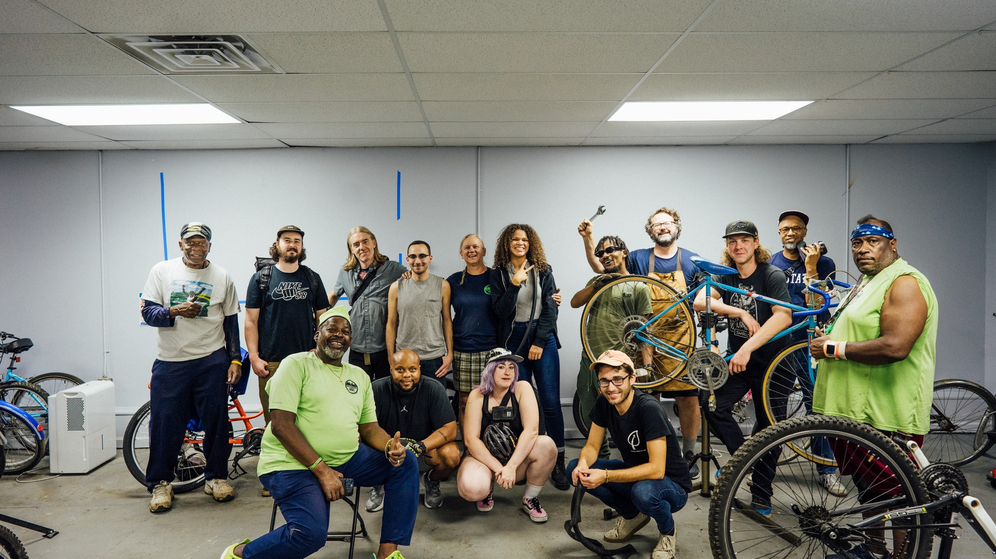
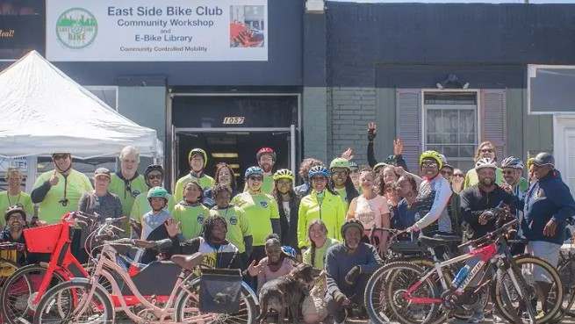
East Side Bike Club Buffalo, NY
E-bike Library program centered in Buffalo’s East Side that provides
e-bikes for residents to borrow for $1.

Slide 12
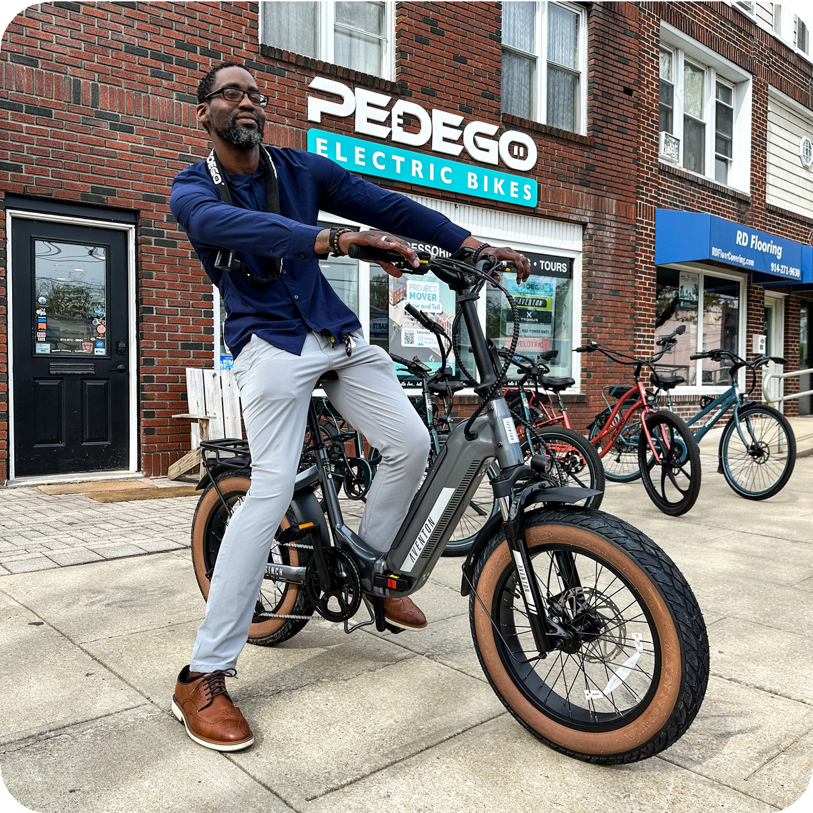
E-Bike
Incentives
Point-of-sale rebates for
purchasing e-bikes
Incentives are higher for
people with lower incomes
Safety education
Supporting local e-bike
retailers

Slide 13
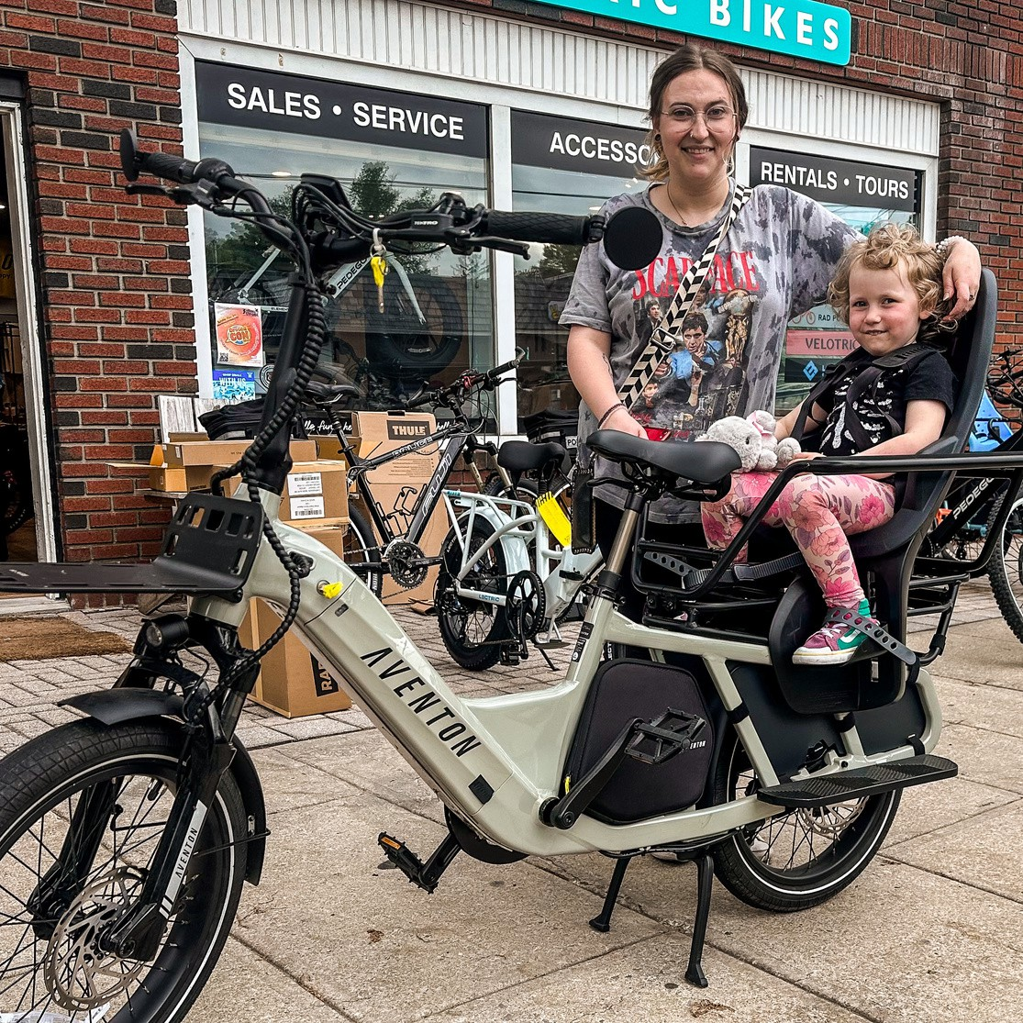
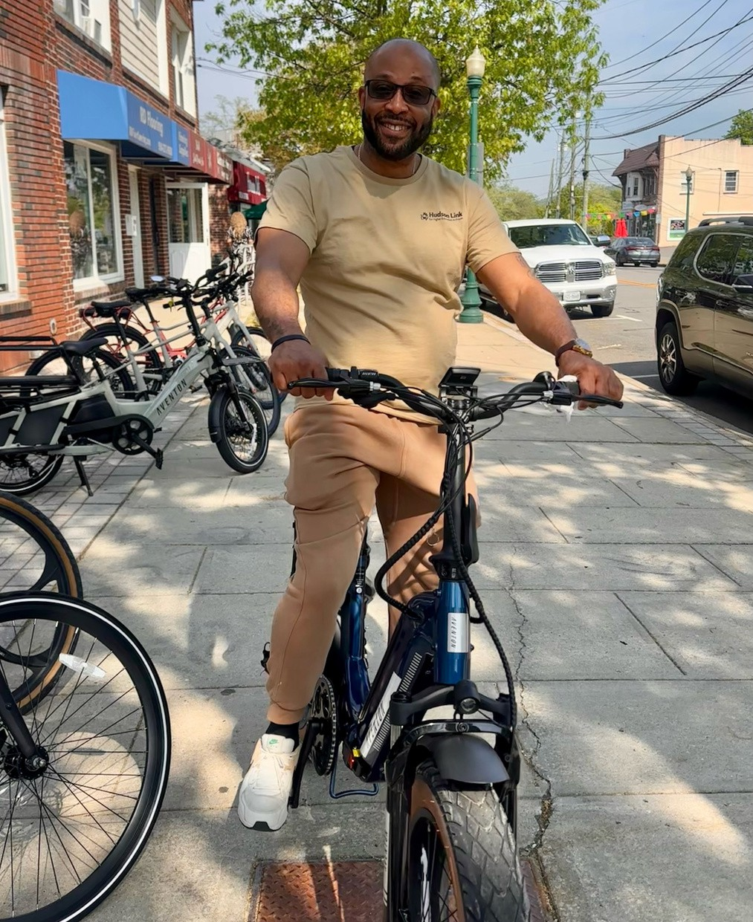
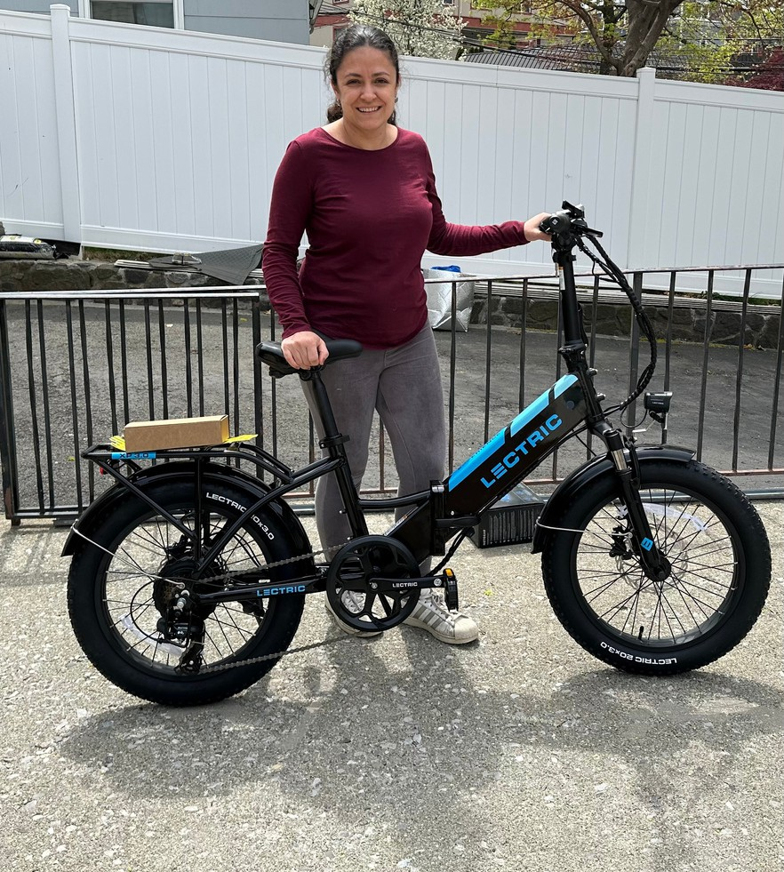
E-Bike Incentive Programs Buffalo &
Westchester Co, NY
Pilot programs that are providing the first e-bike incentives in NY state.

Slide 14
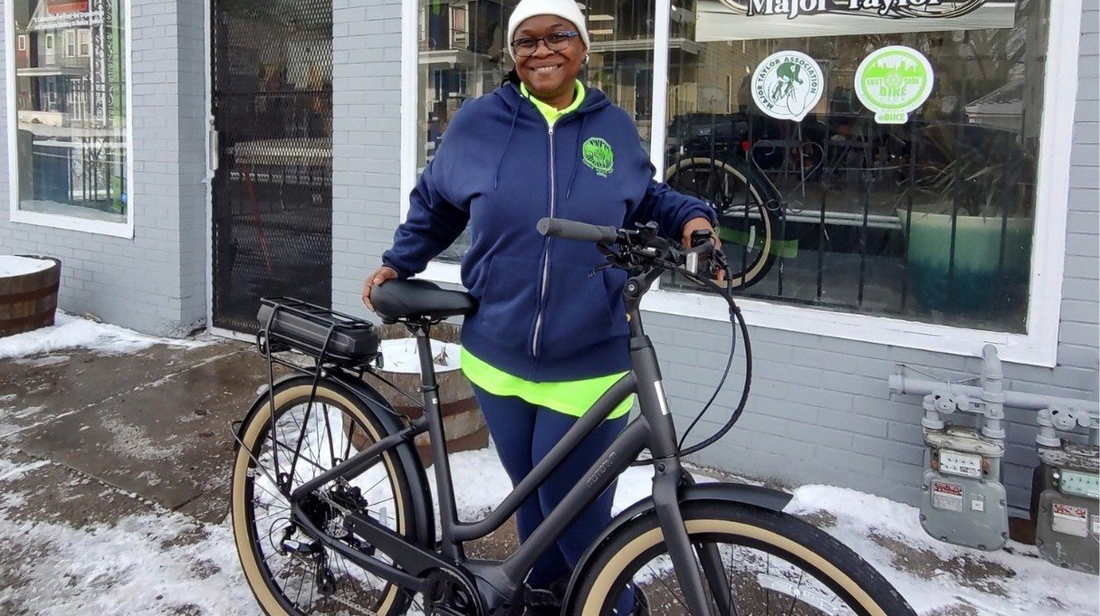
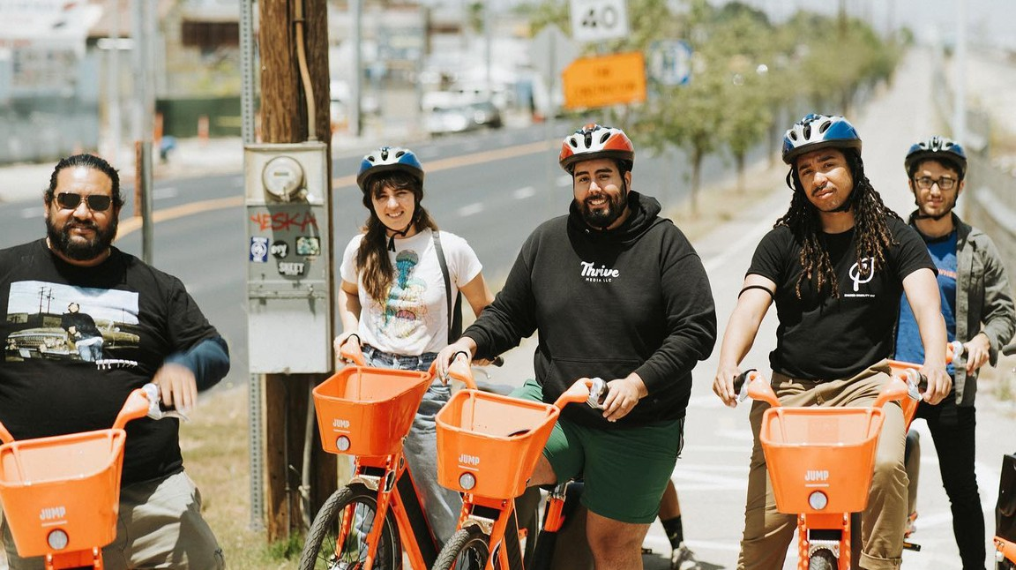
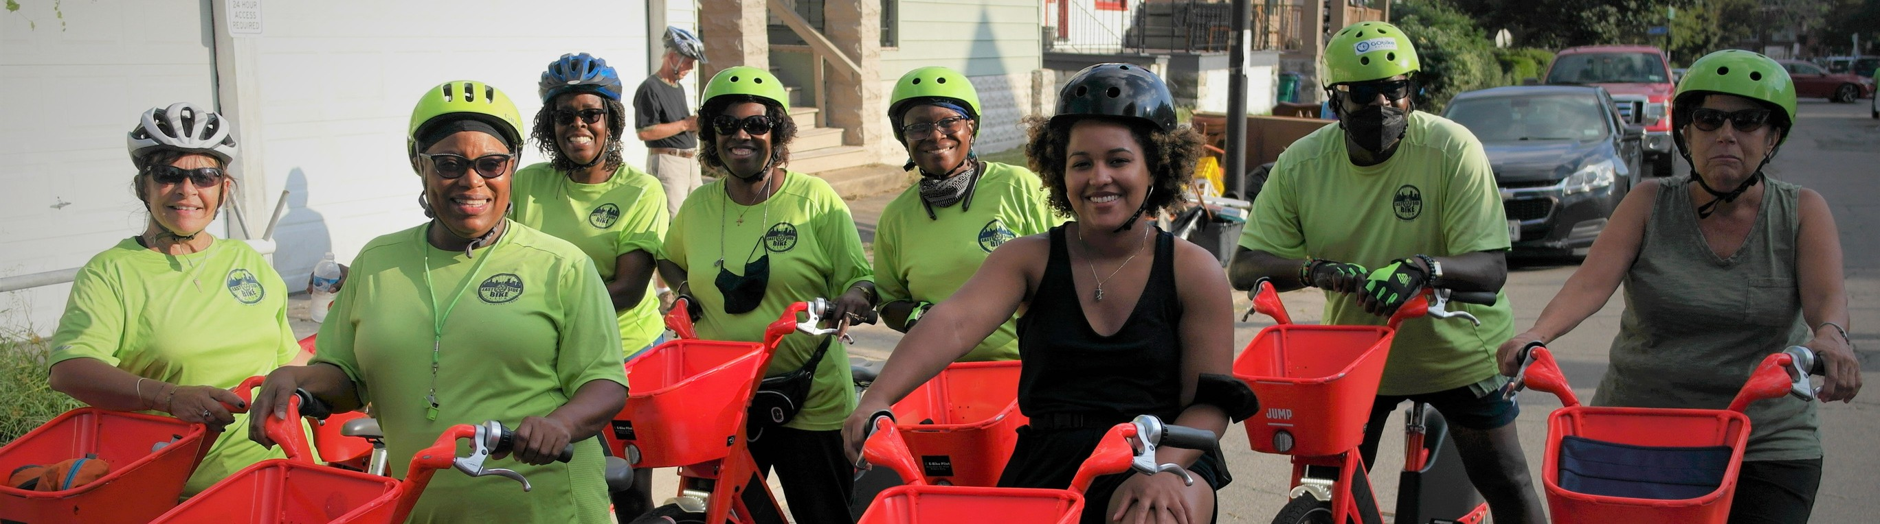
Where do we go from here?
Where do you see opportunities to integrate e-bike programs in your projects?

Slide 15
Thank You!
Tyler Madell tyler@sharedmobility.org

