Slide 1
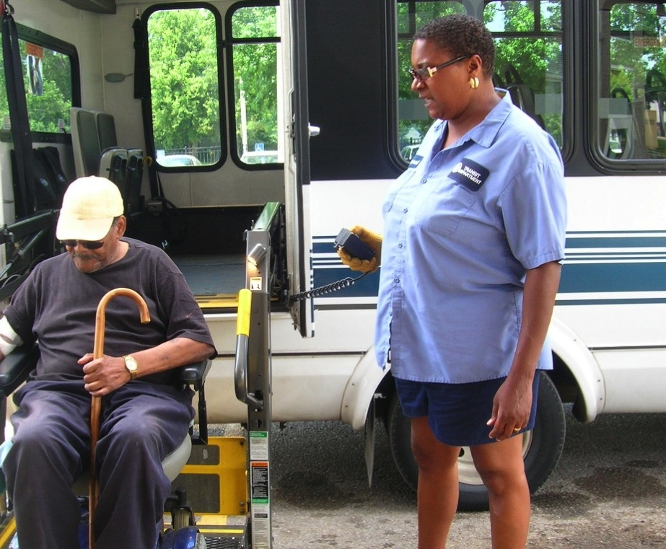


February 12, 2016
Operation Easy Access

Slide 2
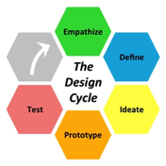
Our challenge…
Design an innovative solution to improve access to post-hospitalization medical care to help low-income, older adult(65+) patients in South King County avoid rehospitalization.

Slide 3
Why now?
Provider Perspective
Patient Perspective
Readmission cost
> $11,500/patient
Shorter hospital stays present
discharge planning challenges
Resource sharing fragmented among care and navigation teams
Case loads high
Socially complex patients
Many patients don’t drive or have funds
Limited transportation contracts /expensive
54% of South King County households are low-income but…
…many do not qualify for Medicaid NEMT
Lack of awareness
No longer drive, lack of social support
Few no and low-cost transportation services
Overwhelmed with discharge instructions/meds
Notes:
Incentive programs motivate people to take responsibility for improving and managing their own health. By driving and sustaining behavior change, incentive-based rewards and
Today, health rewards is a foundational
technique in the health care community to drive consumer and provider behavior. When financial incentives are aligned to the behaviors that improve health or optimize
utilization of health resources, everyone in the health care community wins. Michael Dermer, “'Be Healthy and Be Rewarded' -- With Rewards in Health Care... Everyone Wins!”, 2015. HuffPost Healthy Living, Huffingtonpost.com. Accessed Jan. 29, 2016. http://www.huffingtonpost.com/michael-dermer/be-healthy-and-be-rewarde_b_7890980.html

Slide 4
Might there be a better way to improve access to post-discharge medical care?
To help reduce hospital readmission costs and improve patient outcomes?
There IS!

Slide 5

The patient journey…. let’s meet Margaret

Slide 6
What is the
Care Mobility Rewards Program?

Slide 7

An incentivized healthcare transportation program that improves healthcare access for low-income, older adult discharged Medicare patients in South King County while helping hospitals reduce
30-day hospital readmissions.

Slide 8
Why a patient rewards program?

Slide 9









Workshop
25 professionals from healthcare, transportation, and social services
7 solution concepts and prototypes designed
6 themes emerged
Notes:
Among the great ideas and energy in the workshop, one of the 7 solution concepts generated much excitement and interest.
The idea of a credit-based award system for healthcare transportation.

Slide 10
Why Patient Rewards?
Enablement + Incentive-based Rewards
Disconnect of continuum of care following discharge
CMS-support for payer rewards & incentives
Potential to influence required and recommended post discharge behavior
Patient behaviors ultimately affect health outcomes
Re-directs existing transportation funds into incentivized patient rewards program
“Joint-production” of patient care gaining traction
Existing high rewards program adoption
“70 percent of all healthcare costs are linked to behaviors.”
- Accenture
“Today, health rewards is a foundational technique in the health care community to drive consumer and provider behavior.”
- Michael Dermer, leading expert on healthcare incentives
Notes:
Incentive programs motivate people to take responsibility for improving and managing their own health. By driving and sustaining behavior change, incentive-based rewards and
Today, health rewards is a foundational
technique in the health care community to drive consumer and provider behavior. When financial incentives are aligned to the behaviors that improve health or optimize
utilization of health resources, everyone in the health care community wins. Michael Dermer, “'Be Healthy and Be Rewarded' -- With Rewards in Health Care... Everyone Wins!”, 2015. HuffPost Healthy Living, Huffingtonpost.com. Accessed Jan. 29, 2016. http://www.huffingtonpost.com/michael-dermer/be-healthy-and-be-rewarde_b_7890980.html

Slide 11








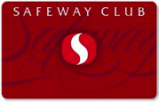
26% increase in loyalty program memberships
2012 - 2014
Drug stores
Airlines
Bookstores
Restaurants
Grocery stores
Retail stores
Financial services
Travel & Hospitality
Notes:
Americans are still signing up for loyalty programs in droves – memberships jumped 25.5%, to 3.3 billion, from 2012 to 2014

Slide 12
How will this Pilot Program work?

Slide 13
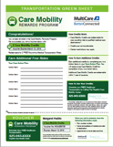
Discharge Planning Assessment
Discharge
Post Discharge
Step 1
Step 2
Step 3
Step 4
Incentive Program Management(IPM) Portal
Medical Appt Scheduled
Transportation Scheduled
Transportation Consult @ Discharge
Transportation Green Sheet
Post Discharge
Simple patient profile setup
Initial Care Mobility Credits awarded
Provider, patient, and Hopelink access
Green Sheet/collateral
Credit issuance, redemption, tracking
Patient Navigator, Discharge RN, Social Worker
Care Mobility Center call
Patient or caregiver calls Care Mobility Center

Slide 14



3
1
Incentive Program Management Portal
Healthcare Provider
Patient Navigator
2
425-943-xxxx
NEW Express Lane
Care Mobility Center
Call Center
425-943-xxxx
NEW Express Lane
Patient
Or
Caregiver
4
Foundation Transportation Funds
Contracted Trans. Provider
CABULANCE
Contracted Trans. Provider
TAXI
Contracted Trans. Provider
TNC/OTHER

Slide 15
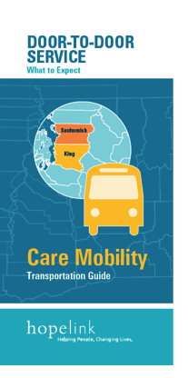
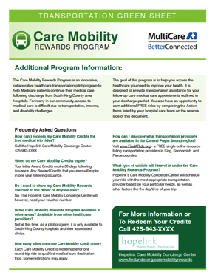
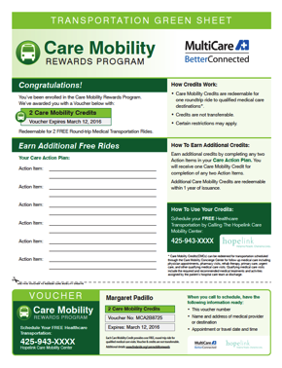
Care Mobility Rewards Program
Patient/Patient Navigator Consult @ Discharge

Slide 16
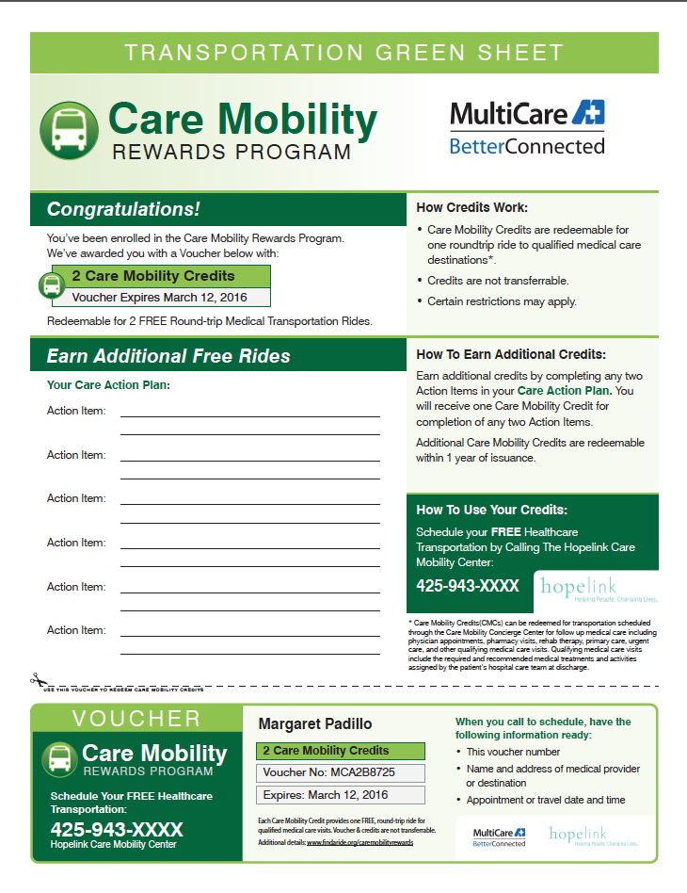
Initial Credits- Awarded by provider at discharge.
1 Care Mobility Credit = 1 Free Round-trip Ride
2 Care Mobility Credits = 2 Free Round-trip Rides
Reward Credits- awarded for Care Action Plan Compliance .
1 Care Mobility Credit received for completion
of any 2 Action Items
Voucher customized to patient.
Initial credits expire 30 days following discharge
Unique voucher identifier number- tied to provider and patient in IPM Portal
Single, 1-call phone number for both patients and patient navigators

Slide 17
Potential Cost Savings
&
ROI

Slide 18
Potential Cost Savings Impact
Estimated # of 30-day readmissions based on 30-day readmissions of Medicare Patients in
South King County, Q2 2014 - Q1 2015. Hospitals included: Highline Medical Center, St. Francis Community, UW Valley Medicine, Multicare Medical Center, Auburn. Source: Qualis Health.
* There are many factors leading to hospital readmissions. Facilitating access to free medical care transportation can be a significant contributing factor to reducing 30-day readmissions for low-income, age 65+ Medicare patients in South King County.

Slide 19
ROI
Includes design & implementation, service & support, annual licensing fee, hosting application, techical support, account management, reporting, and 5000 participant block. Trip cost estimates includes 2 free round-trip rides/patient, 20 miles/round-trip, and blended average cost of $72/round-trip ride + $8/ride Care Mobility Center administration fee.

Slide 20

Operation Easy Access Project Team
Doug Gellert, Project Lead, Hopelink
Jon Morrison Winters, Mobility Expert/Team Lead, Hopelink
Mary Pat O’Leary, RN Planning and Development Specialist,
Aging and Disability Services, Area Agency on Aging for King County
Diane Cimino-Kelly, Director of Care Management, MultiCare Health System
Cindy Zwart, Transportation Program Director, Senior Services
Jate Ekmahasawasdi, Program Analyst, Senior Housing Assistance Group(SHAG)
Nicholas Ramirez, Clinic Manager, Sea Mar Community Health Centers / Kent Medical Clinic
Molly Holmes, Retired, Member, Advisory Council on Aging and Disability Services

Slide 21
Are you ready to begin?

Slide 22
Future Enhancements
&
Scaling the Program

Slide 23
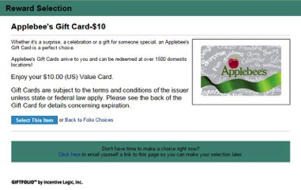
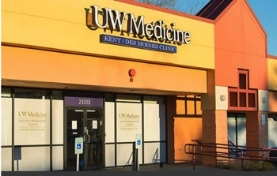
Scaling the Program
  Add & test additional rewards
  Custom rewards catalog available in Incentive Management Portal for increasing participation and motivation
  Extend pilot to affiliated outpatient clinics
  Patients identified for high risk of a rehospitalization can be enrolled in the Care Mobility Rewards Program
  92 affiliated clincs in South King County

Slide 24
Credit-based Incentive Management Portal
Branded design portal
Custom Registration Process
  Custom Reward offerings
  Rewards and Fulfillment
  Automated emails
  Reward Options
  Transaction history with redeemable credit presentation
  PDF print capability upon registration
    Transportation Green Sheet
  Reporting- real-time Admin reports
  Web-based administrative tools
  Participant-level management
    Add participants, manage eligibility, manage profile

Slide 25
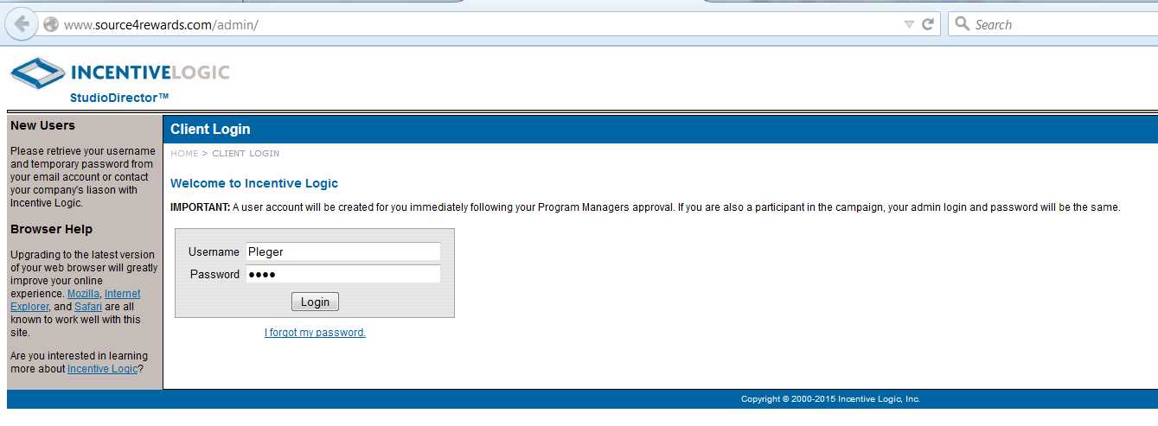
Administrative Portal Login

Slide 26
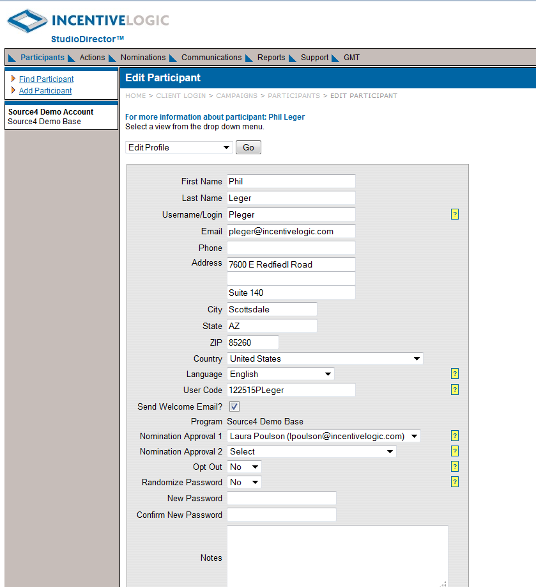
Participant Profile

Slide 27
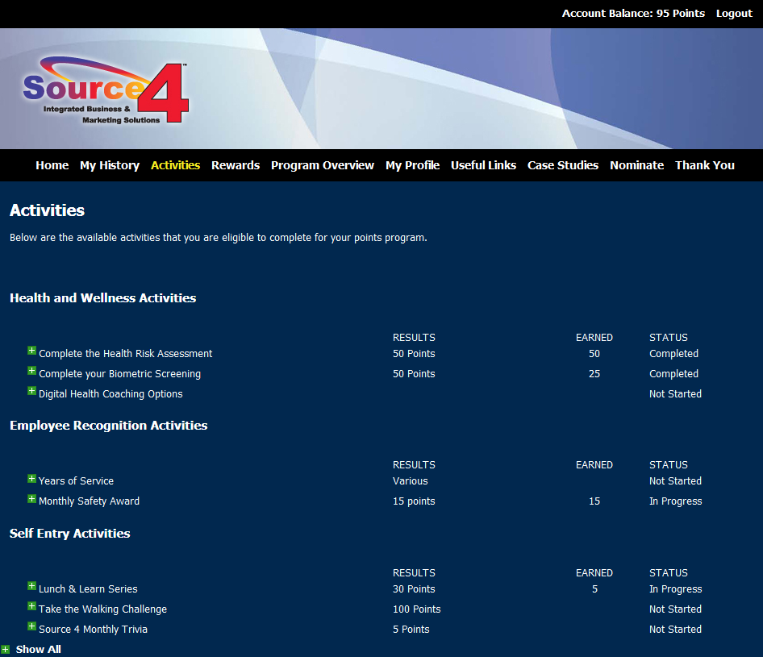
Activities Tab

Slide 28
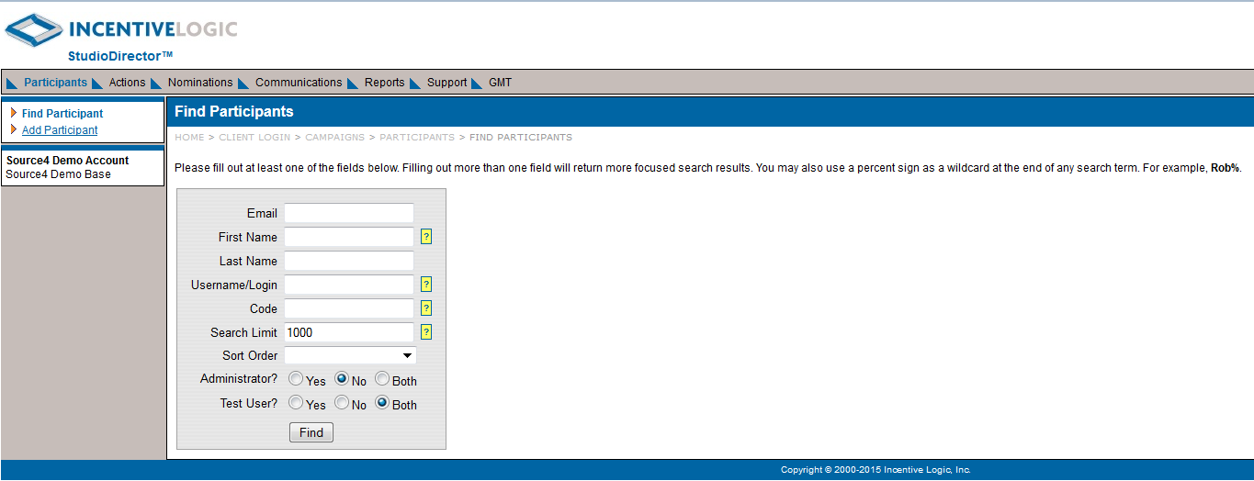
Find Participant Search Fields

