Slide 1

Reducing Re-hospitalizations: Better Patient Outcomes & Cost Savings
In coordination with MedTrans

Slide 2
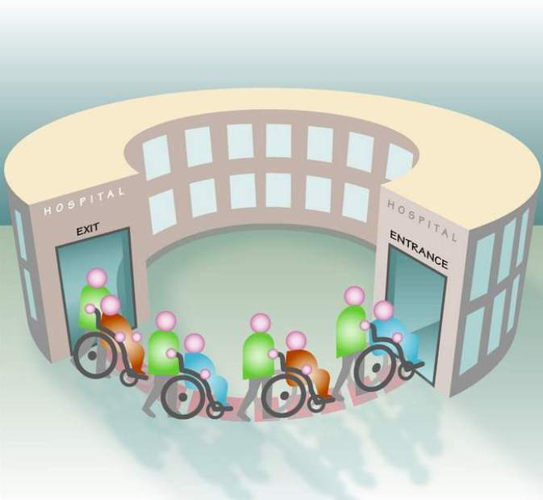
Re-hospitalizations are of primary concern for health care providers, especially hospitals
A readmission may be a result of incomplete discharge planning that does not encompass transportation barriers and/or inadequate access to recommended follow-up care.
Readmissions are expensive, consuming a disproportionate share of expenditures for inpatient hospital care.

Slide 3

They are costly for the healthcare provider and the patient
Appropriate follow-up care is significantly less expensive than subsequent inpatient care;
Identifying patients who are at high risk for readmission BEFORE they are discharged is the key to more effective follow-up care, and diminishing the volume of patients revolving through hospital doors;
Patients are often too afraid or overwhelmed to ask for help while in the hospital, even though they know they need it.

Slide 4

Identifying high risk patients before discharge enhances the quality of care they receive.
Hospital care staff should identify patients at the highest risk for re-hospitalization;
  Develop a criteria for identification of high-risk patients
  What factors cause patients to miss follow-up appointments?
Arranging post-hospital care before discharge should include evaluation of the patient’s transportation resources.

Slide 5

After discharge, it is essential that your patients keep their follow-up appointments
They may be thinking:
“How will I get to my appointments?”
Some patients may not attend their follow-up appointments if they don’t have reliable transportation. They may not want to “burden” friends
or family by asking for help
with transportation to medical appointments.

Slide 6


MedTrans offers a simple solution to your patient’s medical transportation worries
Call 844-220-1243 with your patient’s appointment information.
A MedTrans Mobility Specialist will help you!

Slide 7

The Mobility Specialist will obtain the following information from you:
Patient’s name and phone number
Date of birth
Address where they will be picked-up
Appointment date and time
Address of the appointment(s)
Assistive devices they’ll need (if any)
Payment source for the trip(we’ll find the most economical trip option)

Slide 8

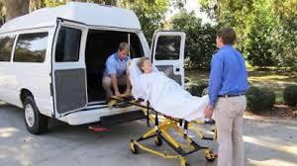
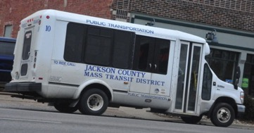

Your Mobility Specialist will use the information provided to research available and affordable transportation options. Public transit vehicles are CLEAN, COMFORTABLE, and SAFE.

Slide 9

The Mobility Specialist will contact the patient with the available transportation options, and they can choose which one best suits their needs.
They might prefer a particular mode of transportation (bus, van, taxi, etc.)
They might choose the least expensive option
They might choose the option with the least amount of transfers or wait time

Slide 10

The Mobility Specialist will schedule the trip with the chosen transportation provider.
Once the trip is scheduled, the Mobility Specialist will provide the patient with their pick-up and drop-off times, and exact fares. You will also receive confirmation that the patient’s transportation has been scheduled.

Slide 11


Now that the patient has transportation options, you can be assured that the patient’s health status is monitored, and the patient has greater peace-of-mind that they’re receiving the care that they deserve.
Their risk of readmission to the hospital is greatly reduced…
…and they can get back to doing the things they love!

Slide 12

Managing the transportation needs of your patients most at-risk for re-hospitalization:
Enhances patient health outcomes
Promotes the model of patient-centered care
Diminishes your facility’s
readmission liabilities
Reduces volume of cases
with reduced reimbursement
payments
Sources: Identifying Potentially Preventable Readmissions - Norbert I. Goldfield, M.D., Elizabeth C. McCullough, M.S., John S. Hughes, M.D., Ana M. Tang, Beth Eastman, M.S., Lisa K. Rawlins, and Richard F. Averill, M.S.
Reducing Hospital Readmissions: Lessons from Top-Performing Hospitals - Synthesis Report • April 2011

