Slide 1

Find-a-Ride
Waukesha County!
Connecting People, Transportation, and Health & Human Services.
Notes:
Good afternoon. I am Kathy Gale, Executive Director of Interfaith Senior Programs, a nonprofit agency that focuses on supporting and engaging Waukesha County seniors to live meaningful lives. We are part of a dynamic team working to address our county’s growing need for transportation that seniors and adults with disabilities can easily access and get to their healthcare appointments.
We are Find-A-Ride Waukesha County, Connecting People, Transportation, and Health and Human Services.

Slide 2
Our Team
Healthcare Systems
Regional Planning Commission
Project Manager and Facilitator
Waukesha County Mobility Manager
Waukesha County Government
Public Works, Aging & Disability Resource Center
Nonprofit Organization with Volunteer Driver Program
Regional 211 Provider
Notes:
Good afternoon. I am Kathy Gale, Executive Director of Interfaith Senior Programs, a nonprofit agency that focuses on supporting and engaging Waukesha County seniors to live meaningful lives. We are part of a dynamic team working to address our county’s growing need for transportation that seniors and adults with disabilities can easily access and get to their healthcare appointments.
We are Find-A-Ride Waukesha County, Connecting People, Transportation, and Health and Human Services.

Slide 3
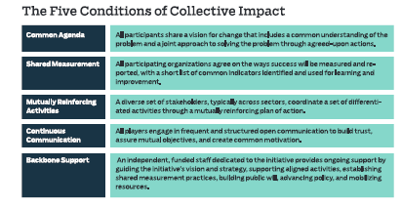
Our Methods
Design Thinking
  Test assumptions
  Increase empathy for audiences
Collective Impact Approach
Common Agenda
Shared Measurement
Mutually Reinforcing Activities
Continuous Communication
Backbone Support
Notes:
Good afternoon. I am Kathy Gale, Executive Director of Interfaith Senior Programs, a nonprofit agency that focuses on supporting and engaging Waukesha County seniors to live meaningful lives. We are part of a dynamic team working to address our county’s growing need for transportation that seniors and adults with disabilities can easily access and get to their healthcare appointments.
We are Find-A-Ride Waukesha County, Connecting People, Transportation, and Health and Human Services.

Slide 4
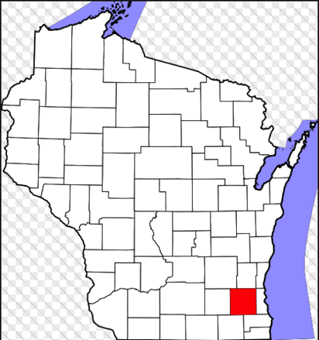
Waukesha County, Wisconsin
550 Square Miles
Mix of Urban, Suburban, Rural
3rd most populous county in Wisconsin (Population: 395,118)
State’s Second Largest Population of Seniors
Notes:
Waukesha county – located in southeastern WI, combination of rural, urban, suburban areas
It has great parks, historic town centers, and commercial areas. It is a nice place to work, live and retire
While Waukesha County is the third most populous county in the State, it is home to the State’s second largest population of seniors.
And, here in Waukesha County, Seniors are struggling to access healthcare services

Slide 5

Healthcare Delivery
Model Has Changed
Past→
local, individual healthcare providers
Today→
regional healthcare systems
Impact→
Patients need to travel longer distances, across boundaries to obtain services
BUT
Our county’s specialized transportation system was developed for local access
Notes:
Over the past 20years, healthcare delivery has moved from individual providers to regional healthcare systems. Yet, the transportation system in Waukesha County was developed with local transportation providers serving immediate population areas.

Slide 6
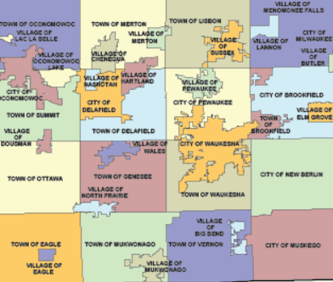


Transportation System
Notes:
In the past, a senior could use a local nonprofit taxi program to travel from home to the healthcare provider in the same city.
Today, however, that senior likely will need to find transportation that can go from home to a regional cancer center, or a regional eye care center, or a major orthopedic healthcare provider.

Slide 7
Result: Fractured System
Challenging for Seniors to Navigate
Lack of System Capacity to serve growing population
Notes:
This disconnect has resulted in a fractured system, which is challenging to navigate because it is difficult to know the details about the options, eligibility, and service areas.
Furthermore, the system lacks capacity to serve a growing population of seniors.

Slide 8
Currently…
79,000 seniors in Waukesha County
Preliminary reports from 2015 for specialized transportation:
  1,750 riders
  65,518 rides
  2.2% of current population

Slide 9
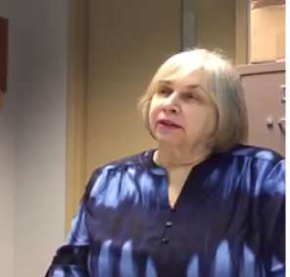
1 in 2 seniors surveyed in Waukesha County reported difficulty getting transportation to healthcare appointments.
Patricia (age 68) is a resident of Waukesha.
She is a travel training volunteer, a client of Interfaith, has macular degeneration, and no longer drives.
Notes:
1 in 2 seniors in Waukesha County reported difficulty getting transportation to healthcare appointments. This is a clip of an interview with Patricia.
*****CUT VIDEO*** Just part about friend.*****

Slide 10


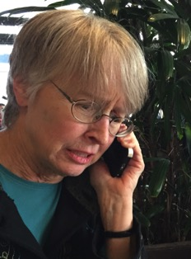

Mrs. Smith’s Dilemma
My Daughter can’t get off work.
I don’t want to bother people from church on short notice.
My friend, Mary, just had glaucoma surgery and can’t drive me.
Notes:
Mrs. Smith is 70 years old and has diabetes. She had to stop driving last year due to macular degeneration.
Her blood sugar has been high for the past two days. She is able to schedule a doctor’s appointment tomorrow afternoon. Her daughter usually takes her, but can’t get off work.
Approximately 17% of U.S. population age 65+ has been diagnosed with diabetes. Economic Burden of Diabetes. Health Aff February 2010 vol. 29 no. 2 297-303
-- That’s over 11,000 seniors in Waukesha County living with diabetes.
(Age is a prominent risk factor for age-related macular degeneration. The risk of getting advanced age-related macular degeneration increases from 2% for those ages 50-59,
http://www.brightfocus.org/macular/article/age-related-macular-facts-figureso nearly 30% for those over the age of 75.)

Slide 11
Who To Call?
  6 not-for-profit senior taxi programs
  3 for-profit taxi programs
  1 county-wide volunteer driver program
  1 healthcare-system coordinated program
  1 accessible van program for the county
  1 public bus system
  1 accessible bus system with limited service area

Slide 12

Frustrated and With No Ride, Mrs. Smith
Cancels Her Appointment
A few days later…. her daughter comes to visit.
Mrs. Smith is confused and difficult to rouse
Daughter Calls 911
→Ambulance
→ Emergency Room
Diagnosed with Diabetic Ketoacidosis
→ Hospital Admission
Notes:
3.6 Million Americans Miss or Delay Healthcare Appointments Due to Lack of Transportation Each Year
How will cost savings be measured over time? Awareness
(First year- standardized measures, create baseline.)

Slide 13
What is the Impact of
Mrs. Smith’s Situation?
Cost to Mrs. Smith and Daughter
Cost to Health Care System
Cost to Society/Taxpayer
Notes:
Length of Stay and Mean Cost from Agency for Health Care Research and Quality.
http://www.hcup-us.ahrq.gov/reports/statbriefs/sb93.pdf
Mean Hospital Stay for Diabetes =$10,937
Mean Length of Stay for Diabetes= 5.3 days.
Cost of Missed Health Care Appointment to Provider – national average of $85 per appointment (plus missed revenue from appoinment)
Cost to Mrs. Smith and Daughter
Co-pays for hospital stay, ambulance
Daughter- Days Off Work
Potential Long-term Health Effects
Cost to Health Care System
Missed Appointment to Provider
Any Unreimbursed Services
Cost to Society/Taxpayer
911 Call
Ambulance Ride (If unreimbursed)
Medicare Coverage

Slide 14


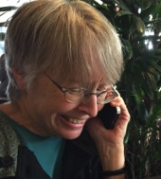
What if …..
Is this Find a Ride Waukesha County? I need to get to a doctor appointment but I don’t understand which service I should call.
I can help you find the right service that you are eligible for and even connect you to
schedule the ride.
Thank you! I was so afraid that I would have to cancel the appointment because I didn’t have a ride.
Notes:
What if…. What if Mrs. Smith had a different conversation? What if she could call one number and get information about her transportation options, help with becoming eligible, and even the ability to schedule a ride. In this scenario, she could get to her doctor’s appointment, get help with her diabetes, and likely avoid hospitalization.
Mrs. Smith is one example of the seniors and adults w/disabilities who need transportation. Our goal is that every person like Mrs. Smith has this experience and access to the transportation needed to obtain healthcare.

Slide 15

Our Solution:
Find-a-Ride
Waukesha County
One Call-One Click Technology System
  Central phone number
  Central internet portal
  Seniors
  People with disabilities
  Family Caregivers
  Professionals in the Healthcare System
Notes:
Seamless access to transportation information, eligibility, and services.
Increased efficiency through expansion of capacity and decrease of administrative burden.
Increased collection of data leading to improved transportation solutions.
Instead of creating a NEW transportation system, build a communication system that will connect customers to the resources already in place

Slide 16
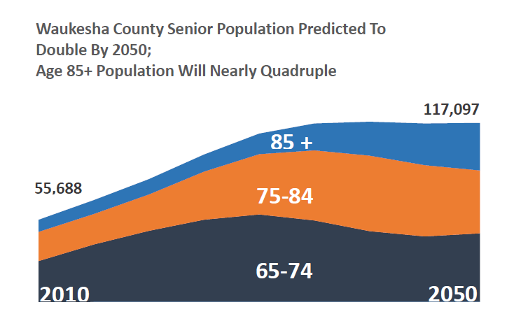
Why Now?
Notes:
Today’s fractured transportation system will NOT serve the growing population of seniors

Slide 17
Currently…
79,000 seniors in Waukesha County
Preliminary reports from 2015 for specialized transportation:
  1,750 riders
  65,518 rides
  2.2% of current population

Slide 18
The need will grow…
Year 2015:
79,000 seniors in Waukesha County
2.2% of current population received rides in 2015 (1,750)
  Year 2050:
  117,097 seniors in Waukesha
  2.2% = 2,574 seniors would need rides
  Age 85+ population will be 4x as large as today

Slide 19

Our research supports the model
  10 groups of seniors and individuals with disabilities
  9 transportation operators (including non-profit “senior taxi” providers, volunteer driver program, and for-profit NEMT providers.)
  2 groups of healthcare professionals at 2 healthcare systems (including inpatient, emergency department, and outpatient clinic settings).
Notes:
Existing research – telling us that there was a problem
Developed a potential solution
Utilized a Design Process, testing assumptions of customer desirability
Research of existing OC2 systems
Ownership – existing team of experts, representation from seniors and adults with disabilities throughout the design process, providers of transportation

Slide 20
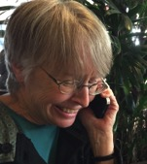
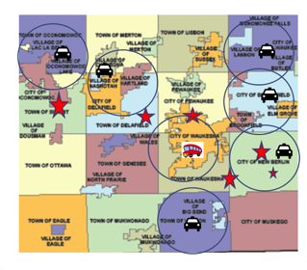

One Call One Click Solution
Notes:
Collective Impact Approach

Slide 21












Phased-In Approach
Notes:
We feel a phased-in approach is key so that we can continue to test the solution and engage all stakeholder in making it a reality.
Phase 1 – Centralized Information and a Warm Transfer
Phase 2 – Centralized Scheduling, shared calendars
Phase 3 – Centralized Dispatch AND new providers

Slide 22

Next Steps: Operational and Financial Implementation
Expand our Team
Identify the Computer Solution
Finalize Measurements for testing success
Obtain implementation funding
Plan for long-term funding
Notes:
Expand our Team (Technology design specialists, engineers) Identify the Backbone organization for OC2
Identify the Computer Solution
Obtain implementation funding: support the system build and implementation of Find-a-Ride Waukesha County.
Plan for long-term funding: Federal 5310, earned income, state transportation funds 85.21

Slide 23

Vision
Equal Access to Healthcare Services
regardless of ability to drive or access to vehicle

